Slide 1
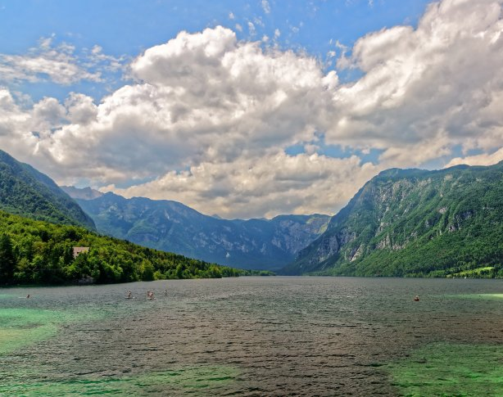
Pollution
Quiz

Slide 2
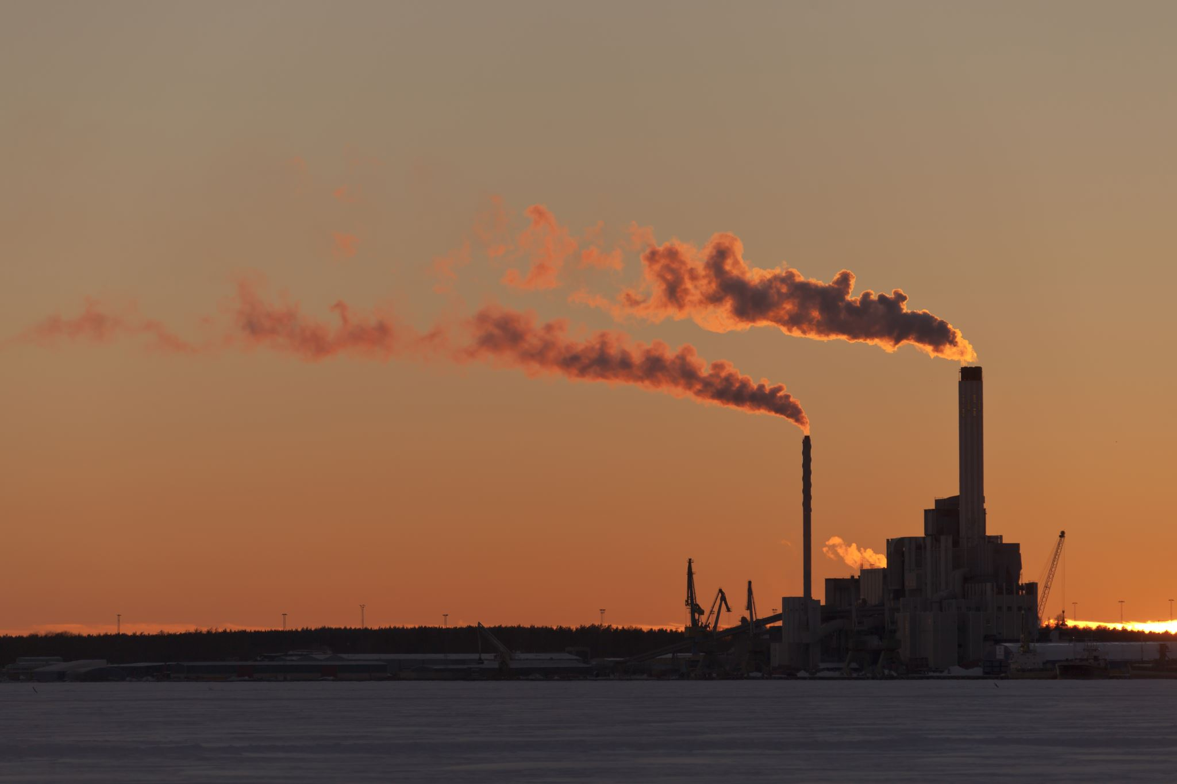
Question 1: Carbon monoxide is a major pollutant of:
(a) Water (b) Air (c) Noise (d) Soil

Slide 3

Question 2: Supersonic jets cause pollution by thinning of:
(a) Sulfur dioxide layer (b) Carbon dioxide layer (c) Ozone layer (d) None of these

Slide 4

Question 3: Which one of the following fuels causes minimal air pollution?
(a) Kerosene oil (b) Hydrogen (c) Coal (d) Diesel

Slide 5

Question 4: Clouds are present in:
(a) troposphere (b) stratosphere (c) mesosphere (d) thermosphere

Slide 6

Question 5: Global warming is caused due to the____ concentration of CO₂ in the air.
(a) Decreased (b) Increased (c) Both (a) & (b) (d) None of these

Slide 7
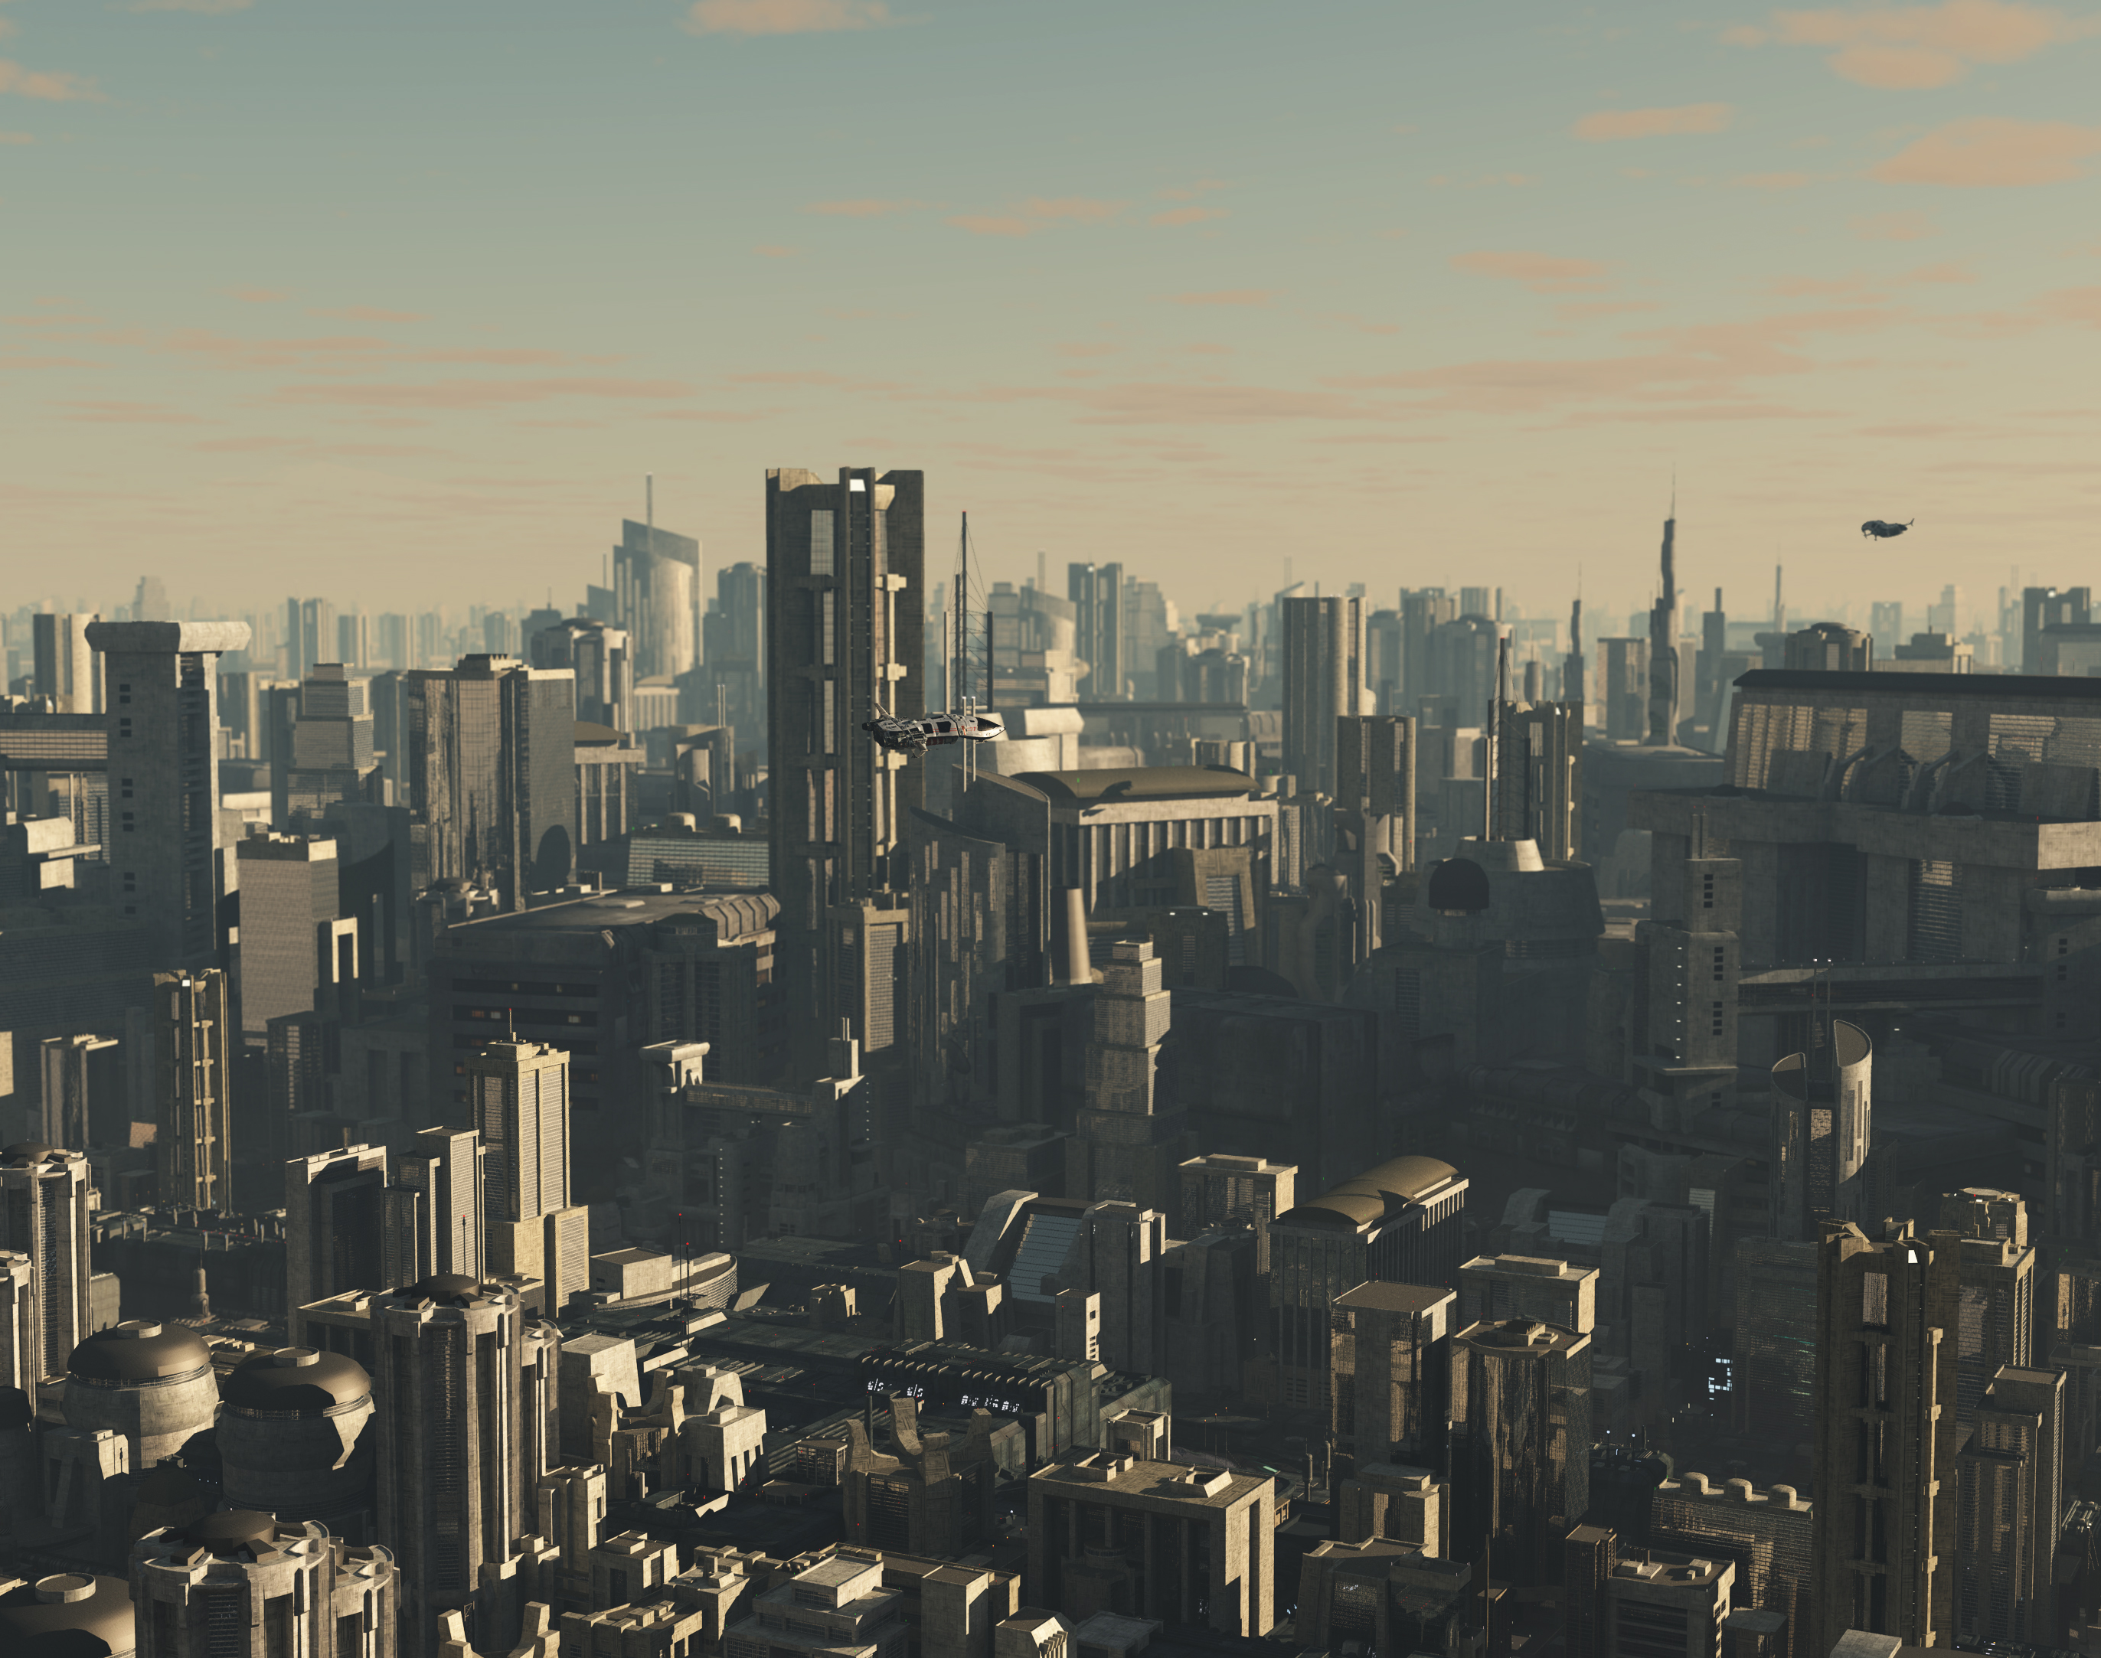
Question 6: Generally speaking, the atmosphere in big cities is polluted mostly by:
(a) Radioactive fall out (b) Household waste (c) Automobile exhaust (d) Pesticide residues

Slide 8
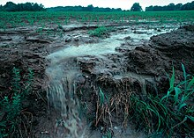
Question 7: Most harmful pollutant is:
(a) CO₂ _{(b)} SO₃ _{(c)} NO₂ _{(d)} SO₂

Slide 9

Question 8: Air is a/an:
(a) element (b) Compound (c) mixture (d) None of these

Slide 10
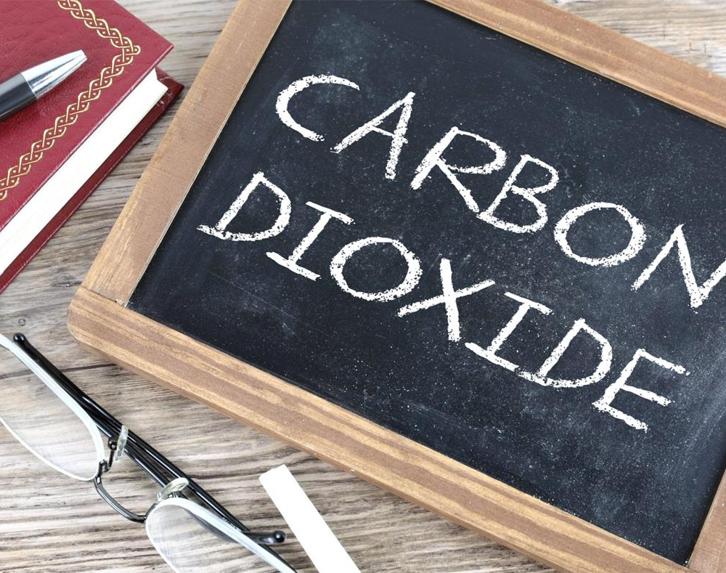
Question 9: The carbon dioxide content in the air that we exhale is about:
(a) 4% (b) 8% (c) 12% (d) 16%

Slide 11

Question 10: Air pollution effects are usually found on:
(a) Leaves (b) Flowers (c) Stems (d) Roots

Slide 12
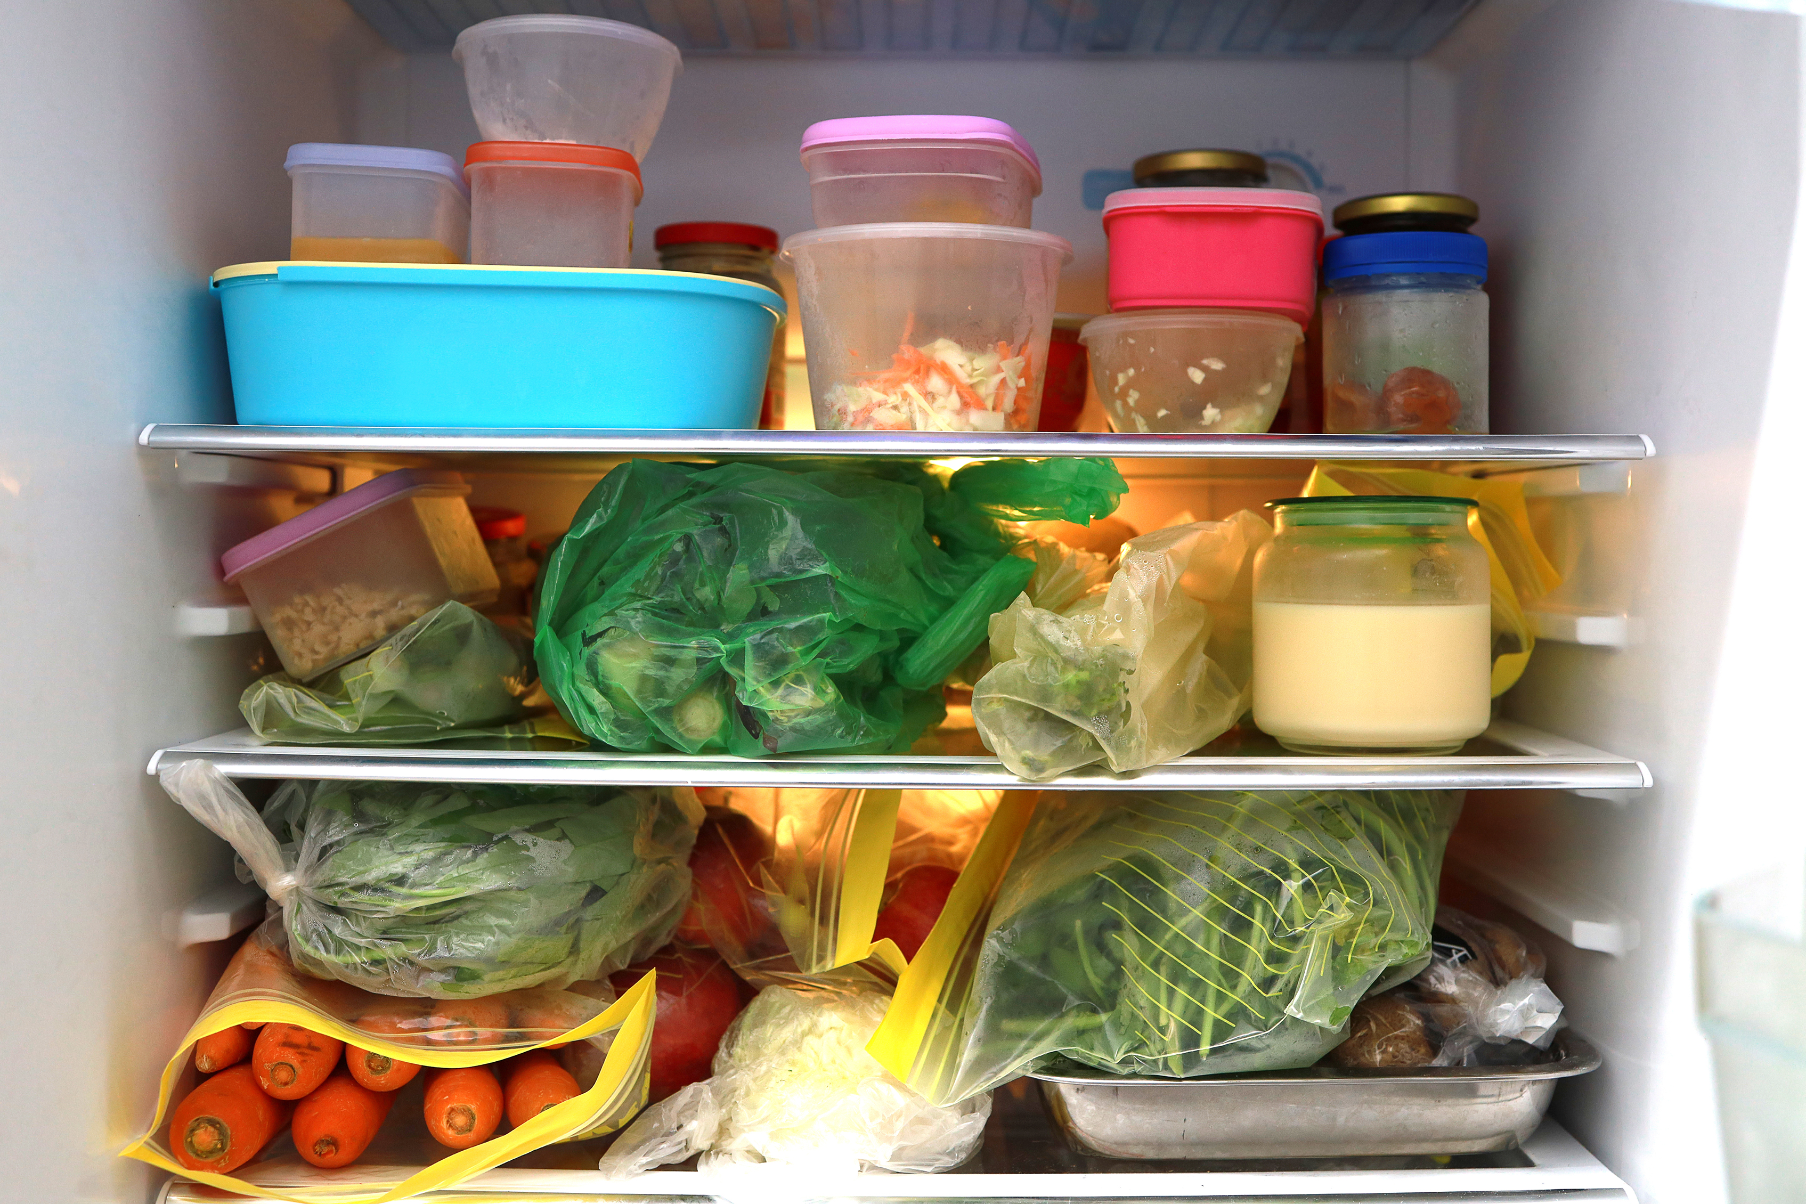
Question 11: The cooling agent in a refrigerator is:
(a) Oxygen (b) Nitrogen (c) Freon (d) carbon dioxide

Slide 13
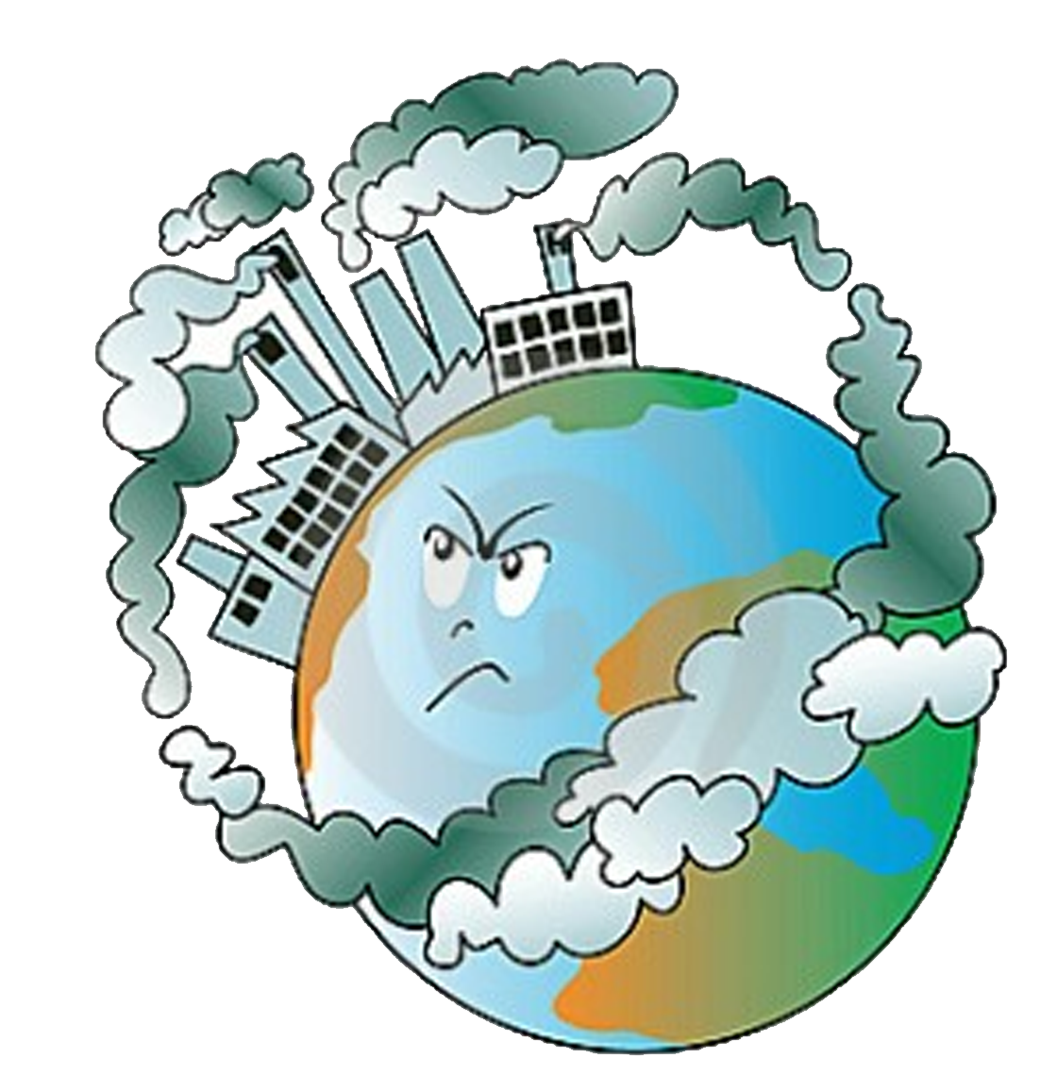
Question 12: Air pollution is not caused by:
(a) Pollen grains (b) Automobiles (c) Industries (d) Hydro-electric power

Slide 14

Question 13: Acid rain is caused due to pollution of the atmosphere by:
(a) Carbon Dioxide (b) Methane Gas (c) Ozone & Carbon Dioxide (d) Nitrous Oxide & Sulfur Dioxide

Slide 15
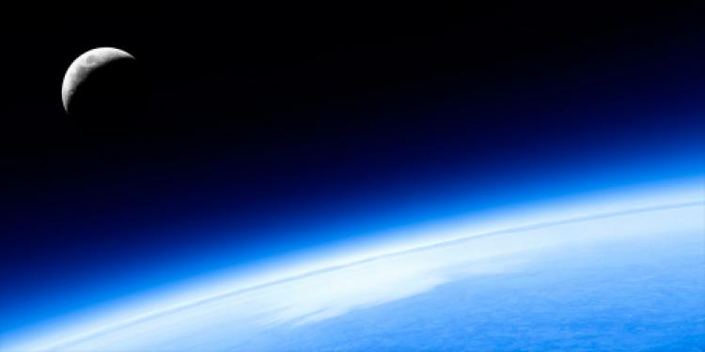
Question 14: Ozone protects the living organisms on the Earth from:
(a) Ultraviolet radiations (b) Infrared radiations (c) Gamma radiations (d) None of the above
.

Slide 16
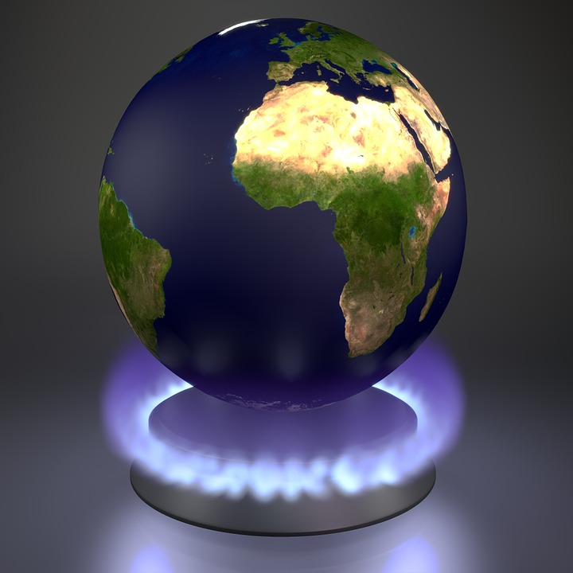
Extra question: Green House gas is:
(a) Nitrogen (b) Oxygen (c) Methane (d) Carbon dioxide

