Slide 1
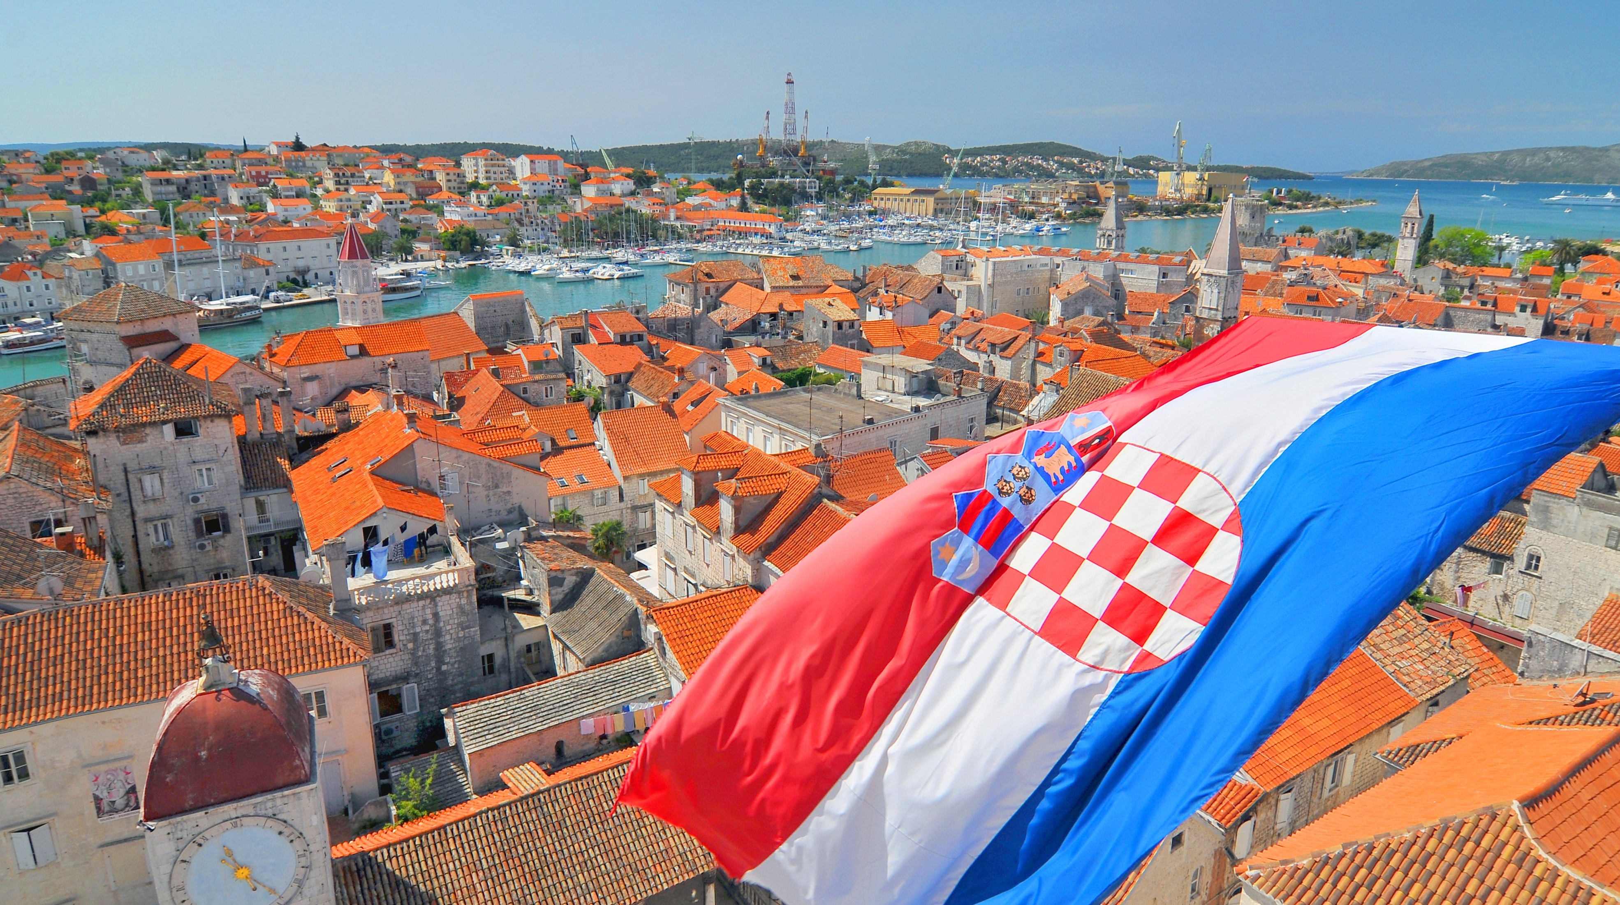
croatia

Slide 2
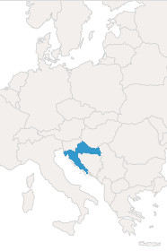
About Croatia
A country at the crossroads of Central and Southeast Europe
Its coast lies entirely on the Adriatic Sea
It borders with 6 countries
It is divided into 21 counties
Capital city: Zagreb
Population: nearly 3.9 million

Slide 3
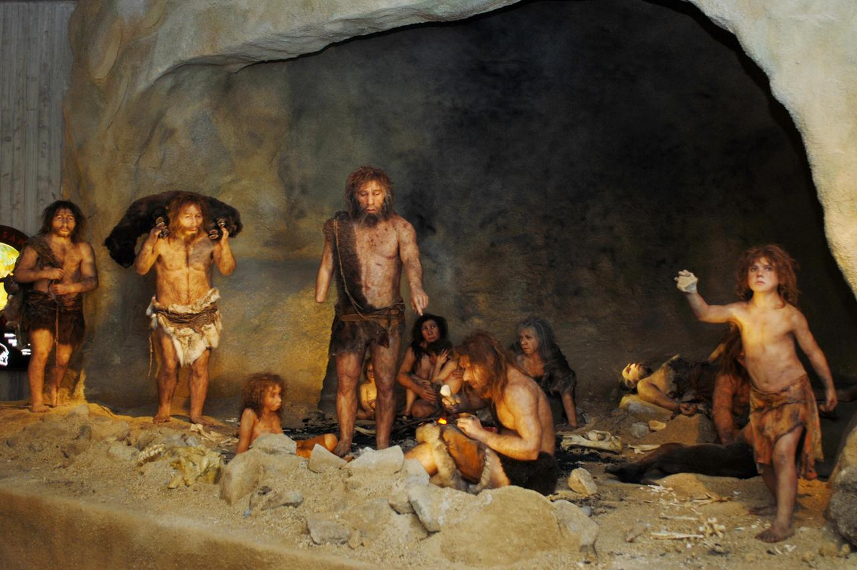
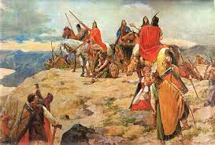

History
paleolithic period
Krapina Neanderthals
Around the early part of the 7th century Croatian tribes arrived from Poland
Through the past Croatia has been the part of the Greek, Roman, Venetian and Austro-Hungarian Empires and the part of the Yugoslavia
1991. - Croatian War of Independence
7th century
20th century

Slide 4
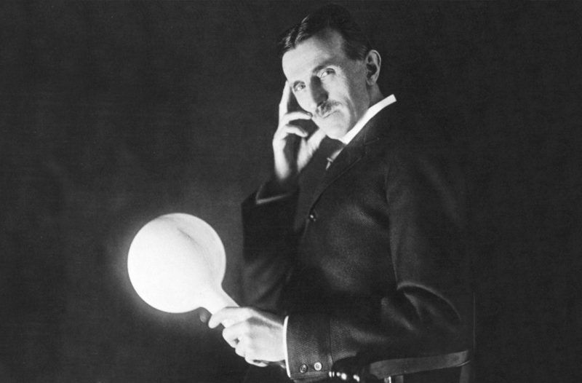


Culture
Because of its geographical position, culture of Croatia is usually defined as a blend of Central European, Mediterranean and Balkans cultural circles
Red-and-white checkerboard
The UNESCO's World Heritage List includes ten sites in Croatia
Necktie
Pen
Nikola Tesla

Slide 5
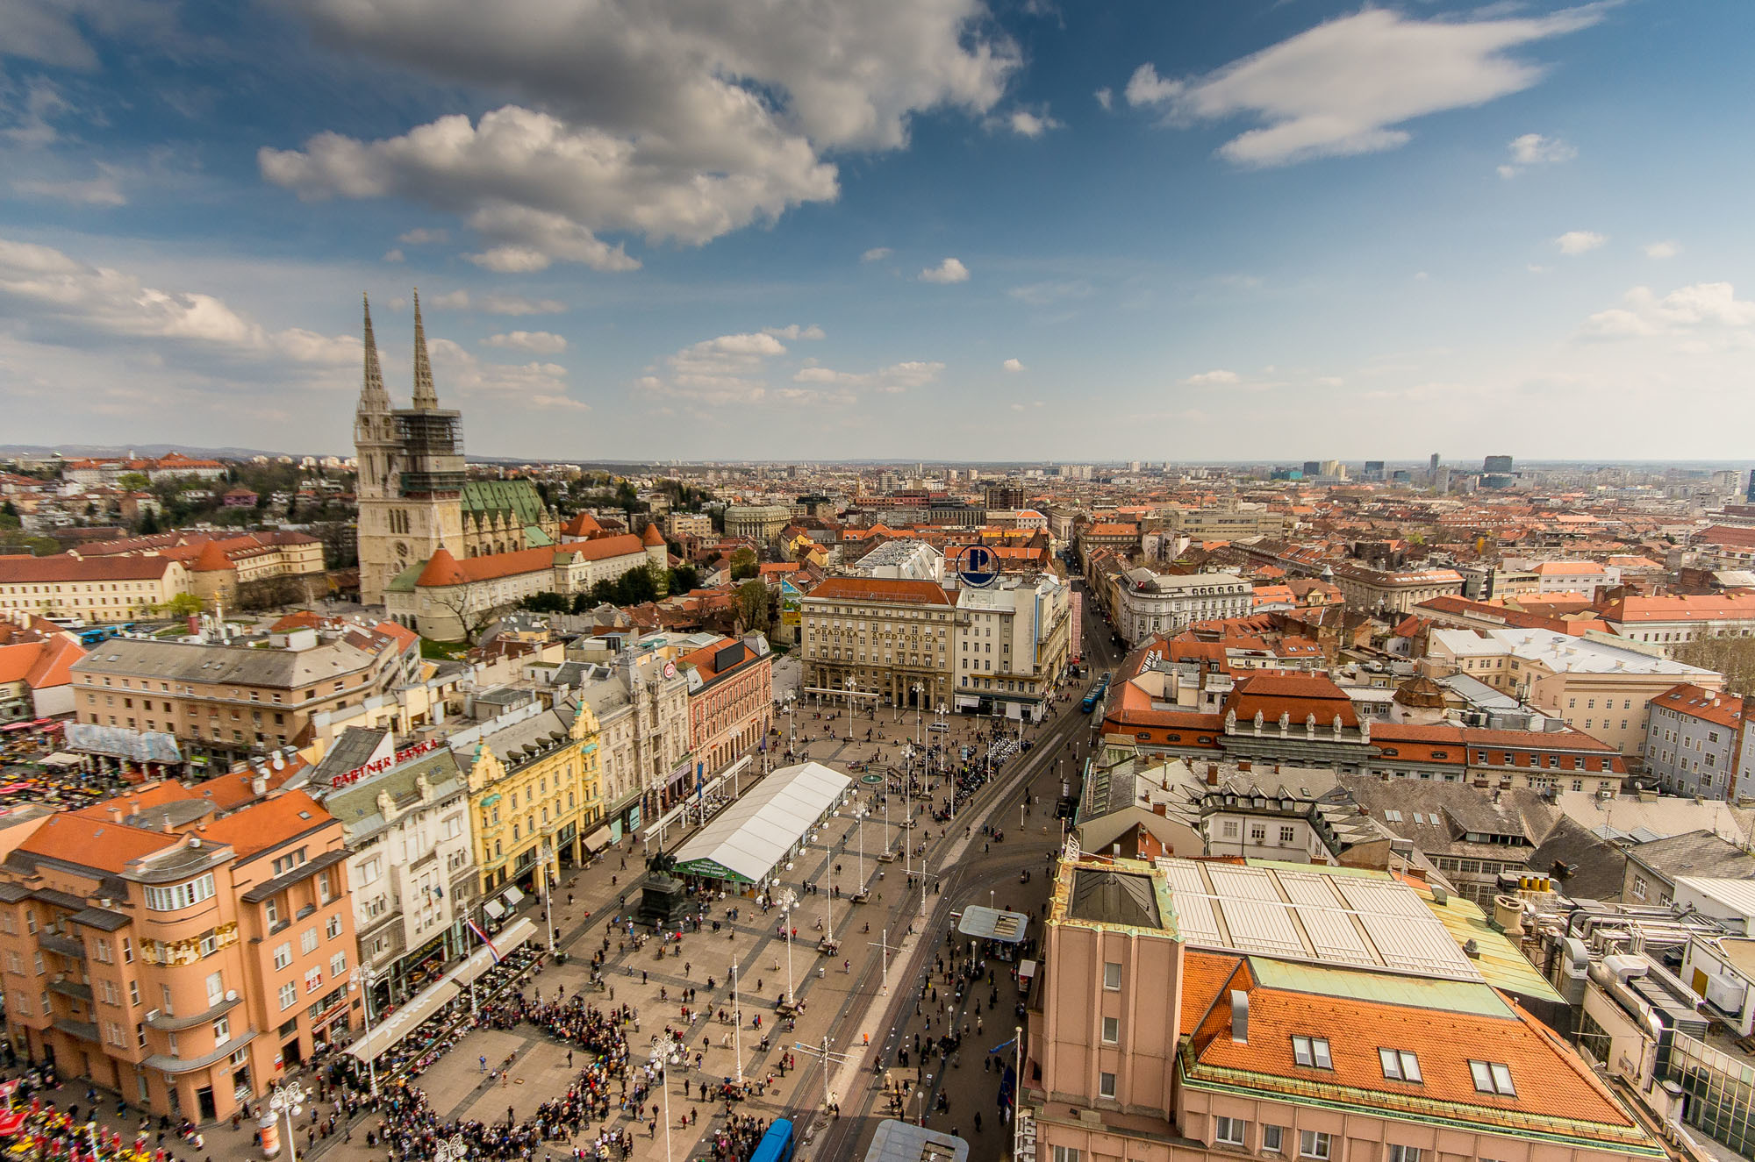
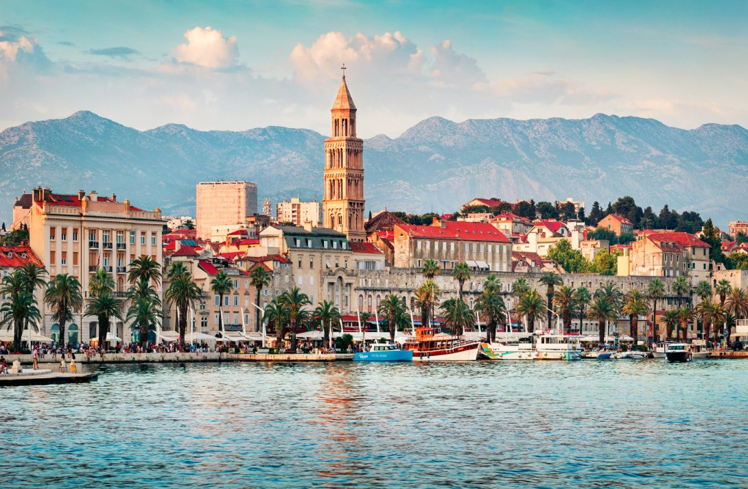
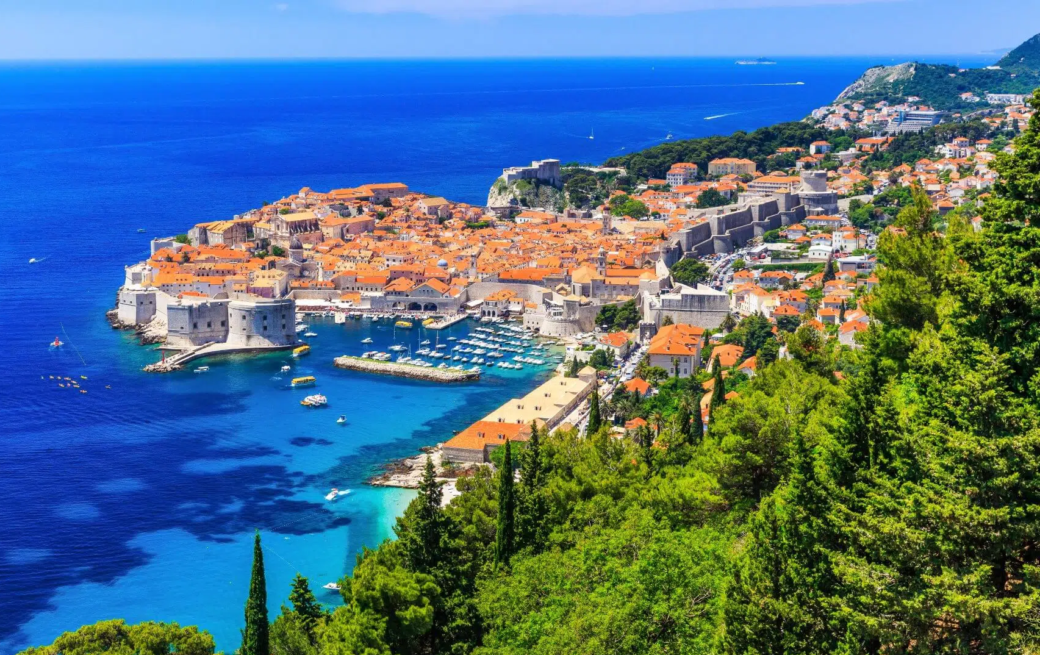
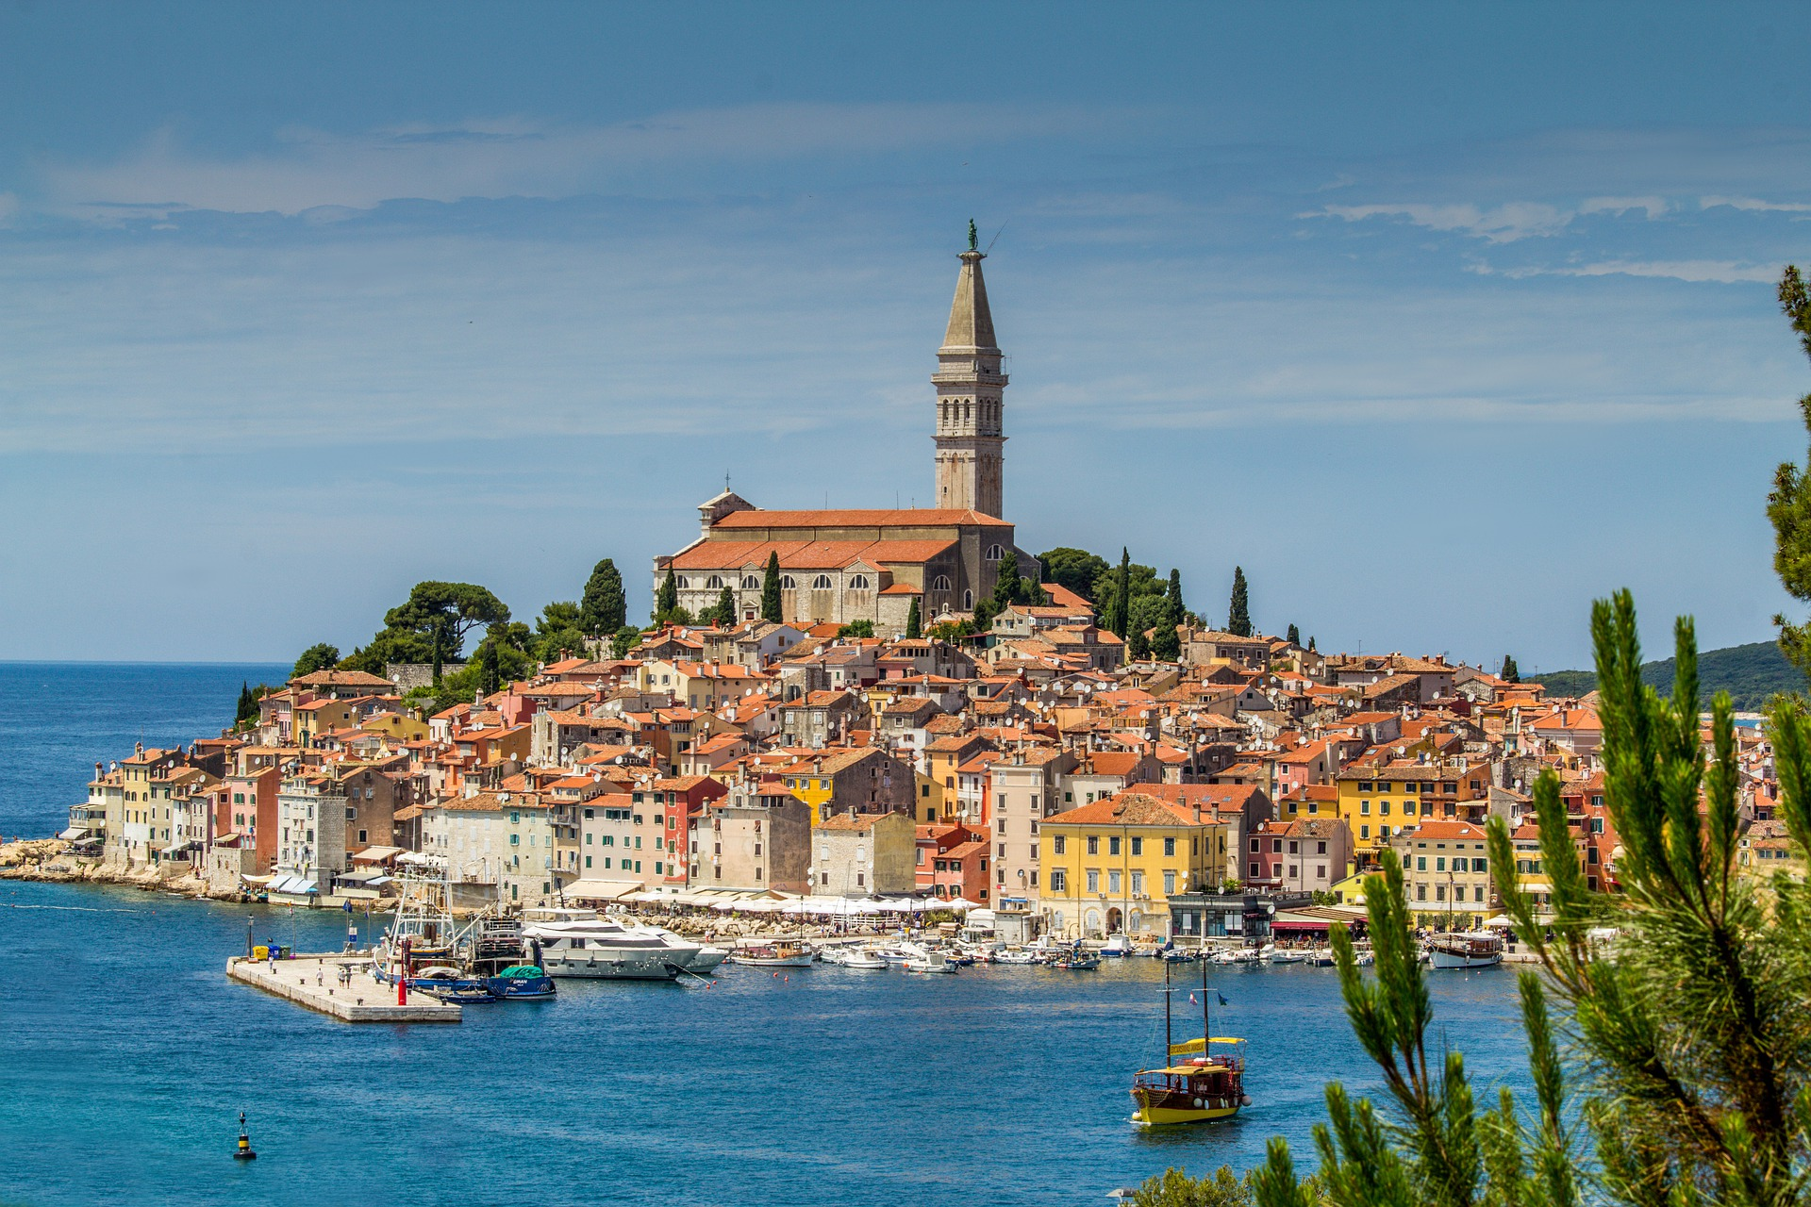
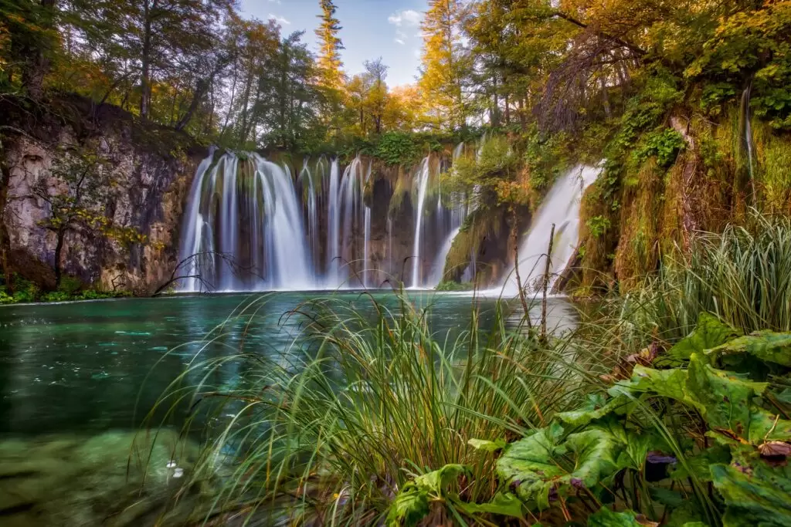
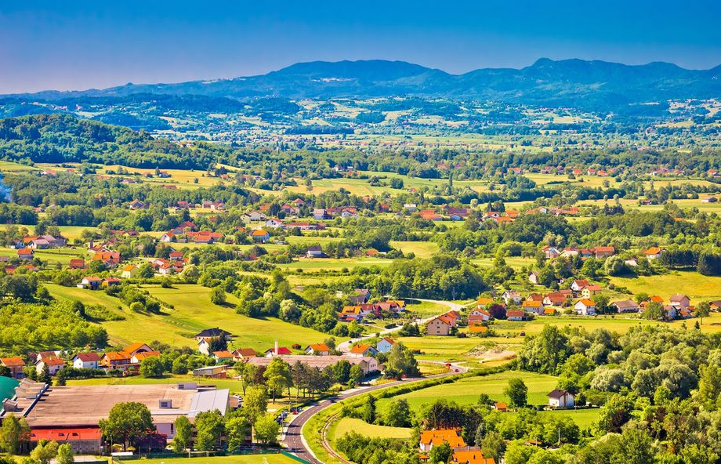
Best places to visit
Zagreb
Split
Dubrovnik
Rovinj
Plitvička jezera
Hrvatsko zagorje

Slide 6
10 interesting facts about Croatia
#1 Croatia has 1246 islands, isles and imlets
#2 World’s first pipe organ that is played by the sea’s rhythmic waves is in Zadar
#3 Croatia is home of the world’s smallest town called “Hum”
#4 Croatia has highest number of UNESCO Intangible Goods of any European country
#5 Zlatni rat beach changes in shape and colour depending on the wind
#6 Roman amphitheatre in Pula is one of only 3 preserved in the world
#7 The oldest inhabited city in Europe is the eastern Croatian city of Vinkovci
#8 Legend says that the town of Ludbreg in northern Croatia is in the centre of the world
#9 The Walls of Ston are the longest preserved fortification system in the world after the Great Wall of China
#10 Croatian men are the 7th tallest on the planet

Slide 7
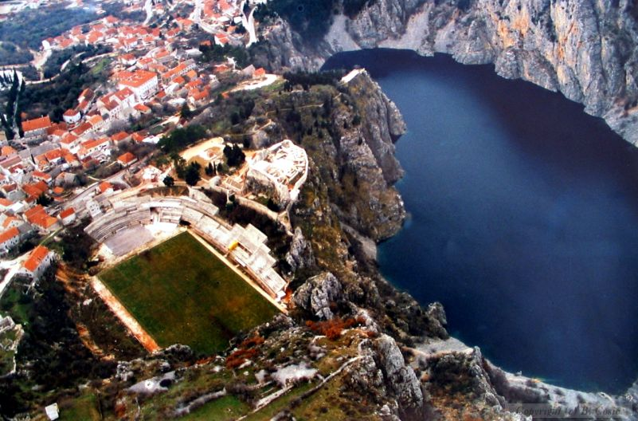
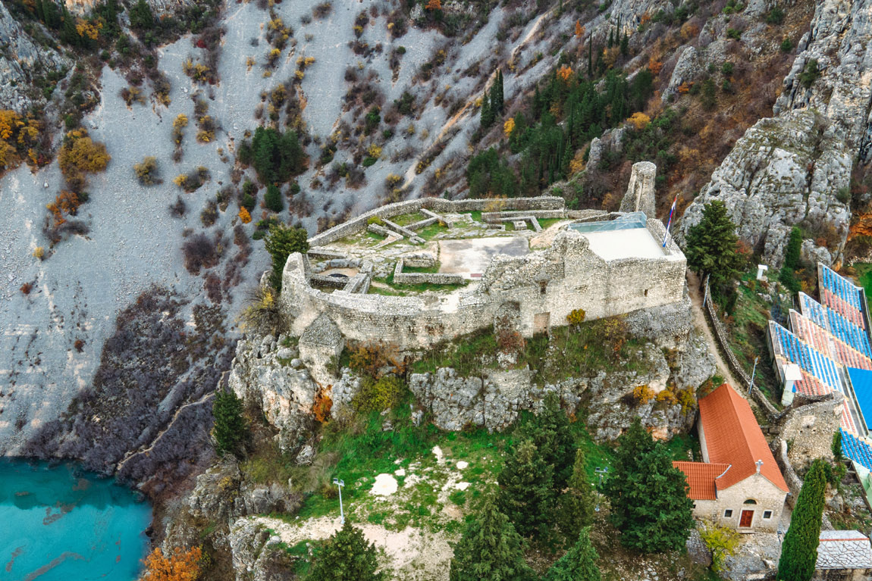
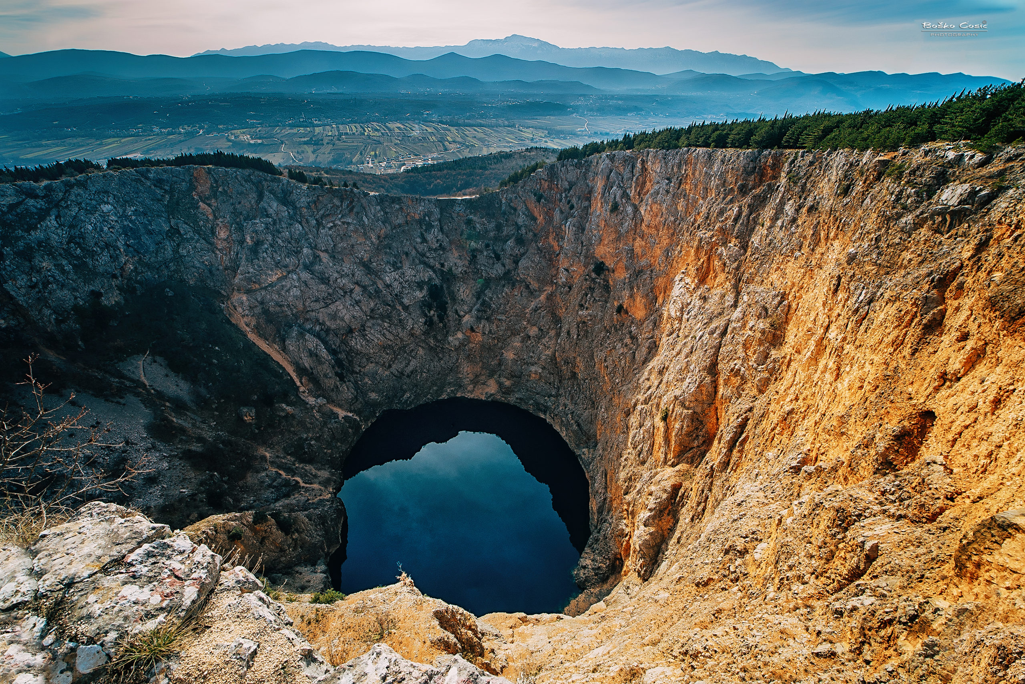
Imotski
Blue lake and Gospin dolac
A small town in Dalmatia
The town is located close to the border with Bosnia and Herzegovina
Blue lake - a karst lake located near Imotski
Red lake - the total explored depth of this sinkhole is approximately 530 metres
Gavan’s palace - the legend about the formation of the Red lake
Topana - the fortress above the town
Gospin dolac - the stadium which was named one of the top ten most beautiful in the world by the BBC in 2017
Topana
Red lake

Slide 8
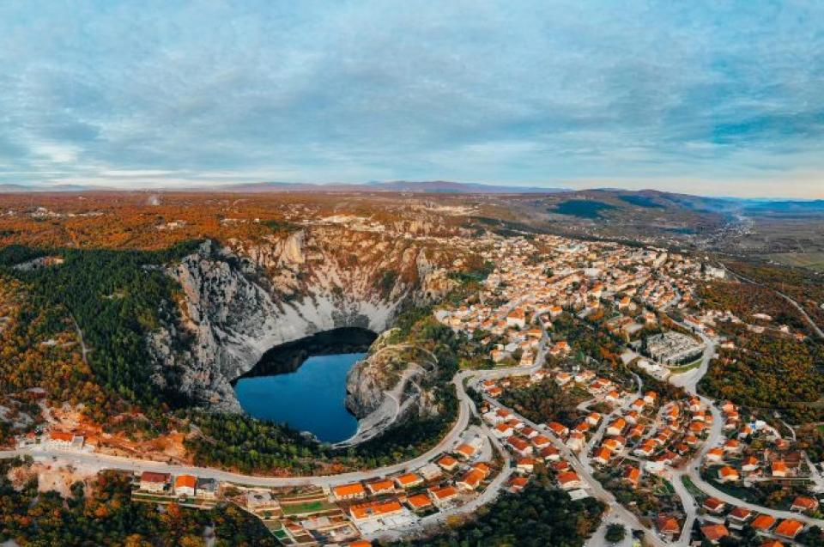
Thank you for your attention! <3

