Slide 1
Water Pollution

Slide 2
What is Water Pollution
Today, it is an issue that threatens living health on a global scale. It is called the unusable condition of the water used in nutrition, drinking, personal and environmental cleaning, which is needed at every point of life as a basic need. Water pollution can be seen visually as well as analyses, chemical tests and microscopic examinations. Bacteria, microbes and harmful substances in the water make the water unhealthy and polluted.

Slide 3
What are the Types of Water Pollution?
Groundwater Pollution
Surface Water Pollution (Surface Water Pollution)
River Pollution
Lake Pollution (Eutrophication)
Sea Pollution

Slide 4
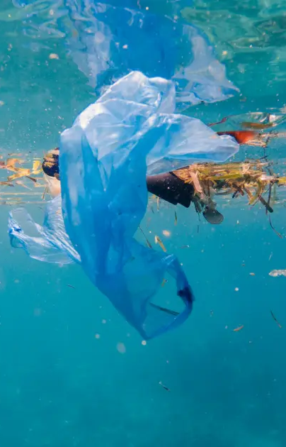
How do the waters of our world get like this?
Mining Industry
Industrial establishments without chemical separation and treatment …
Rubbish thrown in the sea
Oil exploration activities in the sea
Chemical fertilisers and insecticides
Fuel consumption of ships
Unconscious urbanisation
Animal wastes
Radioactive wastes
Lack of awareness about water consumption and cleanliness

Slide 5
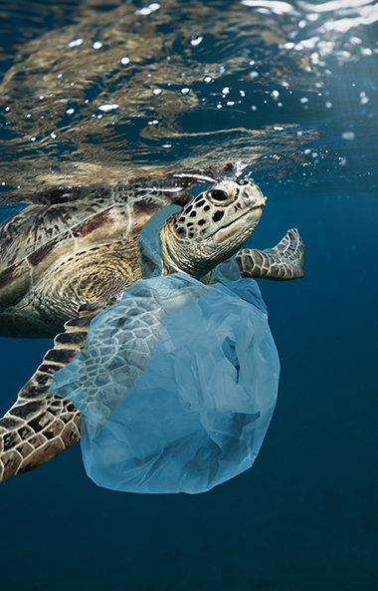
What are the Consequences of Water Pollution?
If measures are not taken against water pollution, clean water resources will face the danger of depletion in the near future. Moreover, this pollution will lead to all kinds of negative effects on life, affecting our world on a global scale and causing a significant decrease in the living population.

Slide 6
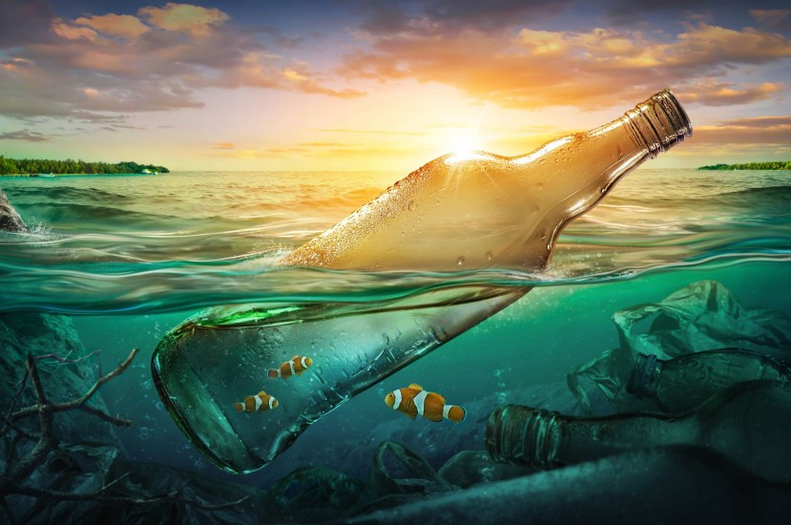
Some of the possible consequences of water pollution are
May cause a disturbance of the ecological balance.
It can cause infectious and fatal diseases (typhoid, amoebic dysentery, bacillary dysentery, cholera and polio).
Can lead to the death of aquatic organisms and the extinction of some species.
Reductions in animal diversity could occur.
May lead to depletion of freshwater resources.
Droughts may occur.
Unhealthy agricultural products may grow due to poor quality irrigation.
May hinder the development of forest areas.

Slide 7

In order to combat water pollution, we must first become individually conscious and do our part for a more livable world by instilling this behaviour in our children. If we personally respect our environment, we can contribute to the formation of a more conscious society by influencing those around us.

Slide 8
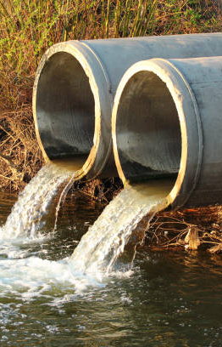
Let us now examine in detail what are the ways to prevent water pollution, individually and globally.
People should be made aware of the use of water and care should be taken to act accordingly.
Water wastage should be prevented to avoid water scarcity.
Oils should be prevented from mixing with water and should be collected in a place just like detergents.
Necessary investments for treatment plants should be encouraged.
Necessary investments for treatment plants should be encouraged..
The conscious use of agricultural pesticides and fertilisers should be encouraged and even training should be given on this subject. Care should be taken not to mix pesticides with water.

Slide 9
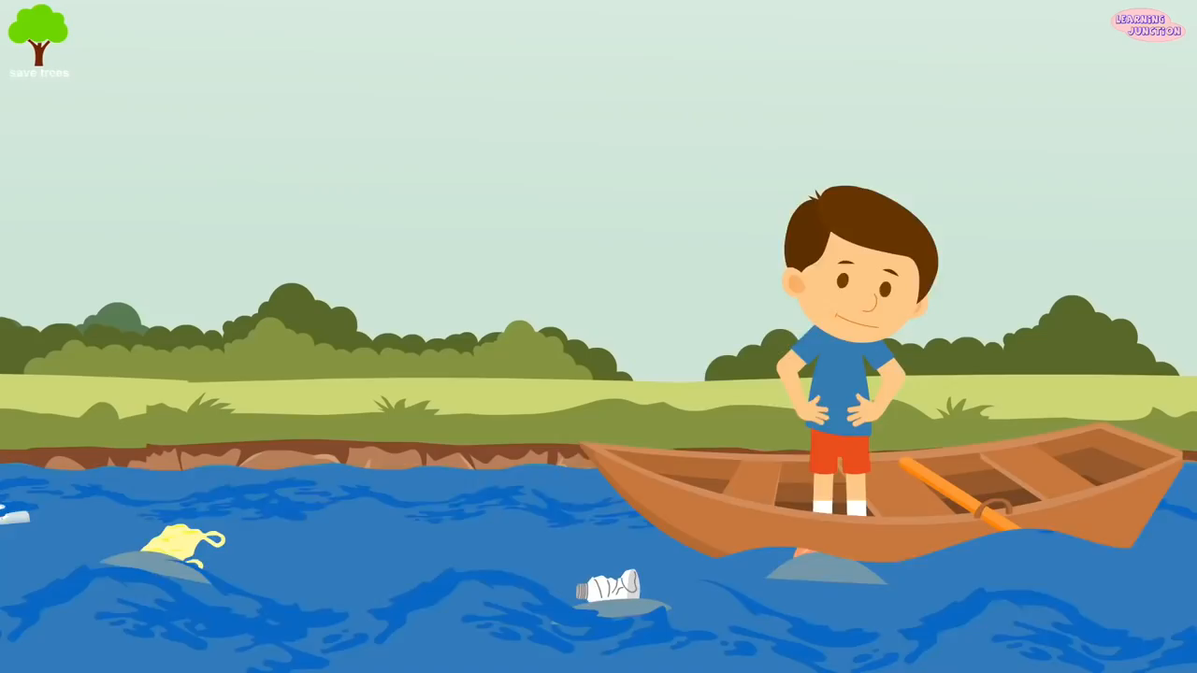

Slide 10
Bibliography
https://www.hurriyet.com.tr
https://ekolojist.net
https://www.rainsoft.com.tr
https://tr.wikipedia.org
https://bilgihanem.com

