Slide 1
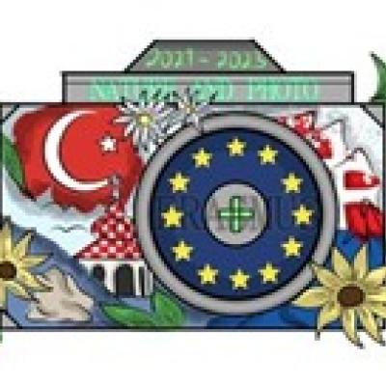
Nature and photo, Erasmus+

Slide 2
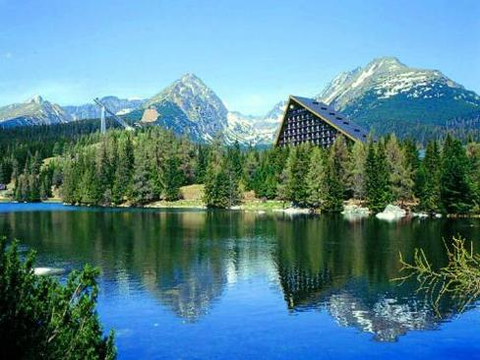

Slovakia- What a Wonderful World

Slide 3
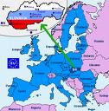

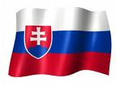
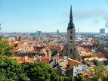
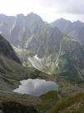

A Fairyland Slovakia
In a world
Behind wild forests
And a deep valleys
You will find the Fairyland.
Will you see the majestic mountains,
Charming castles
And unspoiled nature.
You will fall in love with a country
That awaits you in a heart of Europe.
Discover of wonder,
Real fairytale,
Slovakia.
A little „big“ country.

Slide 4
In the East, in the South, in the North, in the West, Wherever You Live, Your Home is the Best.
Slovakia is situated in the middle of Europe, just right in its heart. The capital of Slovakia is Bratislava, the beauty on the river Danube. There are a lots of sightseens here as well as the natural beauties.
Slovakia has got a picturesque lowlands, the high mountains and deep valleys. And lovely untouched nature. Just look around you. There are so many interesting caves like Domica, Demenovska cave, Dobsinska cave etc.

Slide 5
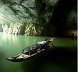
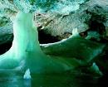




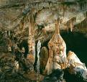


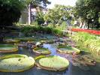
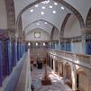





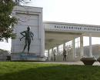


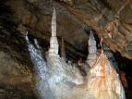
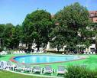



The Wonderful Caves and the Natural Springs

Slide 6






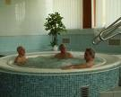
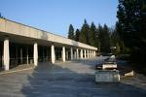

Spas Our Wonderful Riches : there are so lots of them used for the treatment of various diseases.
Look.
Piestany for example. Their Adam Trajan spring has improved the rheumatic,neurological diseases as well as many other patients from all around the world during its long history.
The famous spas are also in many other places of Slovakia countryside.
Bardejov, Trencianske Teplice, Rajecke Teplice, Lucky, Dudince.

Slide 7
What wonders !
There are the high mountains and the deep valleys.The long rivers, the unique lakes.
The beautiful lowlands and the picturesquare countryside.The wonderful fauna and flora.
The extremelly large woods and the meadows with the heards of sheep.
Some unique species like the flower called „Plesnivec“and the animal „Kamzík horský“.

Slide 8
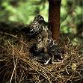
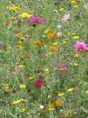
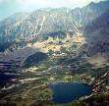


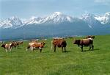
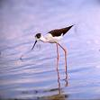
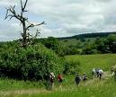


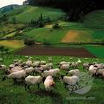

An Unspoiled Nature

Slide 9
The Charming Castles, Facilities for the Tourists
The plate turned upside down-that´s the Bratislava castle
The largest one is Spis castle
The unique ones are the Orava castle, Bojnice castle, Trencin and a lot of others.
There are also lots of ruins like Devin, Beckov, Tematin...
The most famous natural riches of Slovakia are its mountains, woods, lowlands, lakes and rivers.
The High Tatras are only one of them, extraordinary !
Zemplinska Sirava is called „The Slovak sea“.

Slide 10




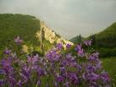



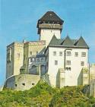

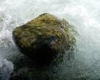


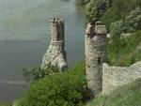


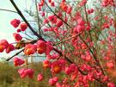




Charming Castles and other Natural Beauties

Slide 11
The Outstanding Museums
There are some unique items mentioned in the Unesco book like Slovak wooden churches or all village Vlkolinec where still people live.
Some extra architecture is also in a village Cicmany.
There are Skanzens of the life in the past in Martin, Nitra.
Almost every big place has a museum and a gallery.
Every region has got its own national costumes and the folk music.
There are a lot of traditions kept by now.
However, a modern culture: the literature, music, technology are very well developed.

Slide 12

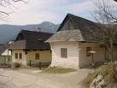
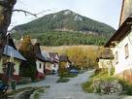

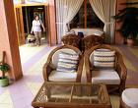

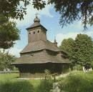
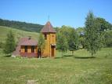
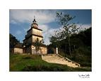




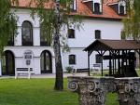
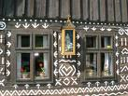
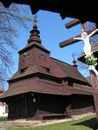
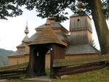
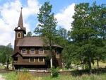

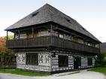

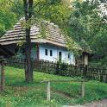


The Outstanding Museums

Slide 13


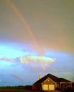
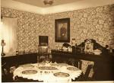
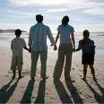
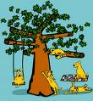


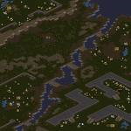



See you in Slovakia!

Slide 14
Recourses:
www.wikipedia.org
www. google.sk

Slide 15







Thank you for your attention.

