Slide 1
OŠ Tin Ujević - Krivodol Croatia
Erasmus+ „Nature and Photo”

Slide 2


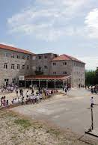

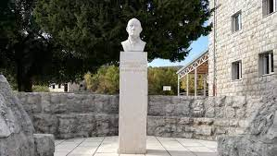
Our school
z
Located in Krivodol – a small village near Imotski in Croatia
Small public primary school
250 pupils
The head school in Krivodol and three branch schools
Students aged 6 - 15

Slide 3
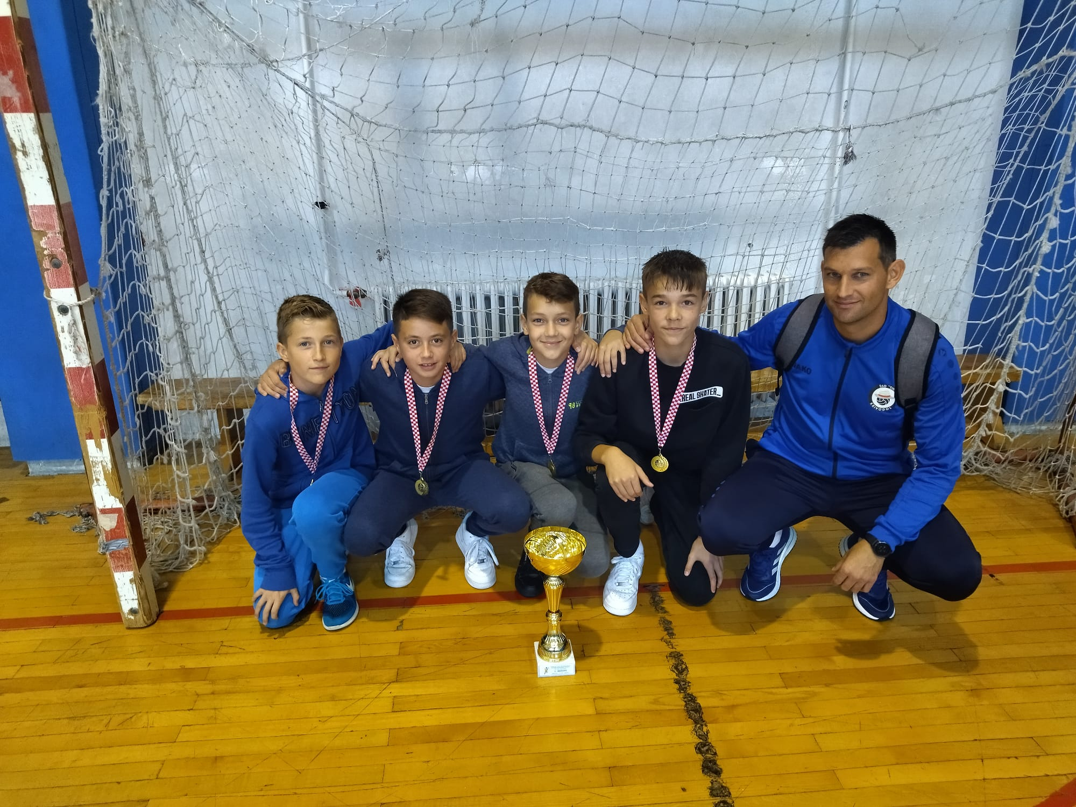
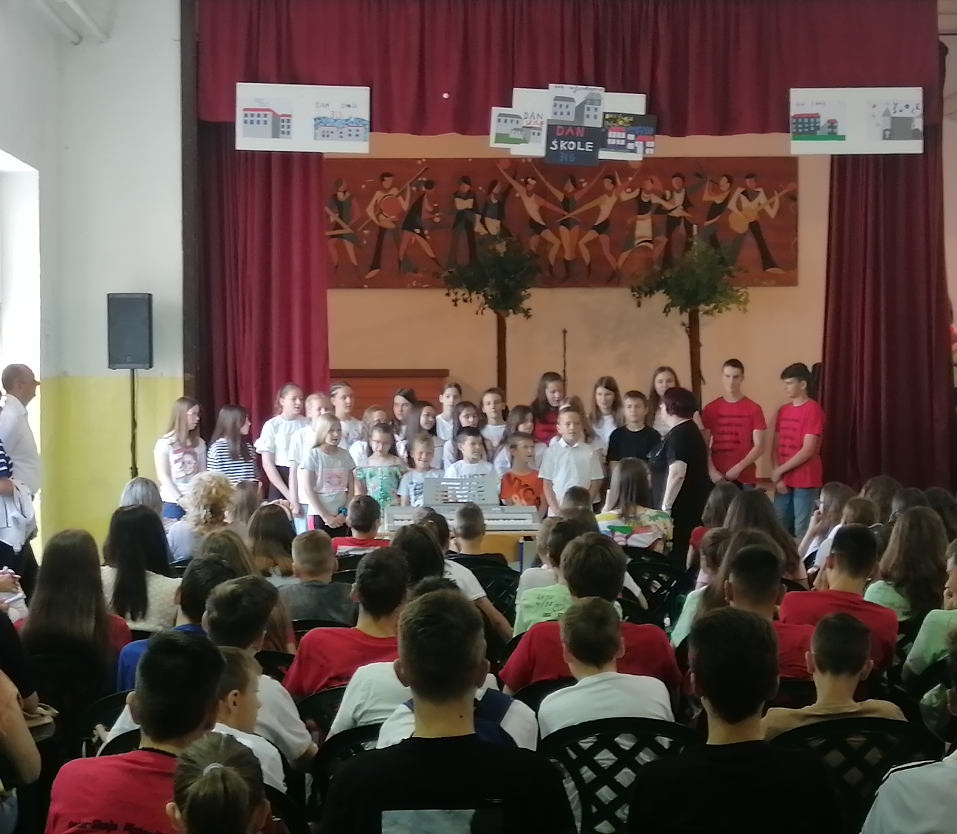
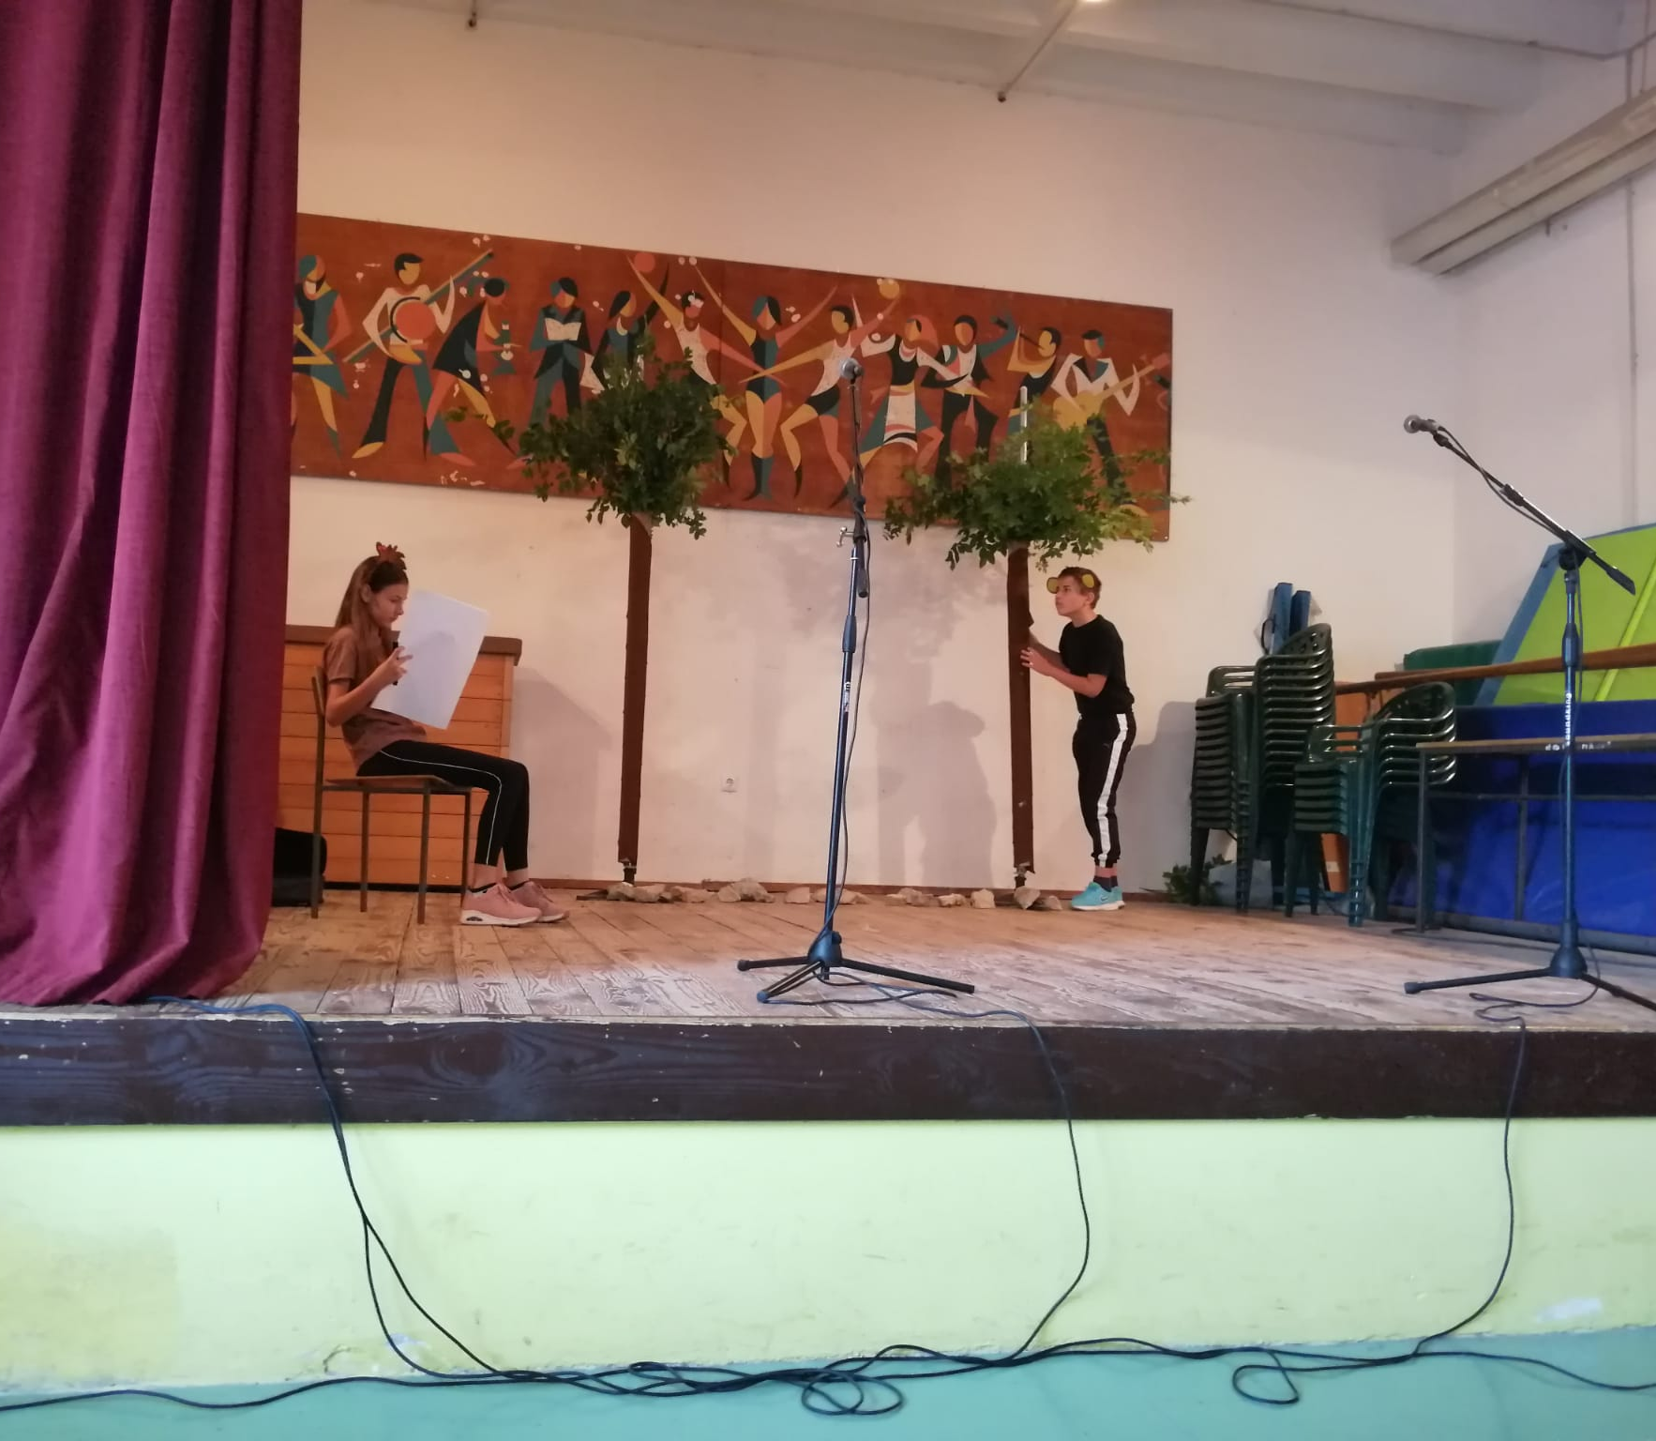
School activities
z
Sports group
School choir
Drama group
Robotics
Science groups

Slide 4
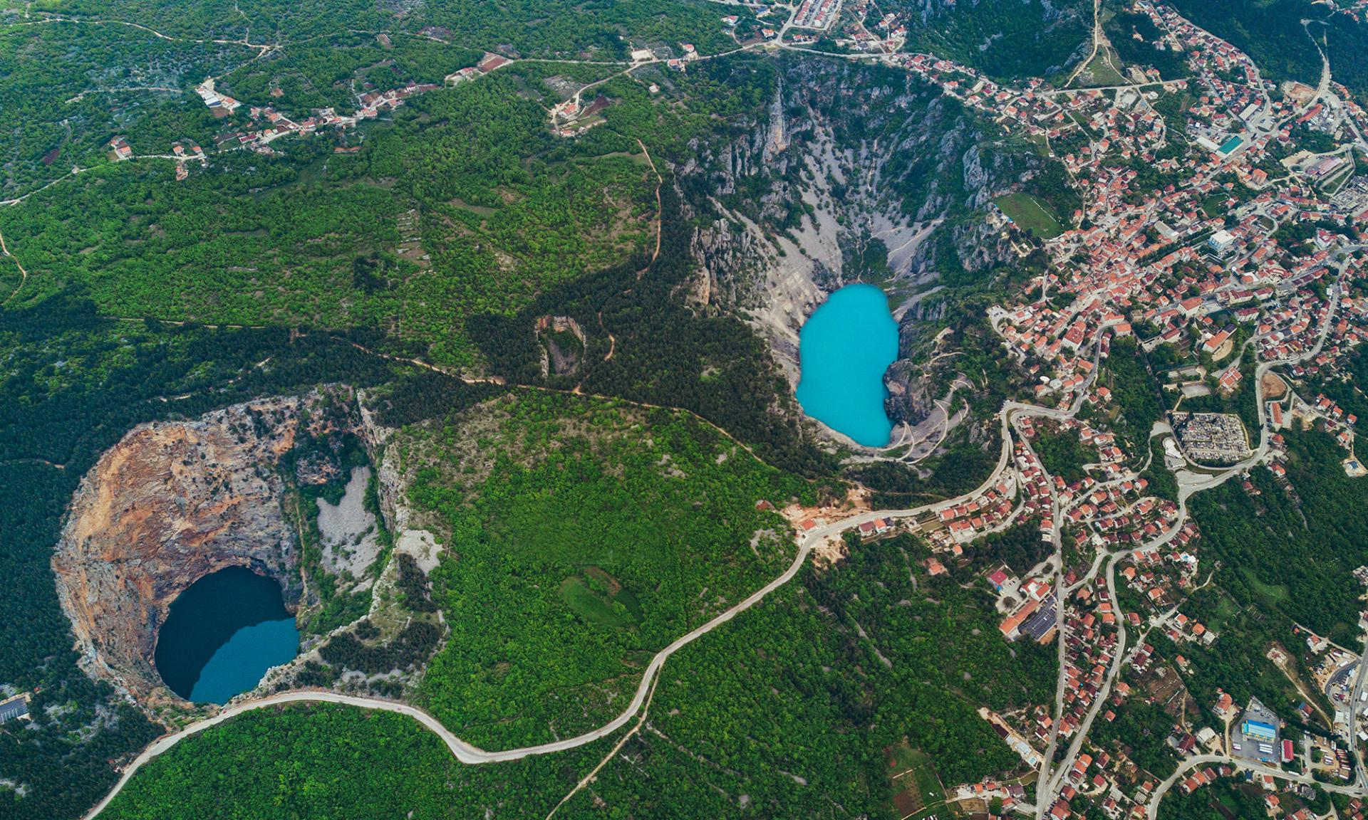
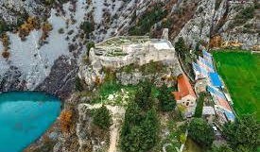
Imotski
z
A small city located in Dalmatia, Croatia
The nearest big city is Split, second largest city in Croatia
Population of Imotski is around 11000 inhabitants
The biggest tourist attractions are Blue and Red Lake and Topana – a fortress situated on a cliff above the Blue Lake

Slide 5
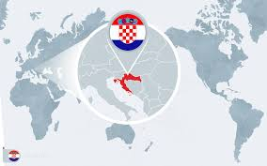
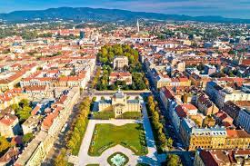
Croatia
z
Croatia is on the crossroads between Central Europe and the Mediterranean
Its official name is The Republic of Croatia
Official language is Croatian
It has 3,9 million inhabitants
The biggest city and the capital is Zagreb

Slide 6
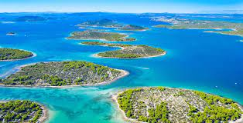
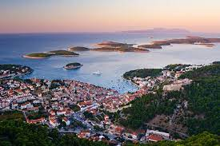
Croatia has 1,185 islands and rocks – 66 inhabited
One of 10 nations in the world with more than 1000 islands
Total coastline lenght is 5,835 km (islands 70% - mainland 30 %)

Slide 7
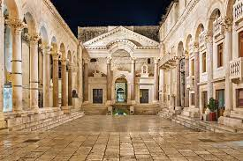
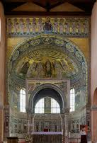
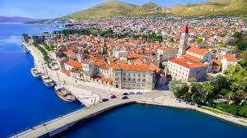
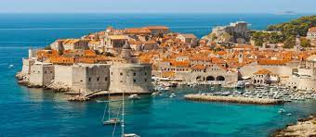
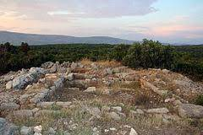
Croatia is home to 10 UNESCO World Heritage Sites, eight of which are cultural sites and two which are natural.
1 Episcopal Complex of the Euphrasian Basilica in the Historic Centre of Poreč
2 Historic City of Trogir
3 Historical Complex of Split with the Palace of Diocletian
4 Old City of Dubrovnik
5 Stari Grad Plain
6 Stećci Medieval Tombstones Graveyards

Slide 8
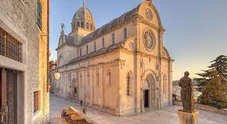
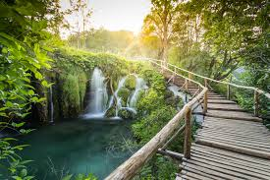
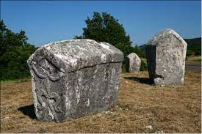
7 The Cathedral of St James in Šibenik
8 Venetian Works of Defence between the 16th and 17th Centuries: Stato da Terra – Western Stato da Mar
9 Ancient and Primeval Beech Forests of the Carpathians and Other Regions of Europe
10 Plitvice Lakes National Park

Slide 9
Thank you for your attention!
z

