Slide 1

Nature and photo, Erasmus+

Slide 2
Protected areas,plants and
animals in Slovakia
Sofia pavlisková 8.b
Simona niemcová 8.b

Slide 3
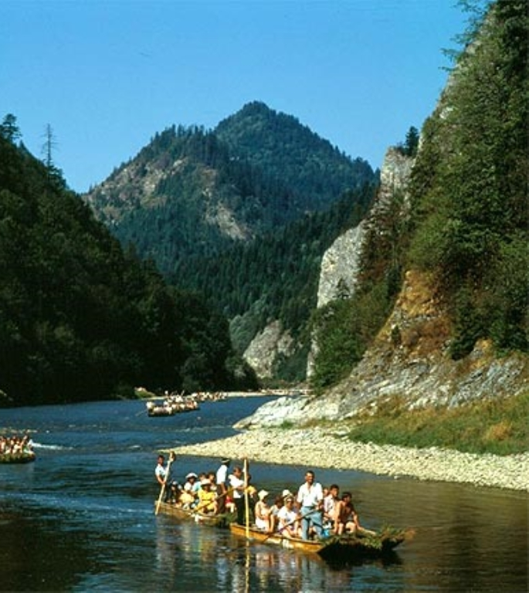
National park of
Pieniny
It ́s the smallest national park in Slovakia
It ́s the second oldest park in Slovakia
The village of Červený Kláštor is the seat of administration
The park has rare species of plants

Slide 4
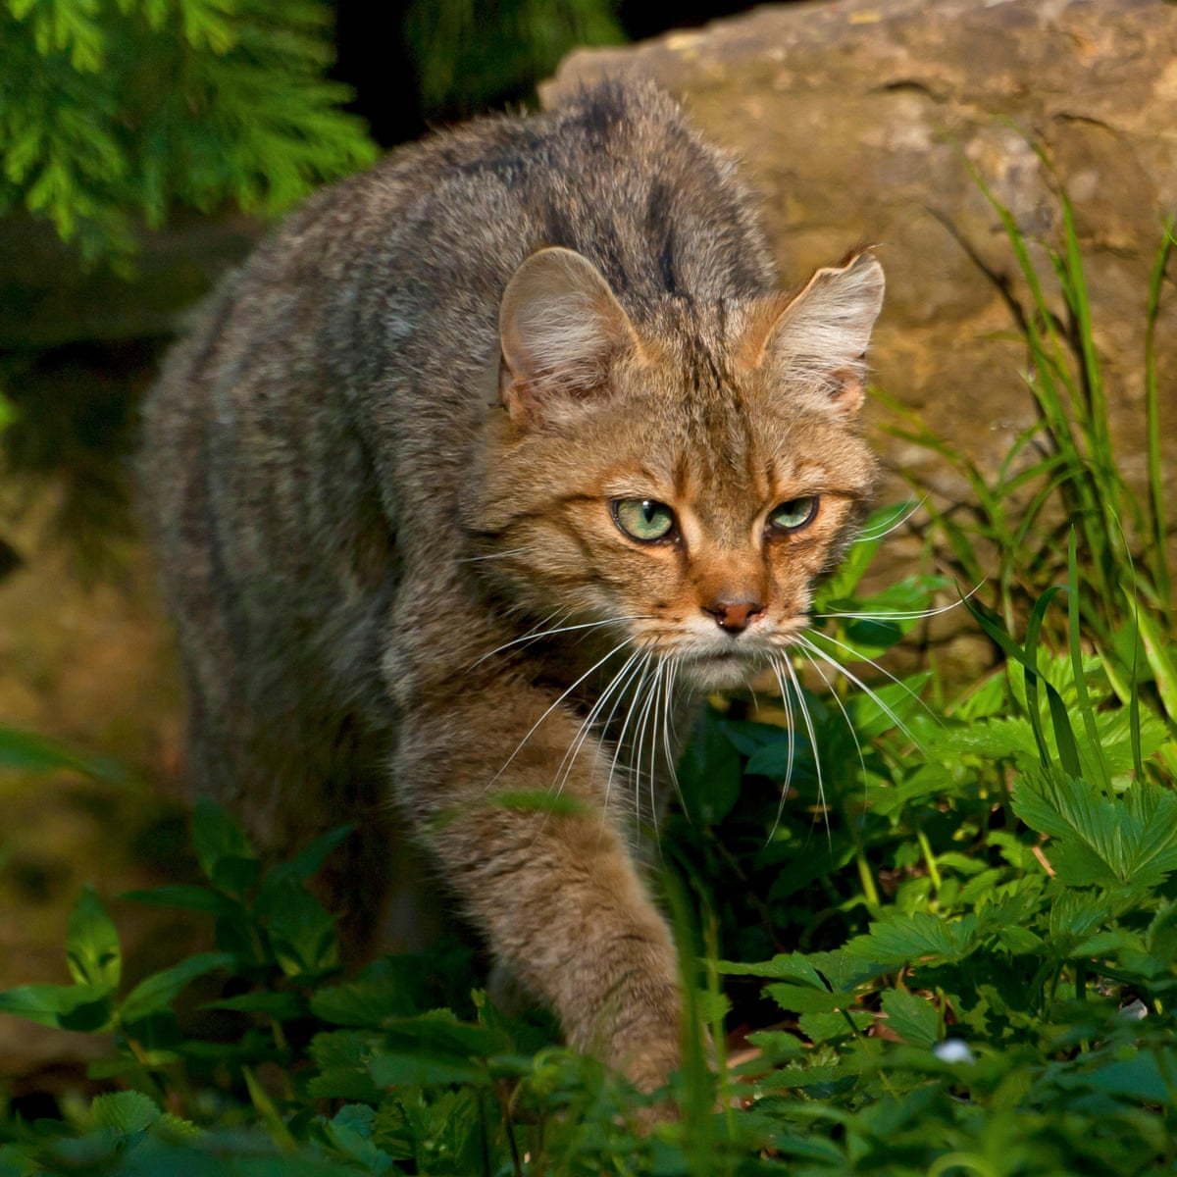
Wildcat
It ́s mix of two wildcats species European wildcat and African wildcat
It ́s very similiar to a normal cat
It can weight from 1,2 kg to 8kg
It ́s one of the least species in dange
It lives in High Tatras and Low Tatras

Slide 5
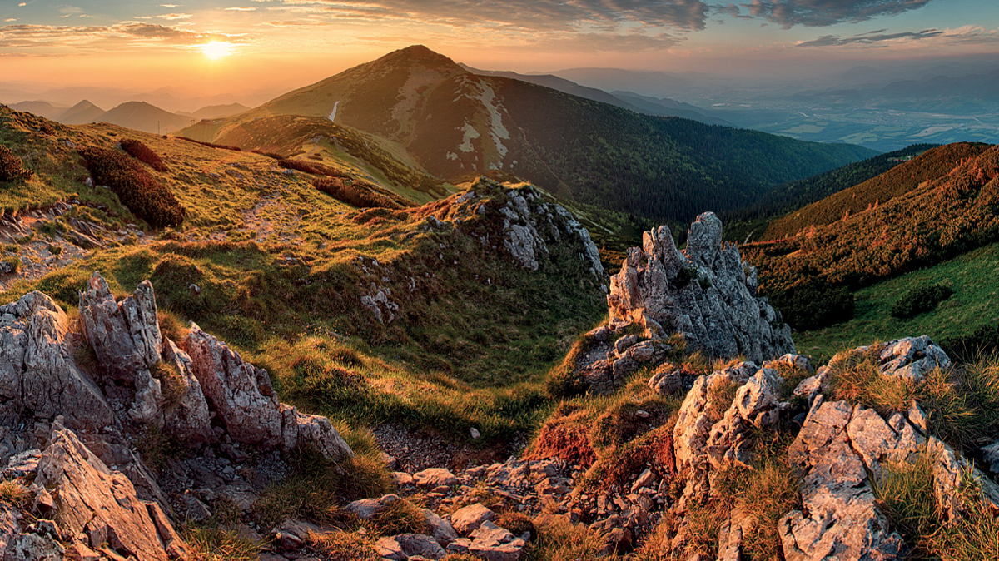
National park of
Malá Fatra
The National Park of Malá Fatra is situated in Slovak high moutains Malá Fatra
The waterfall Šútovský vodopád is popular destination for tourists
The Krivánska part of Malá Fatra was made for rare species of plants and animals in 1967

Slide 6
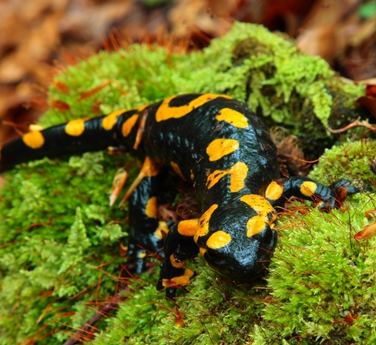
Fire salamander
It ́s common species of salamander in Europe
It ́s black with yellow spots and stripes
It can live a very long one fire salamander lived for 50 years in museum Koeing
It ́s toxic It has toxin samandrim in it and it can be dangerous for human life
It mostly lives in woods and fields near steams

Slide 7
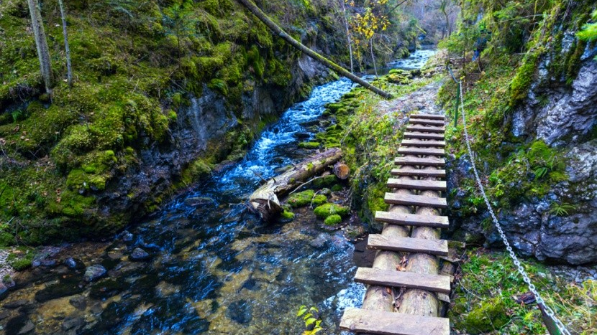
National park of
Slovenský raj
It is one of the youngest national parks in
Slovakia
The National park of Slovenský raj is situated in eastern part of Slovakia
It has one of the biggest ice caves in Europe [Dopšínska ice cave]
There are beautiful caves and waterfalls

Slide 8
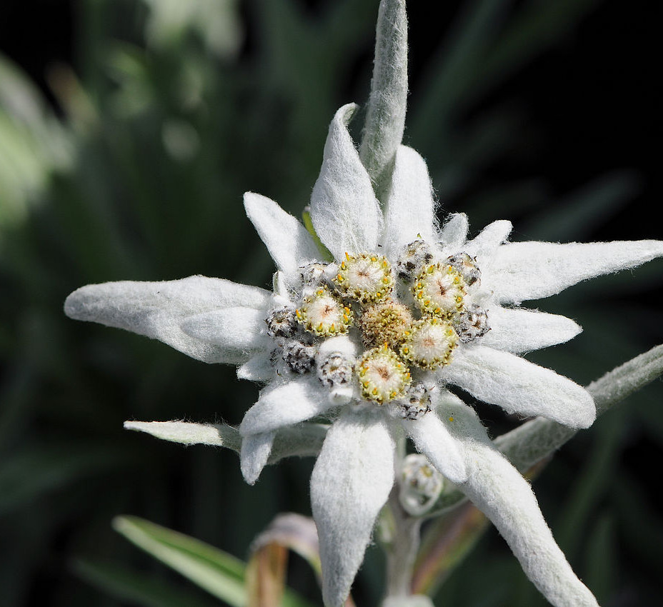
Leontopodium nivale
It is commonly called edelweiss
It is a mountain flower belonging to the daisy or sunflower family Asteraceae
The plants are short lived and can be grown from seed
It is non-toxic and has been used in traditional medicine

Slide 9
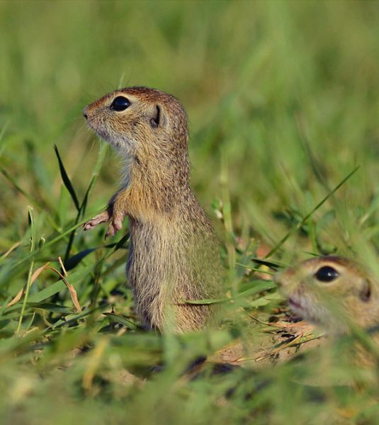
European ground
squirrel
They live in middle and eastern Europe and in Slovakia they live on fields
They are very friendly and you can even pet them
They can have length from 20 to 22 cm and they ́re tail can have lenght 3,8 to 8,3 cm

Slide 10
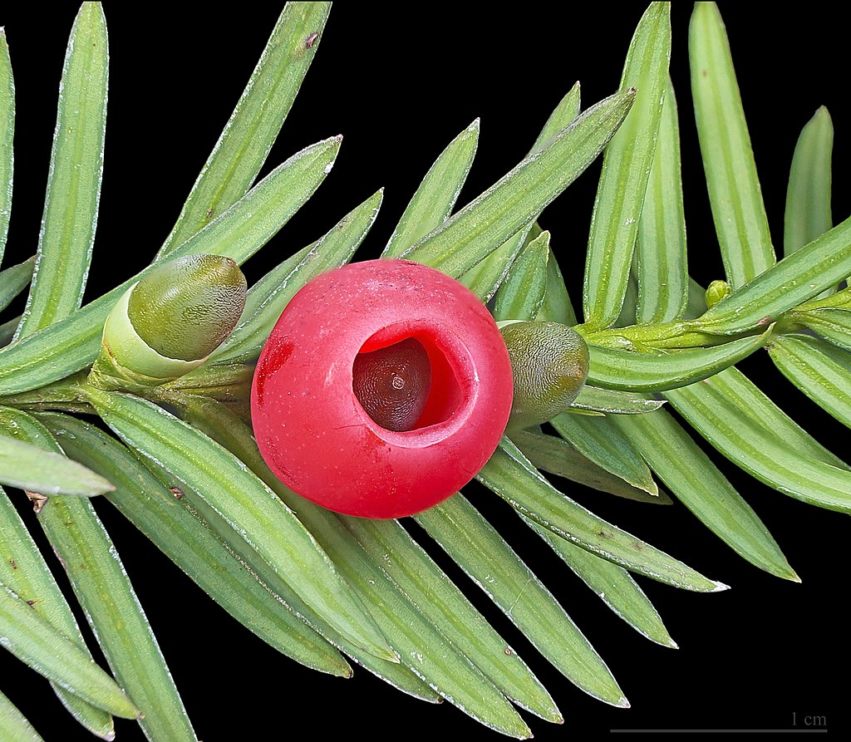
Taxus baccata
It is a specie of evergreen tree in the Taxaceae, native to western, central and southern Europe (including the British Isles), northwest Africa, northern Iran, and southwest Asia
Most parts of the plant are poisonous, with toxins that can be absorbed through inhalation and through the skin; consumption of even a small amount of the foliage can result in death.

Slide 11
Simple thinghs to save our nature
Reduce, reuse, and recycle
Reduce, reuse, and recycle. Cut down on what you throw away. Follow the three "R's" to conserve natural resources and landfill space.
Volunteer
Volunteer. Volunteer for cleanups in your community. You can get involved in protecting your watershed, too.
Educate
Educate. When you further your own education, you can help others understand the importance and value of our natural resources.
Conserve
Conserve water. The less water you use, the less runoff and wastewater that eventually end up in the ocean.
Choose
Choose sustainable. Learn how to make smart seafood choices at http://www.fishwatch.gov/
Shop
Shop wisely. Buy less plastic and bring a reusable shopping bag.
Plant
Plant a tree. Trees provide food and oxygen. They help save energy, clean the air, and help combat climate change.
Don't send
Don't send chemicals into our waterways. Choose non-toxic chemicals in the home and office.

Slide 12
Thank you for your
attention!

