Slide 1

Nature and photo Croatia,Krivodol 21.5.- 27.5.2023 Erasmus+

Slide 2
Pollution of nature
Lara Pavučková, Marko Tribula, Diana Šimková, Filip Boršč

Slide 3
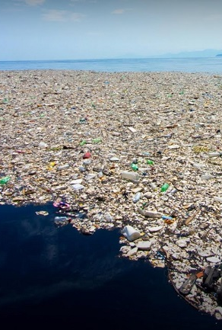
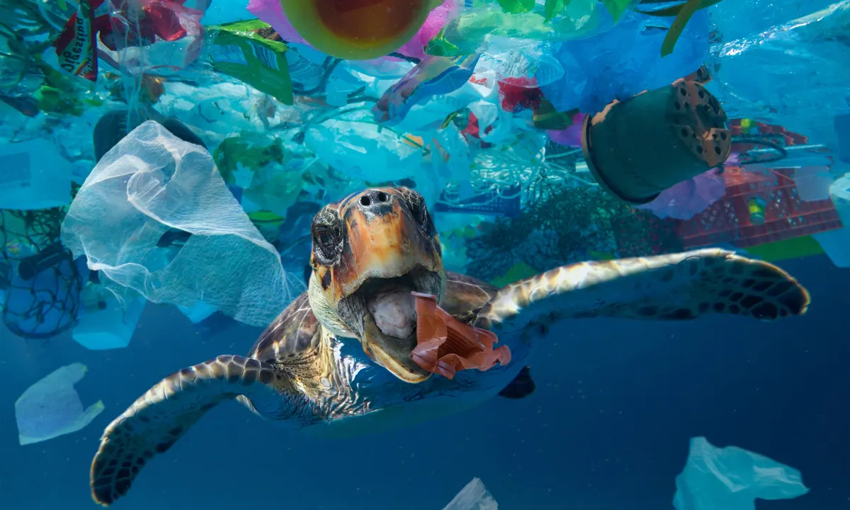
Sea pollution
Marine pollution is a combination of chemicals and trash, most of which comes from land sources and is washed or blown into the ocean.
This pollution results in damage to the environment, to the health of all organisms, and to economic structures worldwide.

Slide 4
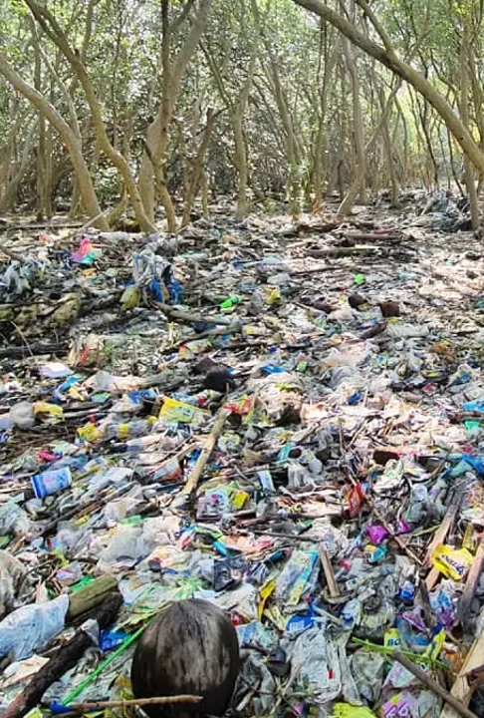
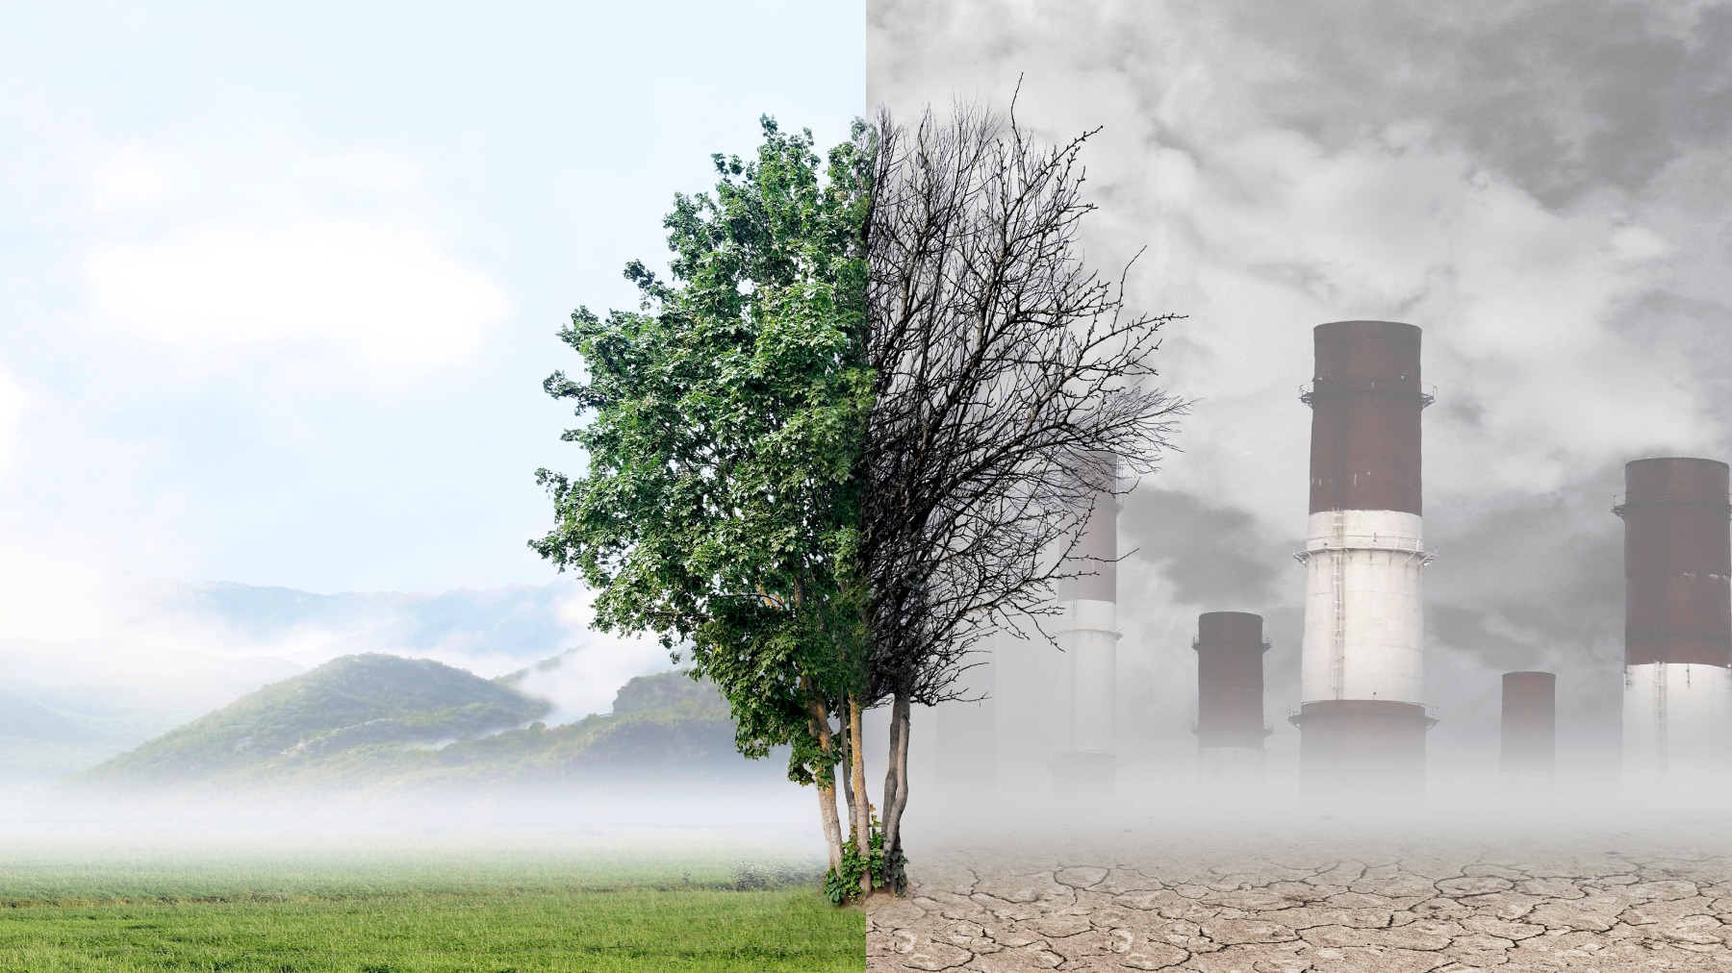
Forest pollution
People throw things into nature they dont need instead of trowing into a container or recyclin.
Forest are facing significant pressures form climate change and air pollution

Slide 5
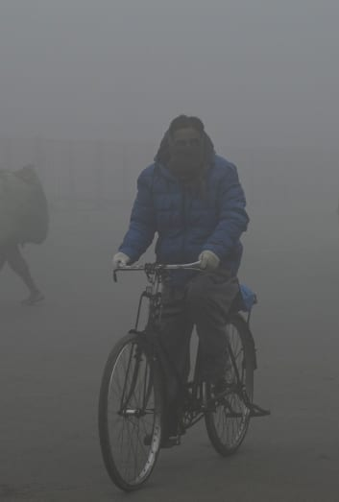
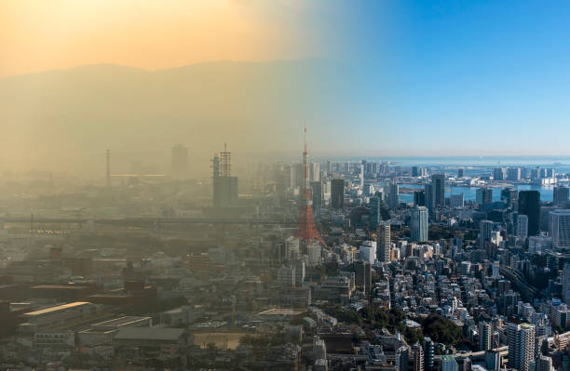
The most polluted city
The most polluted cities globally were Lahore, Pakistan; Hotan, China; Bhiwadi, India; Delhi, India; and Peshawar, Pakistan.

Slide 6
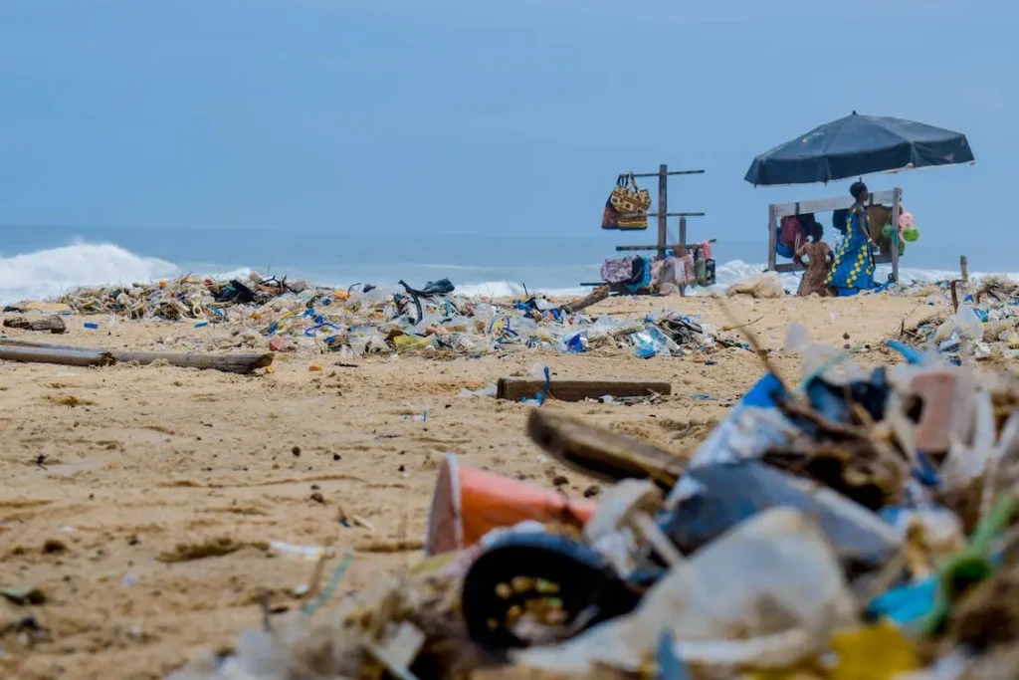
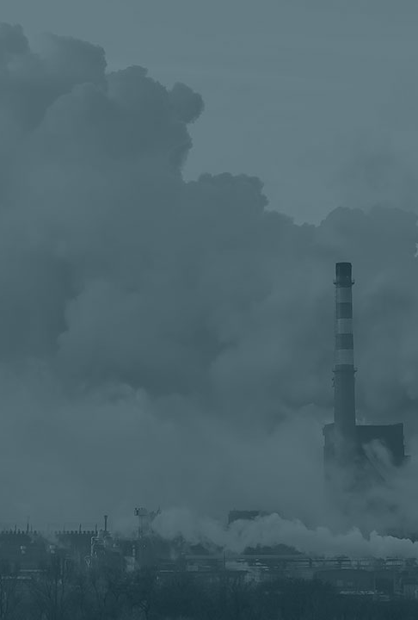
Consequences
All litter, whether intentional or not, causes pollution by releasing chemicals and microparticles as it degrades.
Land pollution touches essentially every area of the living world, including: Contamination of drinking water...

Slide 7
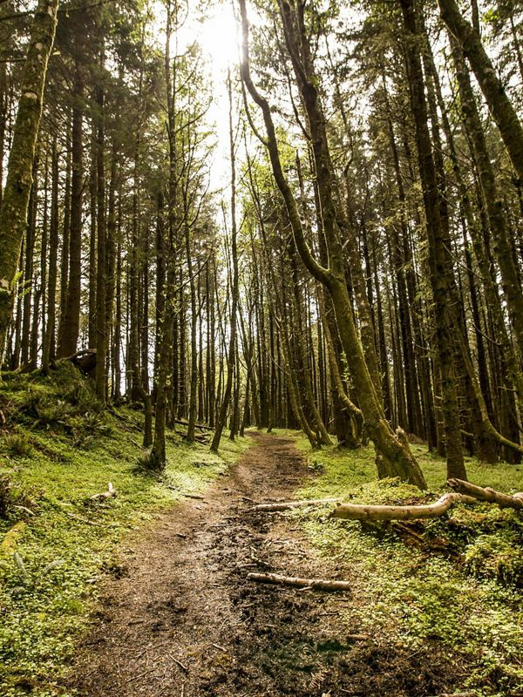
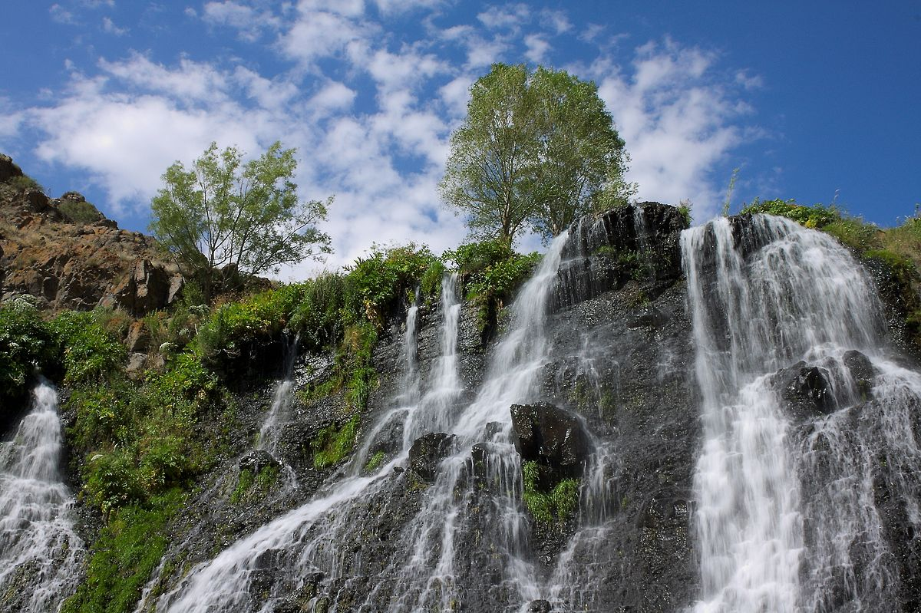
How can we deal with these consequences?
There are now significantly safer practices for disposing of waste, including the recovery and use of landfill gas for electricity
To help reduce the environmental impact of construction sites, it’s important to work with partners that offer comprehensive solutions

Slide 8
THANK YOU FOR YOUR ATTENTION

