Slide 1
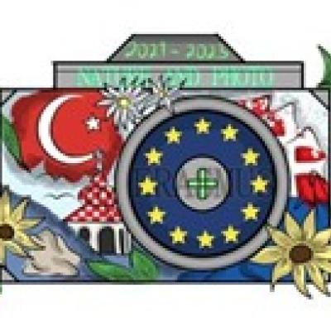
Erasmus + Nature and photo Croatia, Krivodol 21.5.-27.5.2023
Our town Humenne
The city where we live and go to school

Slide 2
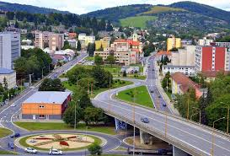
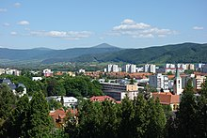
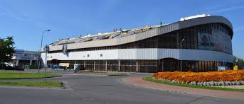
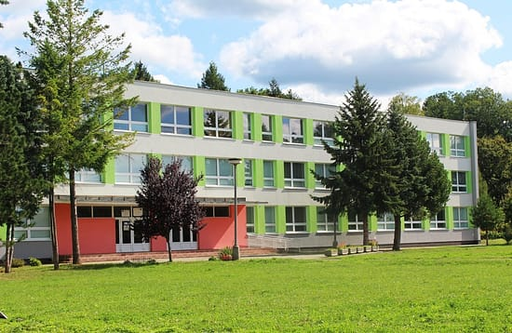
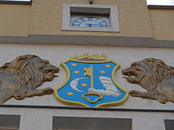
Humenné is the heart of Horný Zemplín on the Laborec river, which belongs to the Prešov region.
It´s economic, administrative and
cultural-social center .
It has about thirty-four thousand inhabitants.
It lies near the borders with Poland and Ukraine

Slide 3
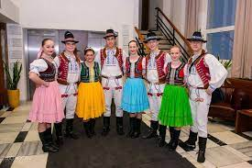
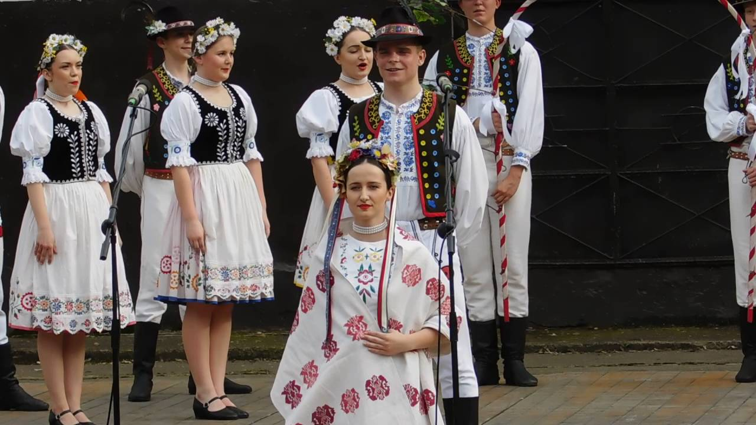

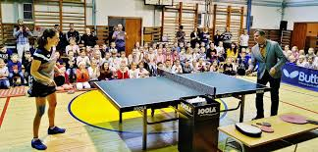

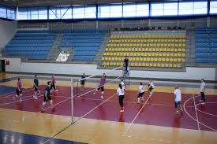
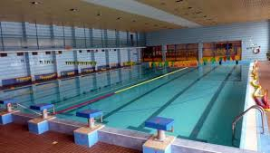
In the past, the city was an important center of textile production.
Humenné is also an important cultural center.
Many cultural events, festivals and concerts take place here every year.
Folklore ensembles focus on preserving and presenting the traditional folk culture, which they present in Slovakia and abroad.

Slide 4
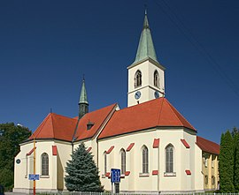
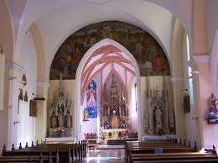


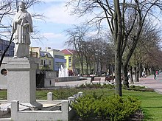
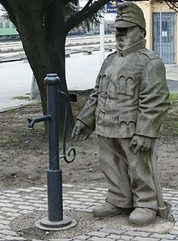
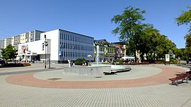
- Important historical and cultural monuments of the city include: - Humenné Castle, the Gothic Church of All Saints, an open-air museum of folk architecture, a Jewish cemetery... - Other tourist attractions include the statue of St. Ján Nepomúcky in the park, the statue of the Good Soldier Švejk, the Fountain of Love on the centre zone, sports hall, winter stadium, shopping centers... - Near the city are the ruins of the Brekov and Jasenov castles, the Vihorlat mountain range, sea ​​eye lake....

Slide 5
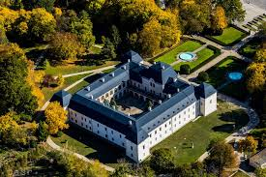
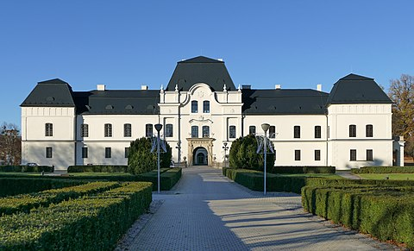
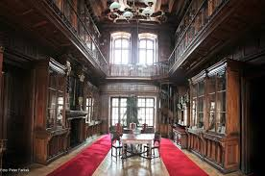
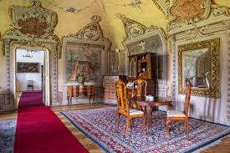
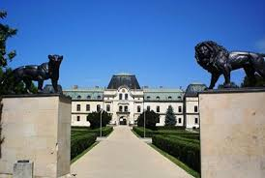
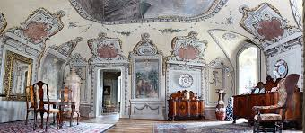
- Castle in Humenne together with the park is a national cultural monument - The former Renaissance residence of the Druget family and later rebuilt in the Baroque style became the property of the Andráš family. - The Vihorlat Museum is located here.

Slide 6
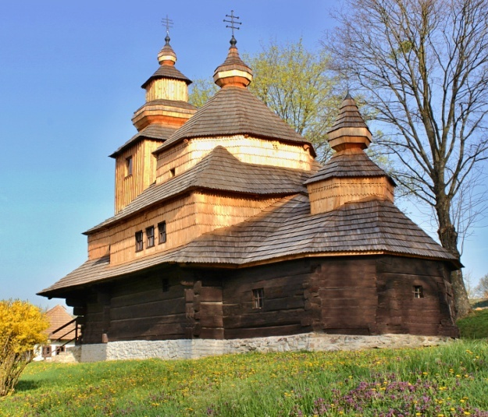
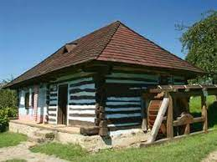
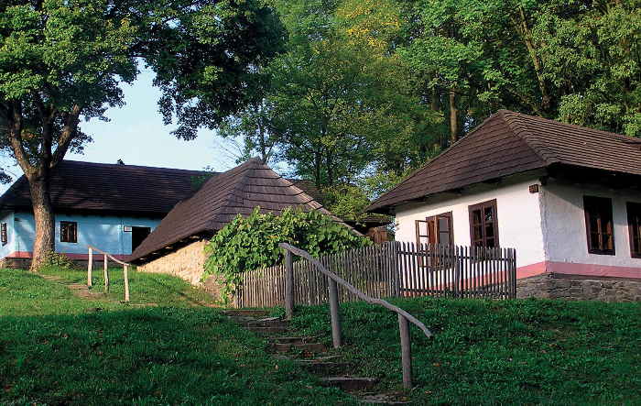
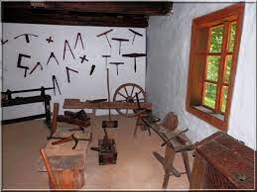
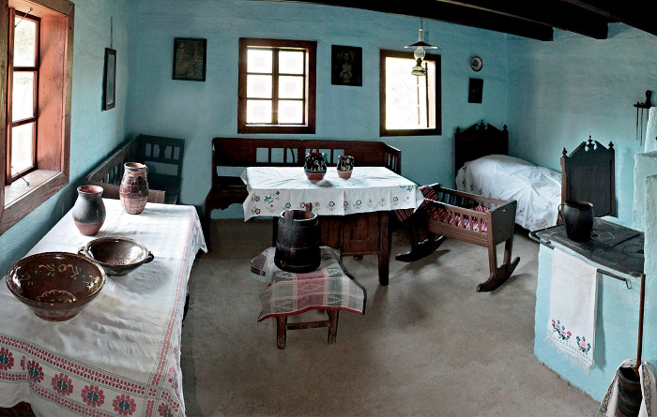
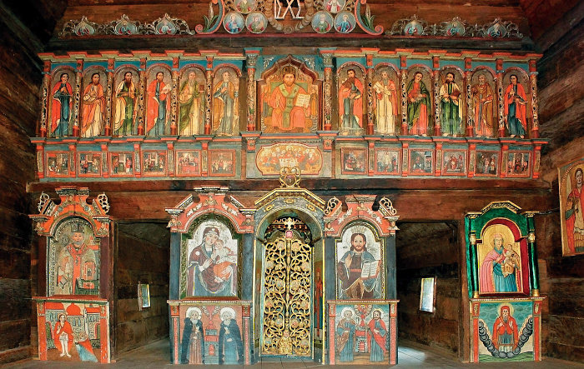
Skanzen is an exposition of folk architecture and housing located in nature.
There are period wooden houses, outbuildings, wells, and a water mill...,
- A church that is built without the use of nails
- Pottery and blacksmith workshop
- All buildings are also accessible from the inside

Slide 7
Thanks for attention.
Erasmus team

