Slide 1

Nature and photo Croatia,Krivodol 21.5.- 27.5.2023 Erasmus+

Slide 2
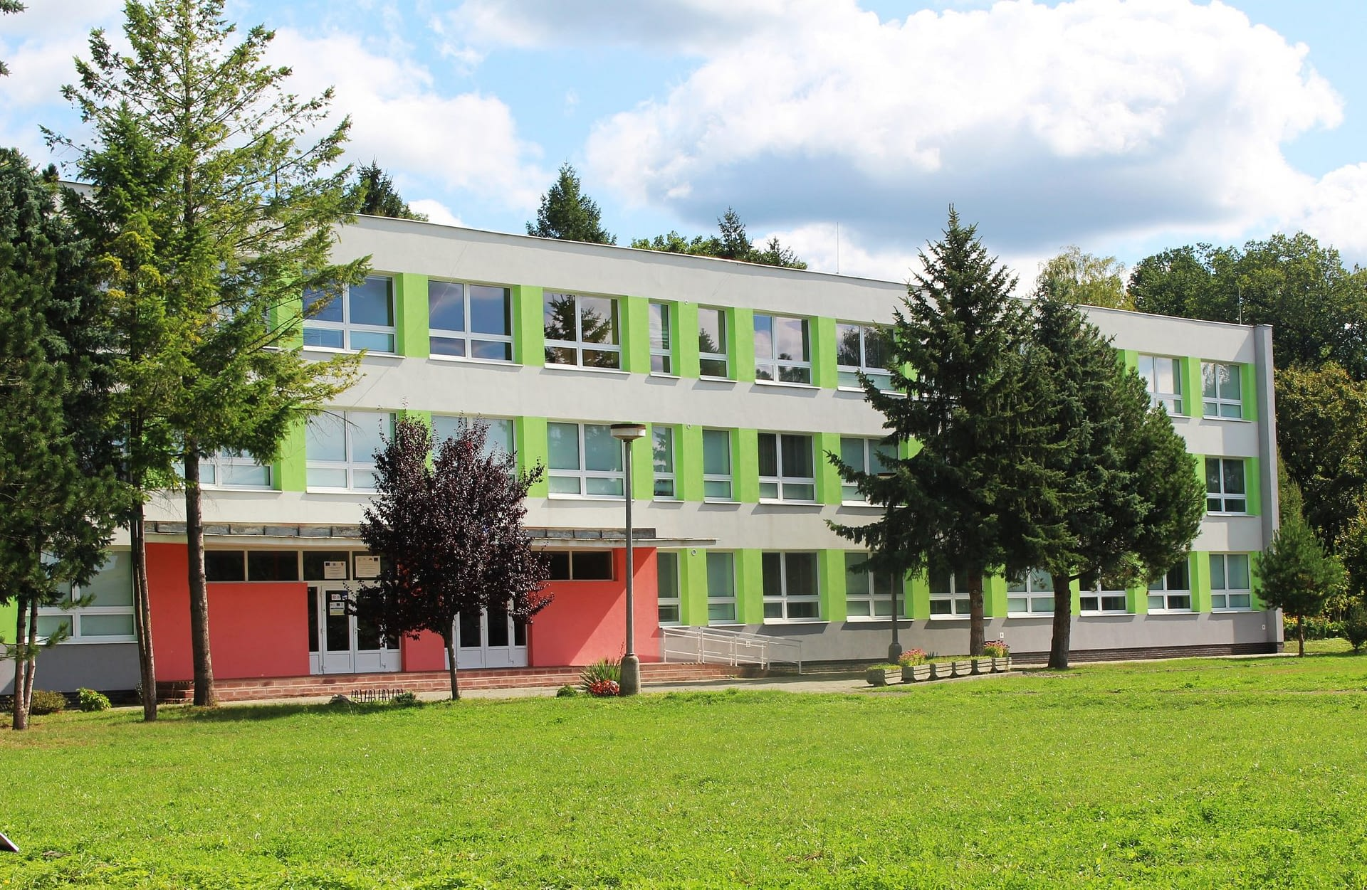
Elementary school kudlovská
The school is located in Humenné town situated in the Eastern Slovakia. We have a total of 343 students aged 6 – 15, 25 teachers. 1 social worker, 8 teachers´ assistants and 1 special pedagogue. We also educate students with mental and physical disabilities, with educational problems and Roma students. They are all integrated in normal classes.

Slide 3
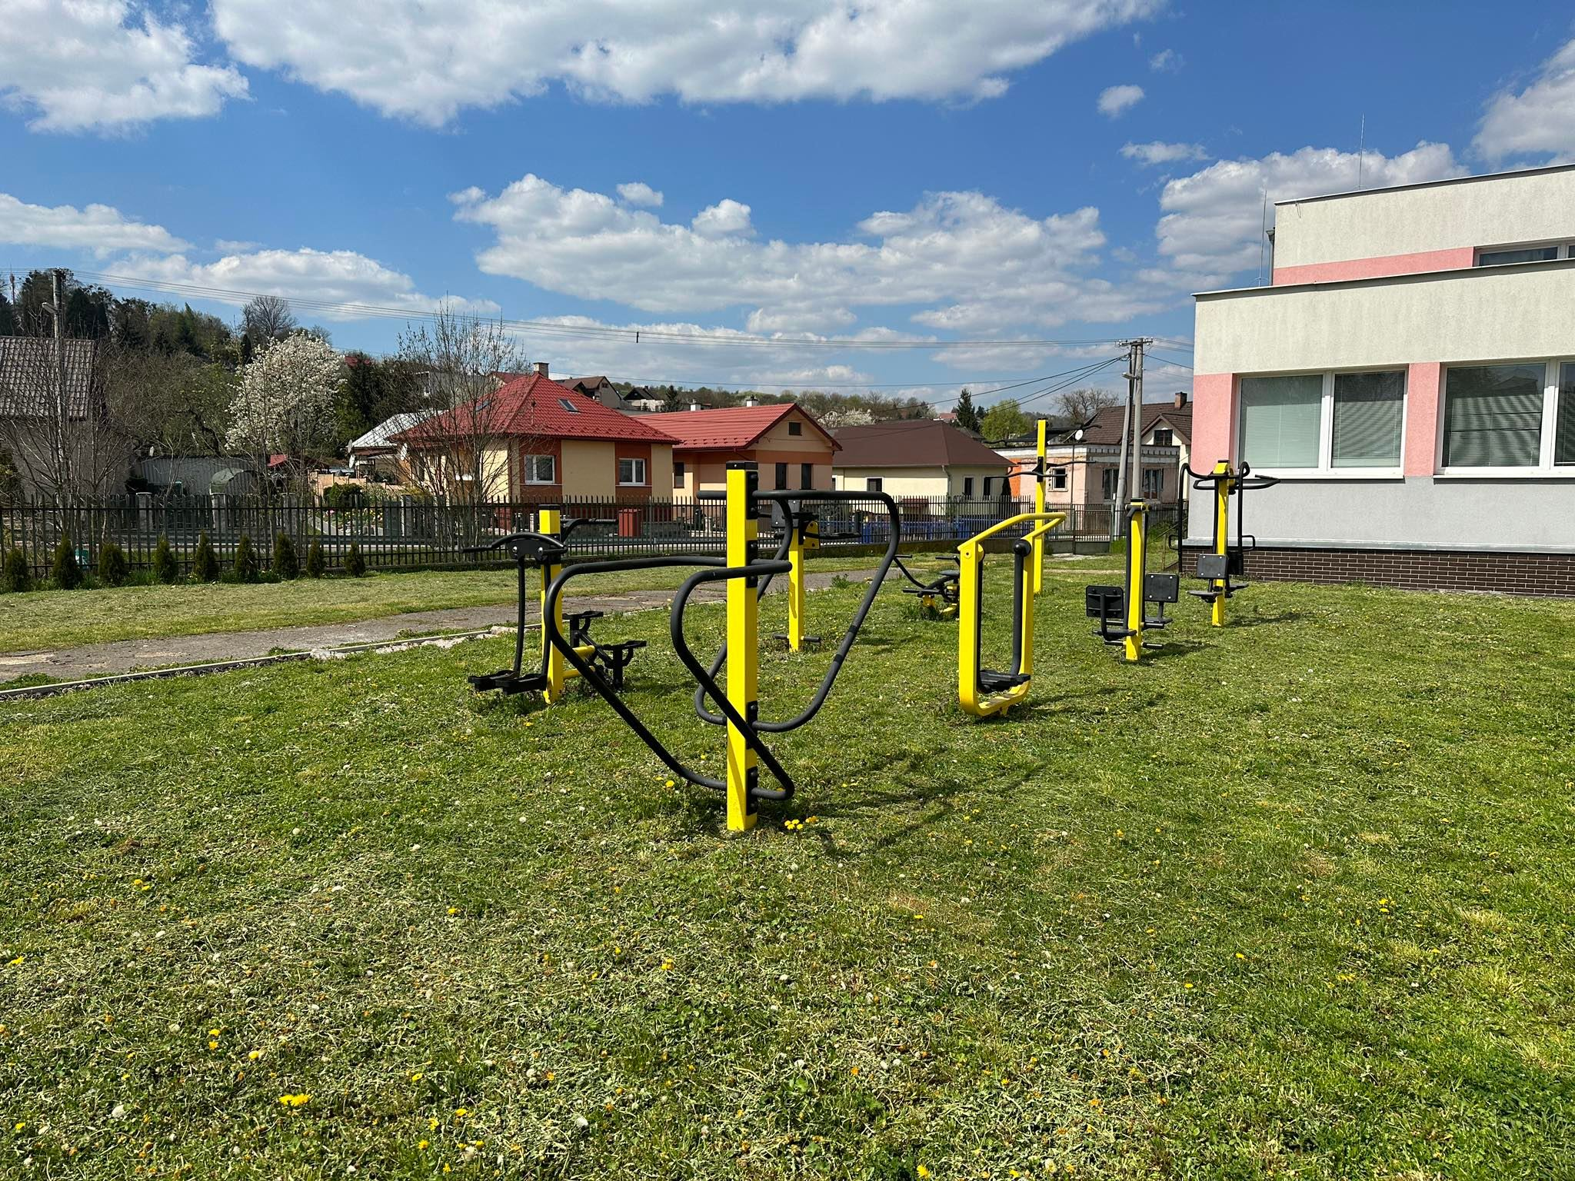
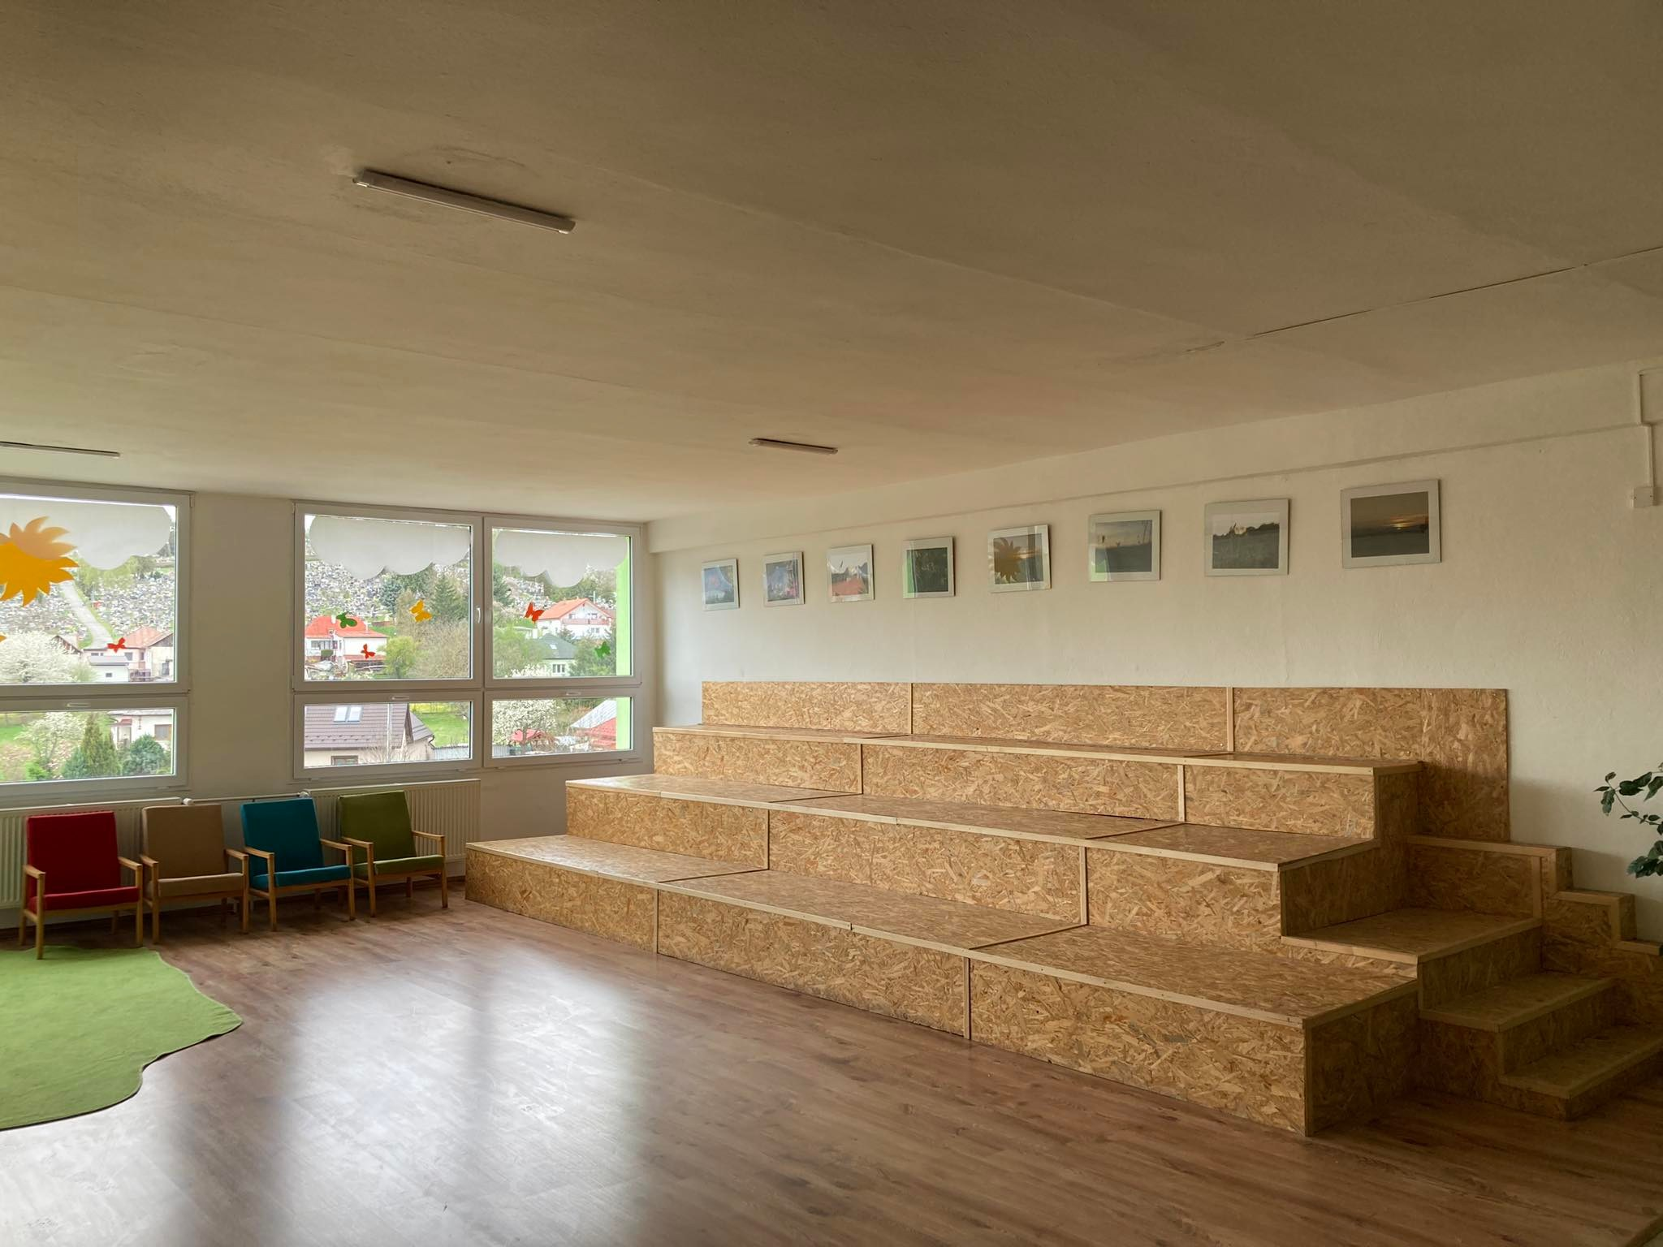
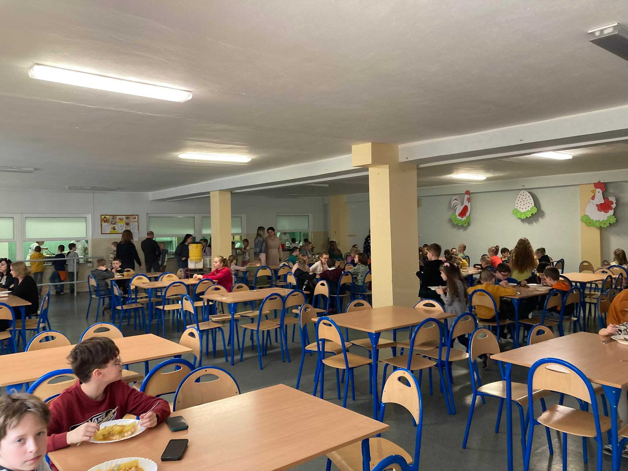
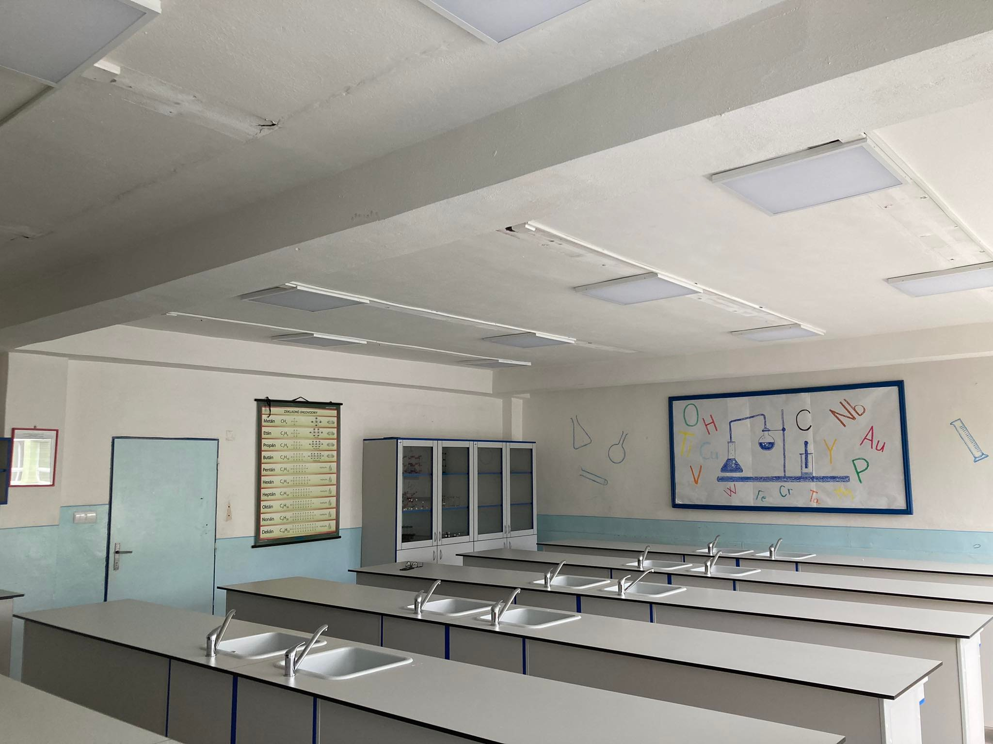
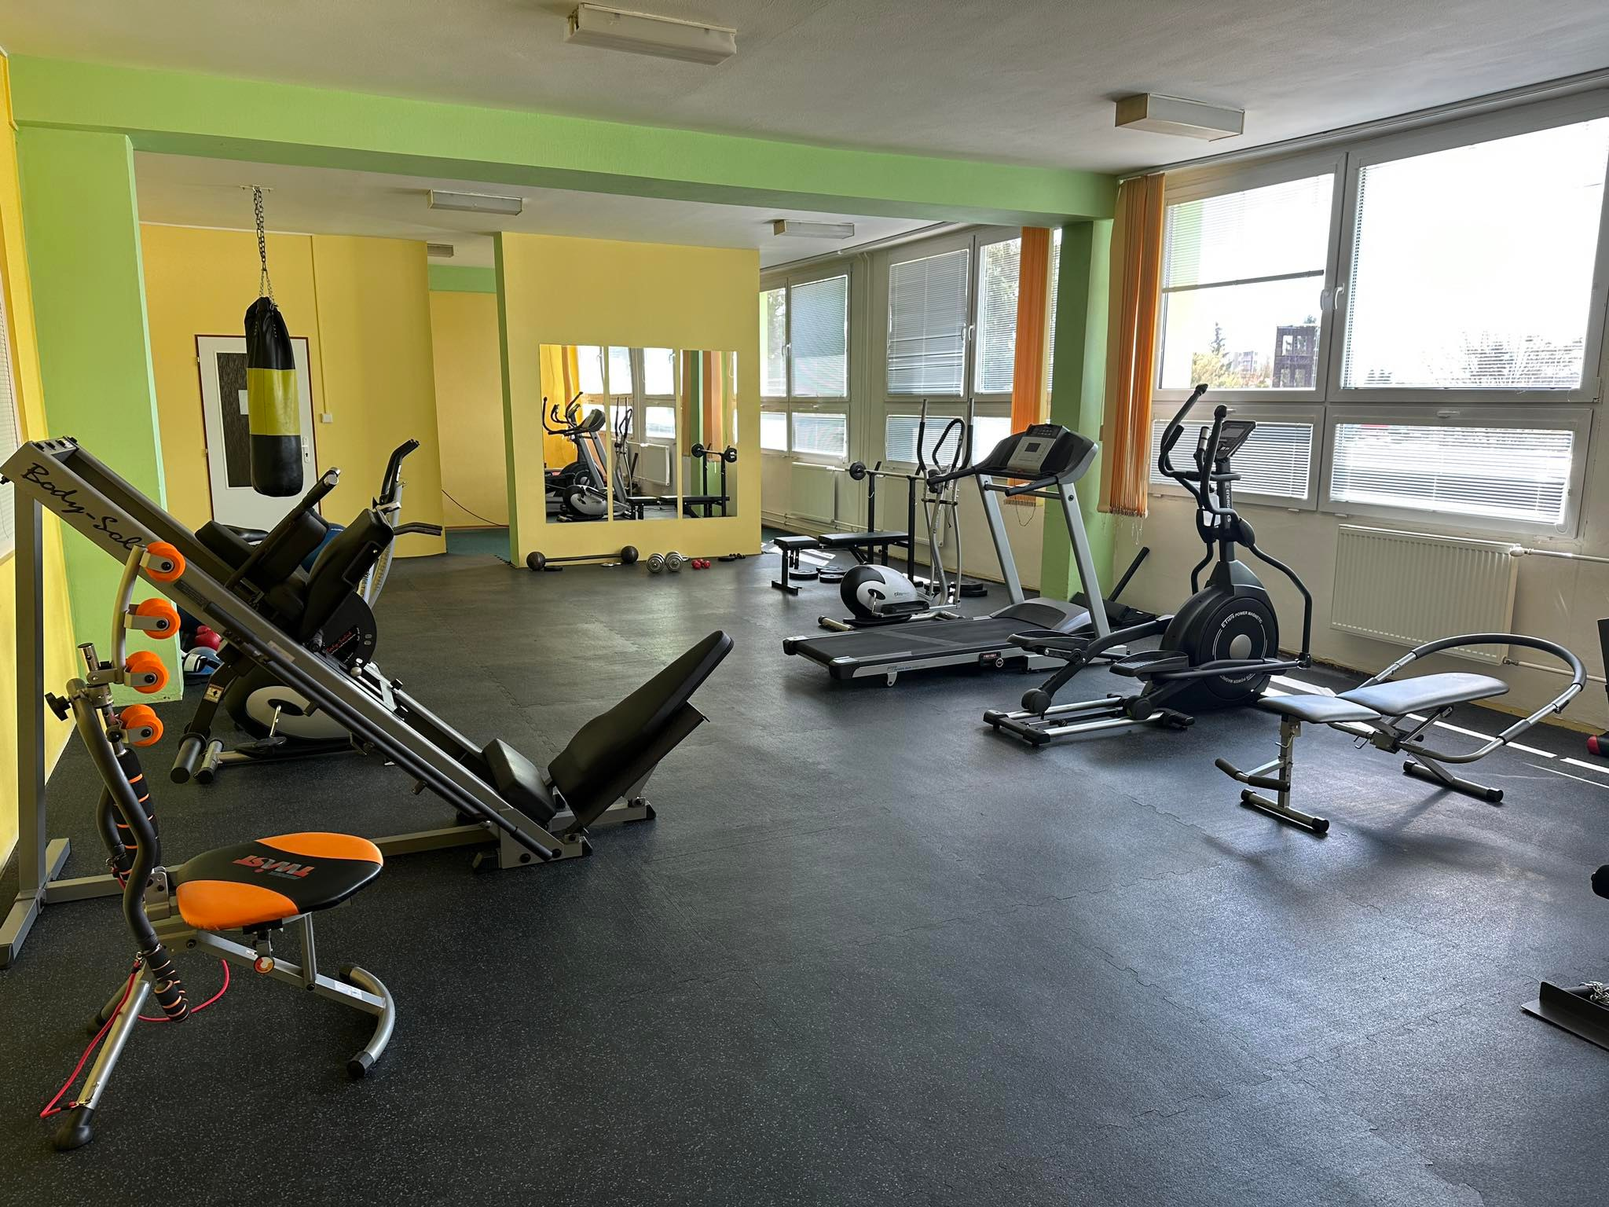
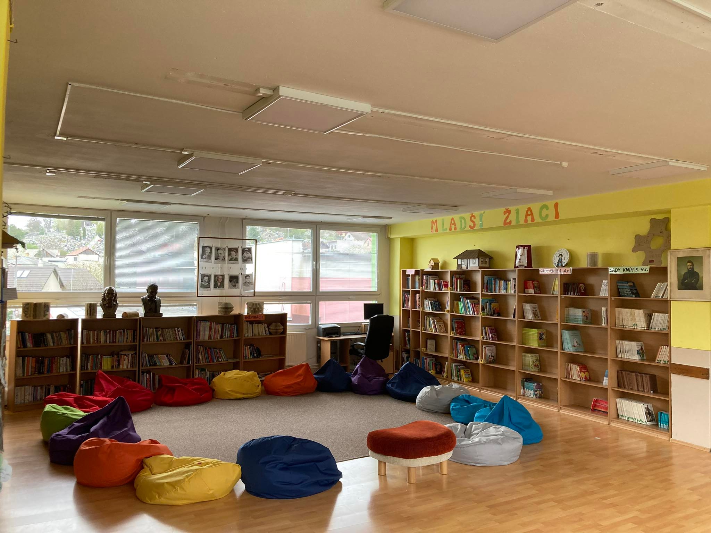
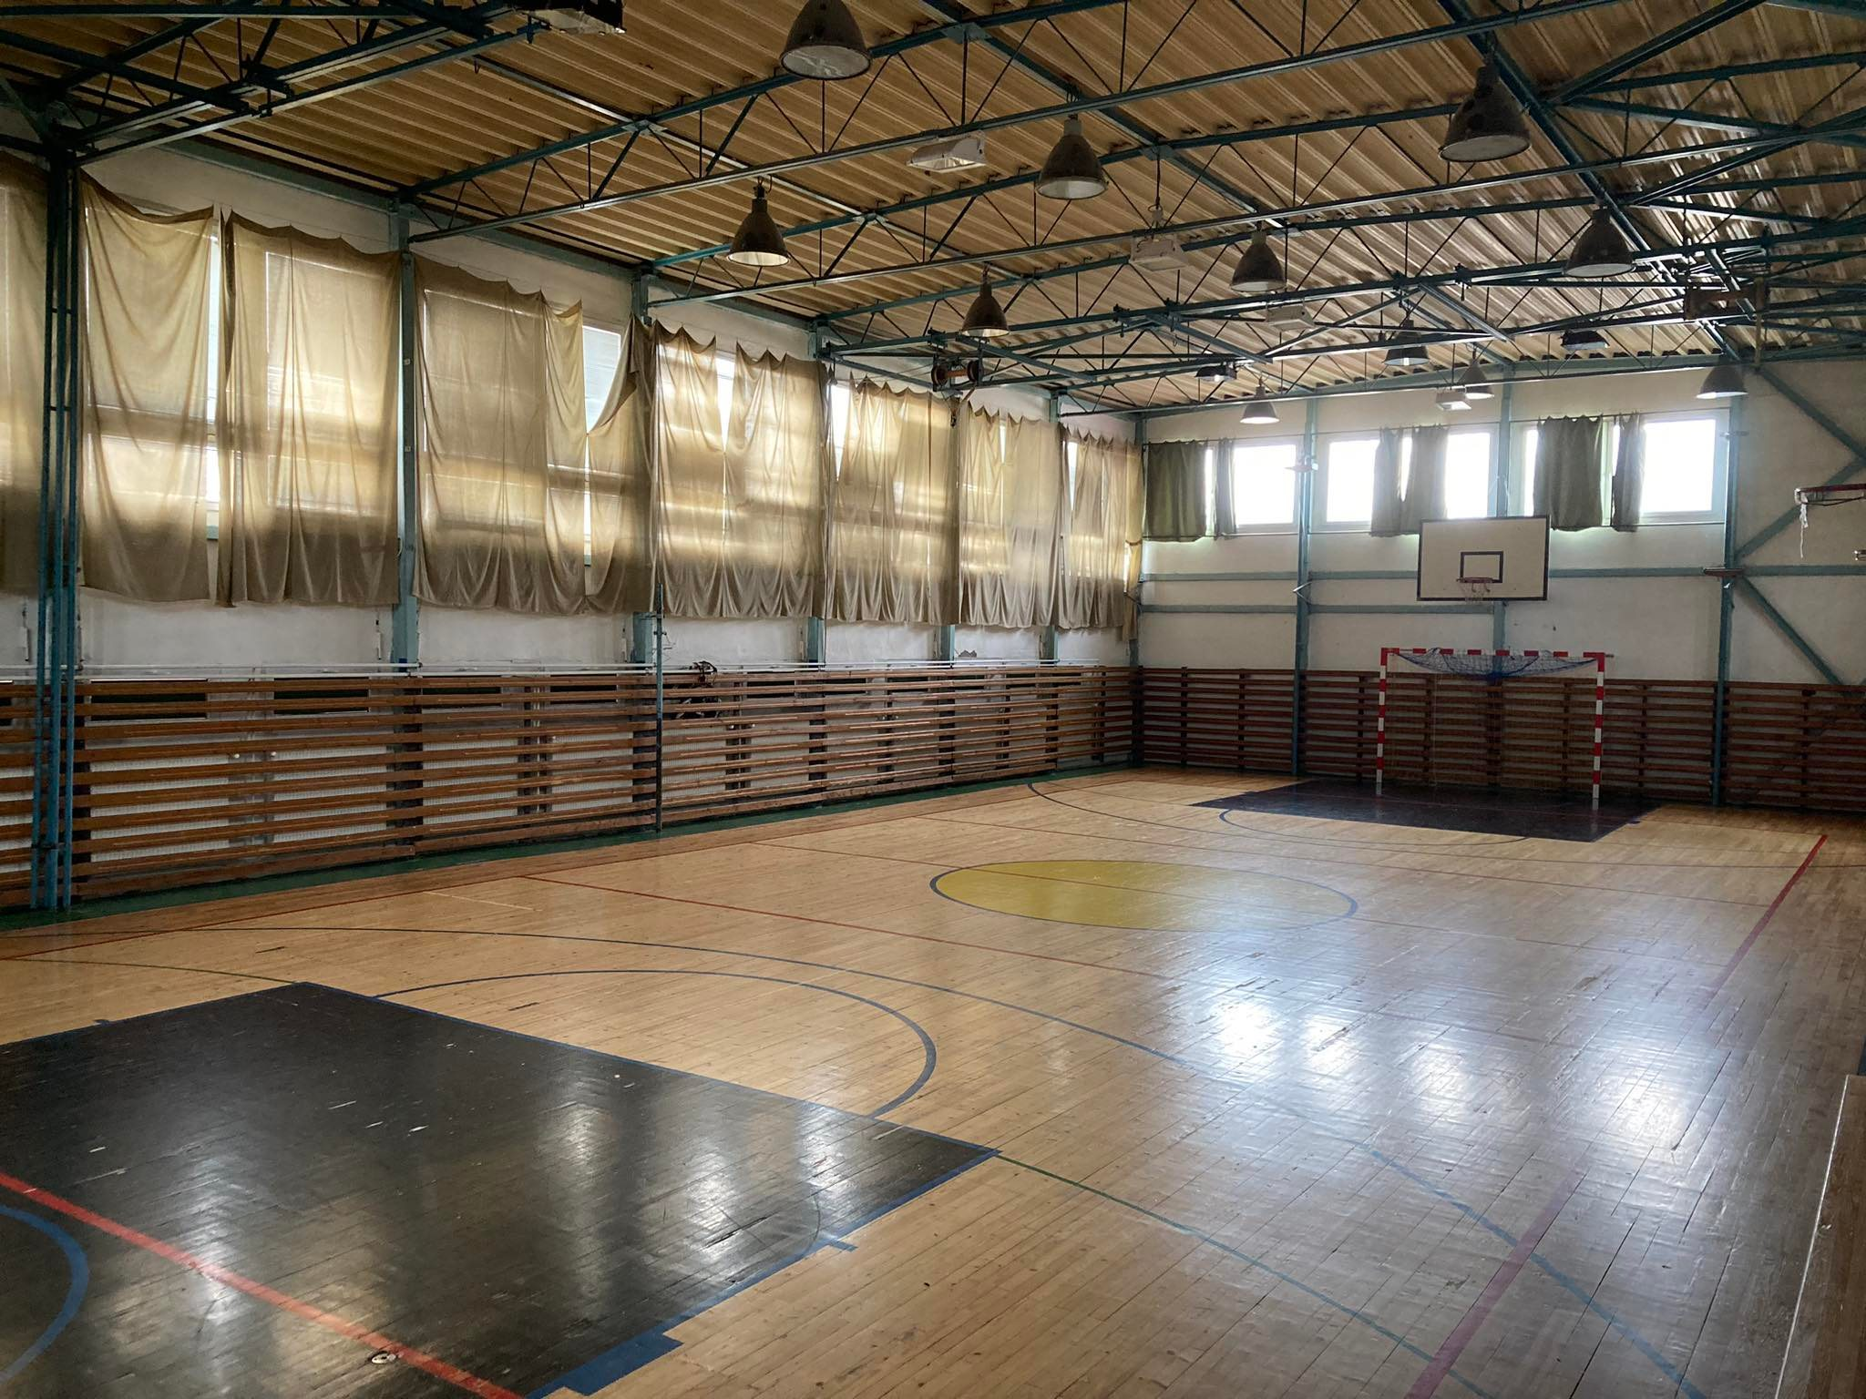
About our school
We have modern classes, laboratories, school library, school canteen,2 gym halls, playground, relax centre, work out playgroung, ...

Slide 4
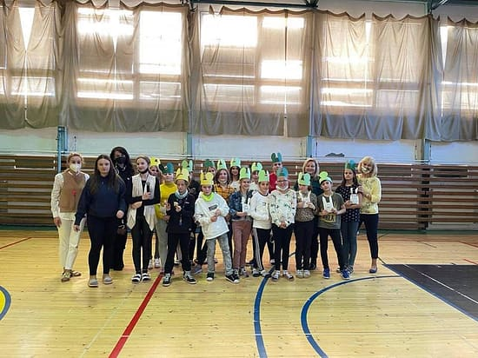
ušiačik
We attend elemetary school 9 years.
Students from 1st class to 4 th class are in first grade and then continue to second grade from 5 th to 9th.
For students moving from 1st grade to 2nd is made special party called Ušiačik.
So they are welcomed by older students.

Slide 5

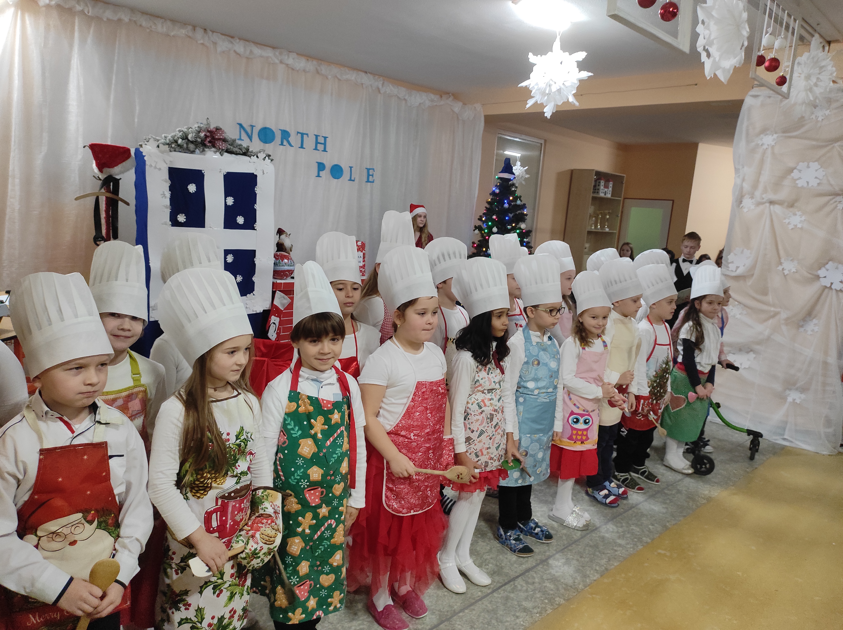
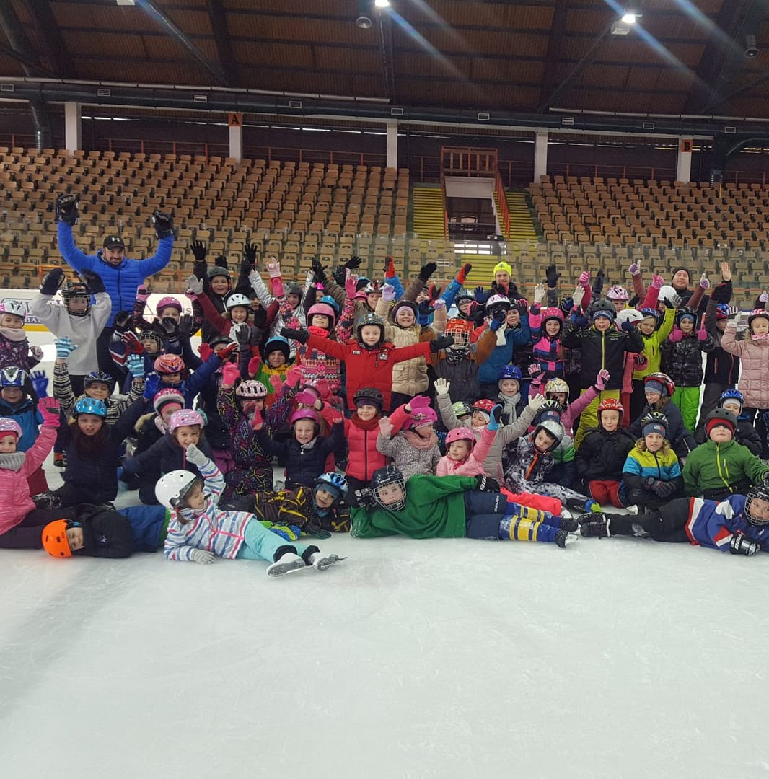
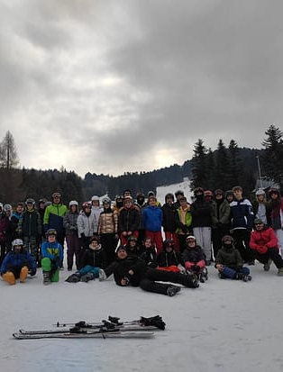
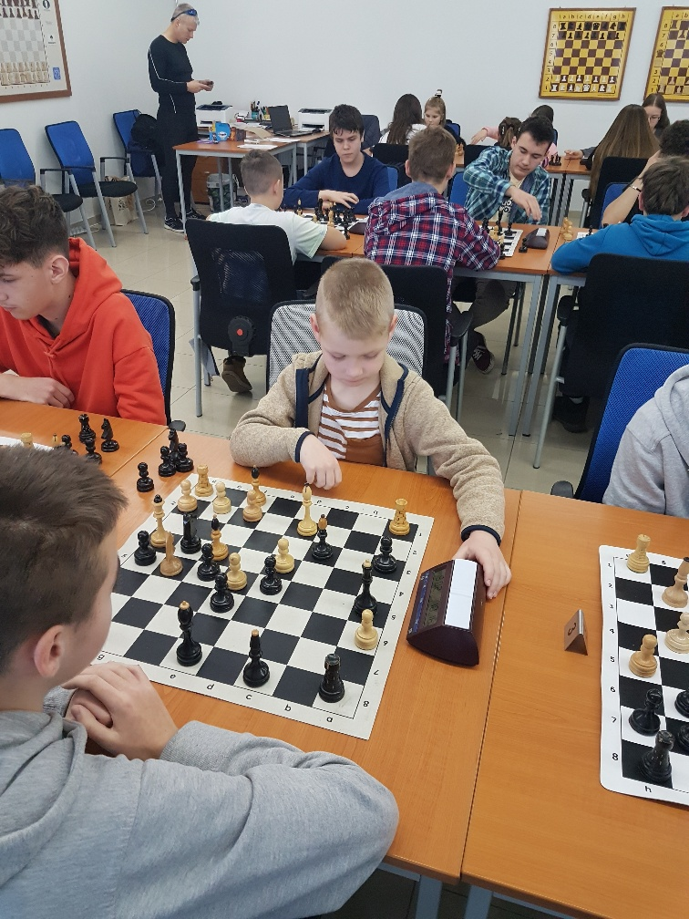
activities
Our school is orginizing a lot of activities for students.
For example ST. Valentines day, various trips to museums, libraries, and also sport activities (world run day).
We have a lot of courses,, too. For example skating course, swimming course and ski course.

Slide 6
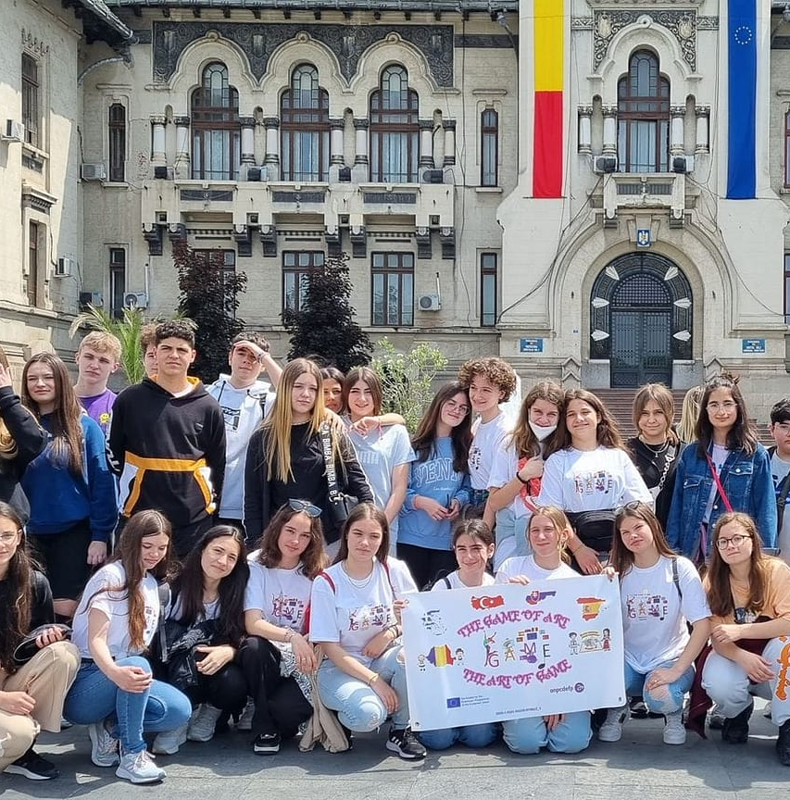

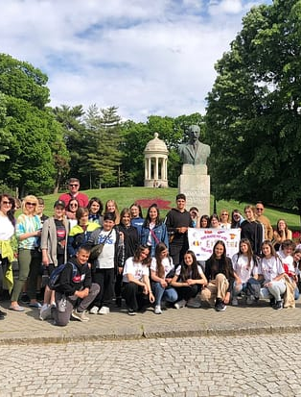
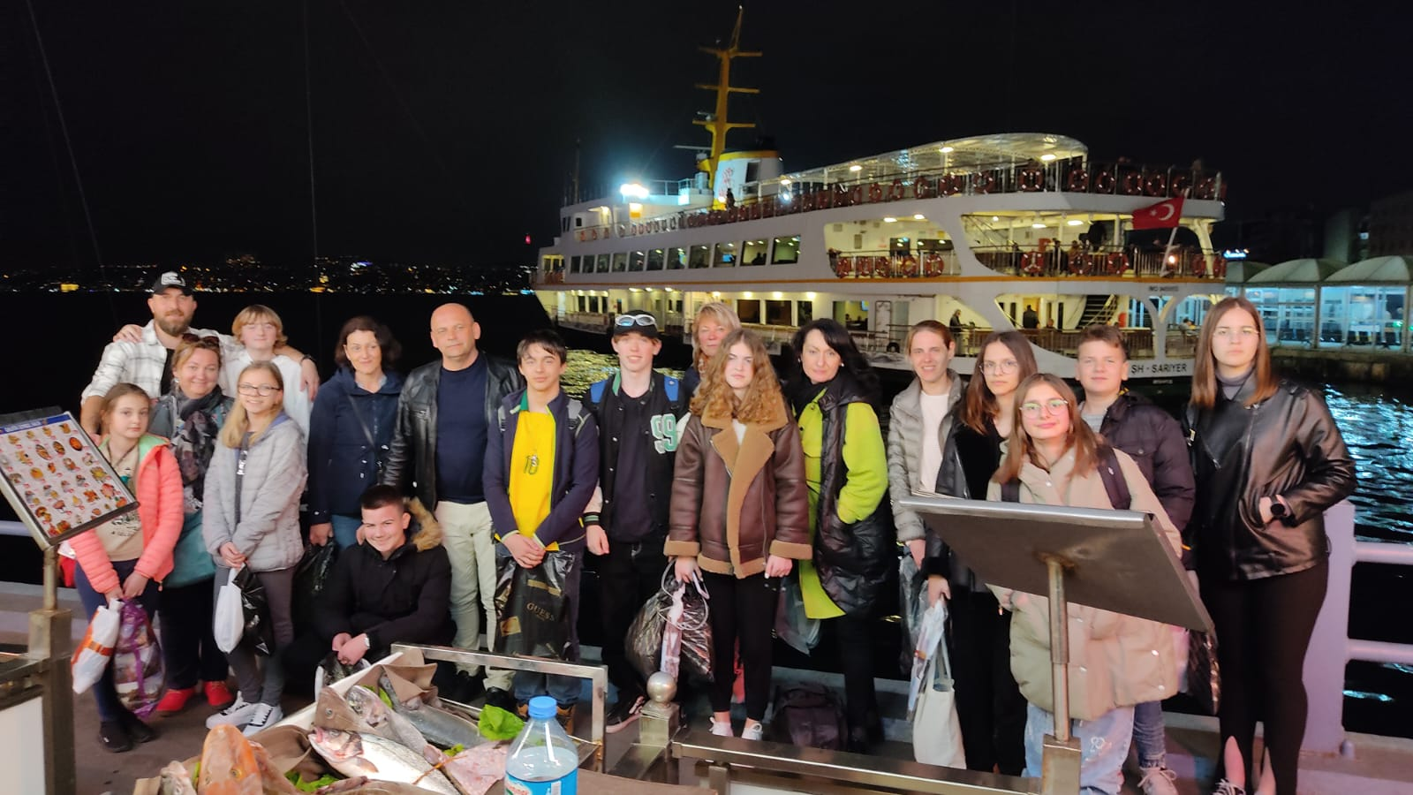
ERaSmus +
Our school takes part in Erasmus + project, too.
It is a very good project because it gives chance to students to meet and learn a lot about other cultures.

Slide 7


THAnk you for your attention

