Slide 1

Nature and photo, Erasmus+

Slide 2
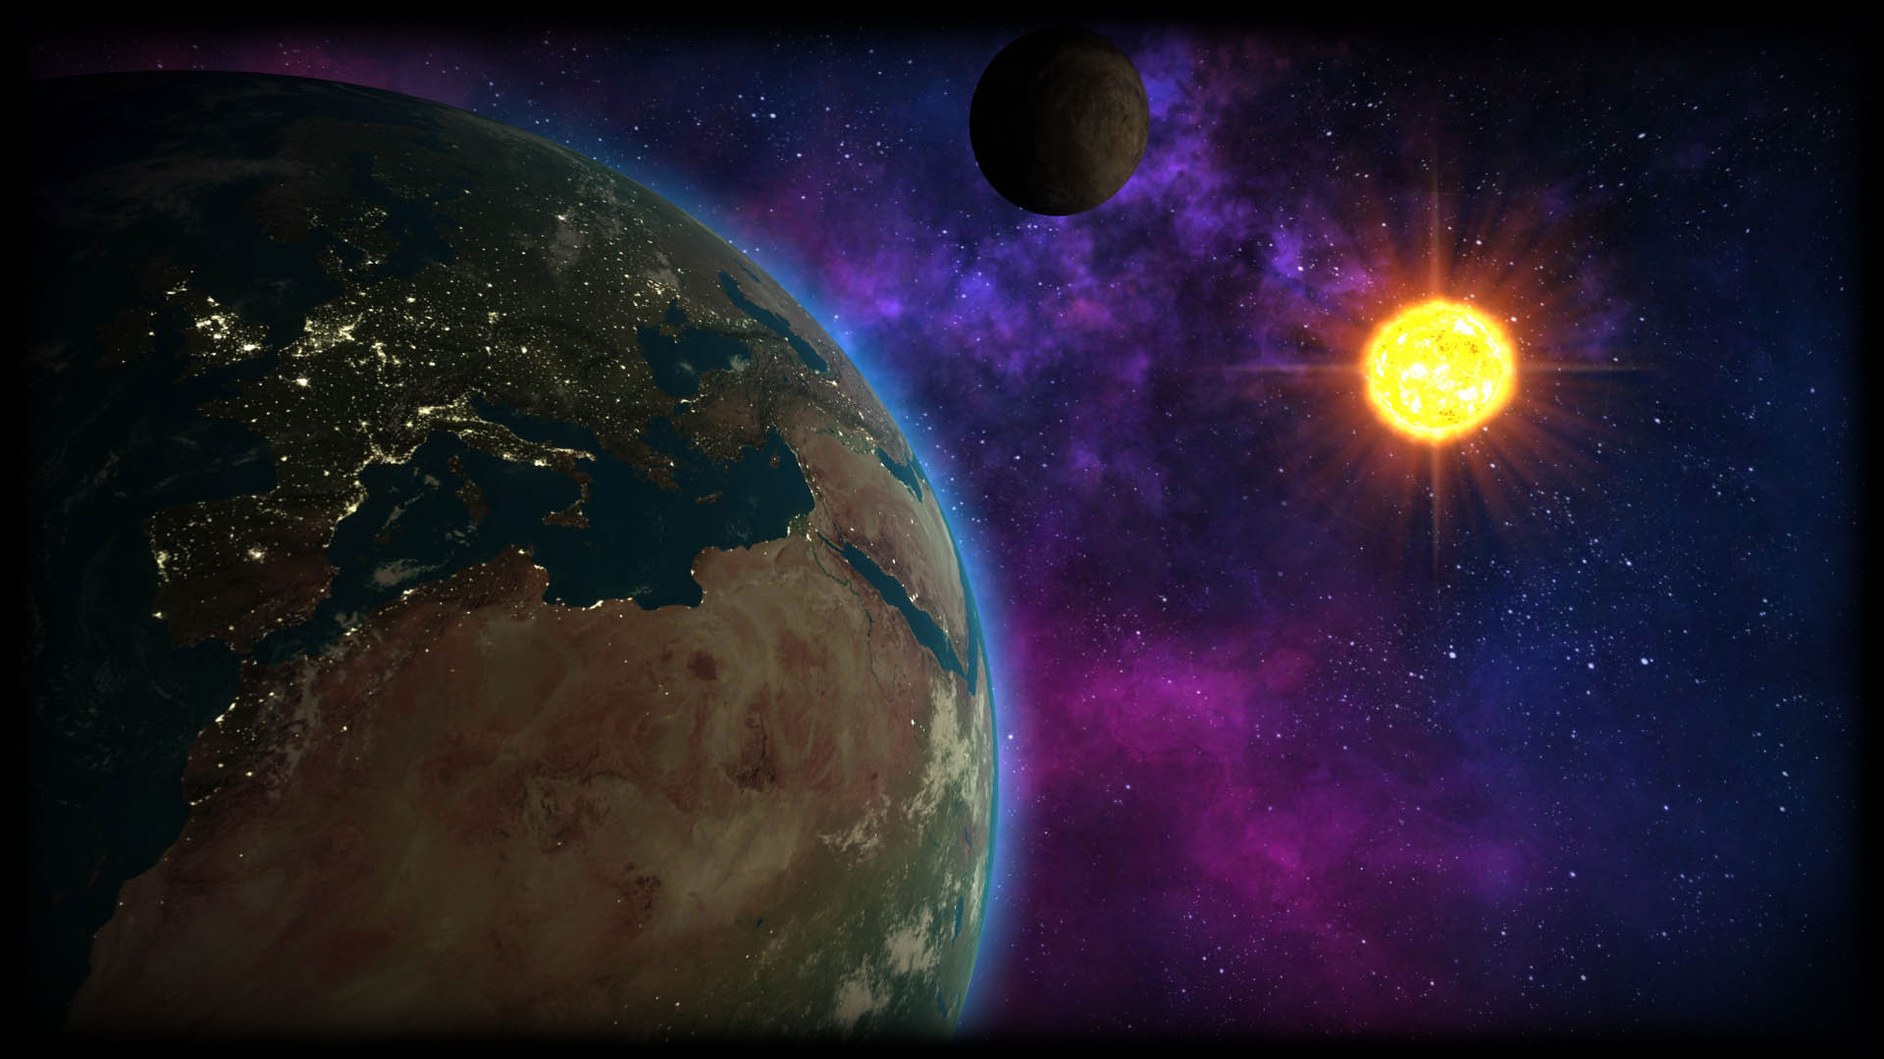

Slide 3
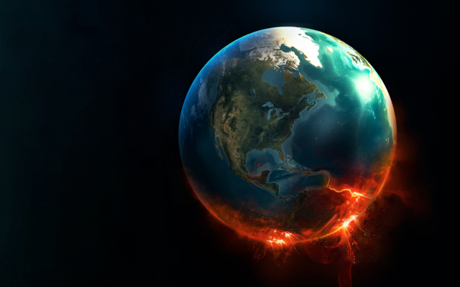
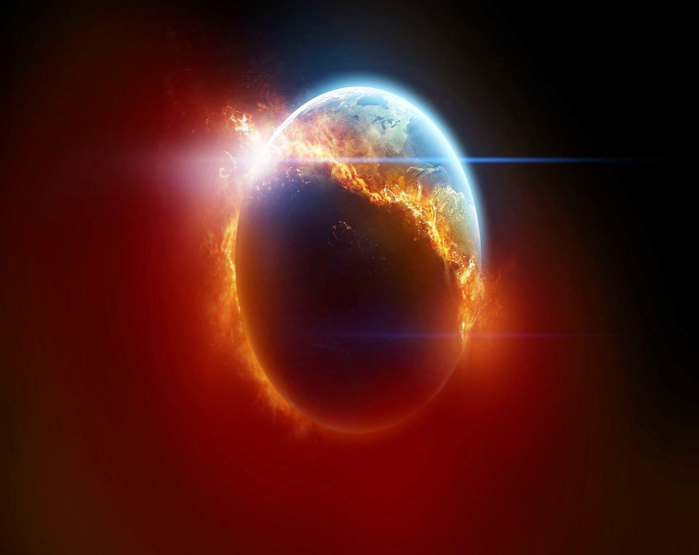

GLOBAL WARMING
.

Slide 4
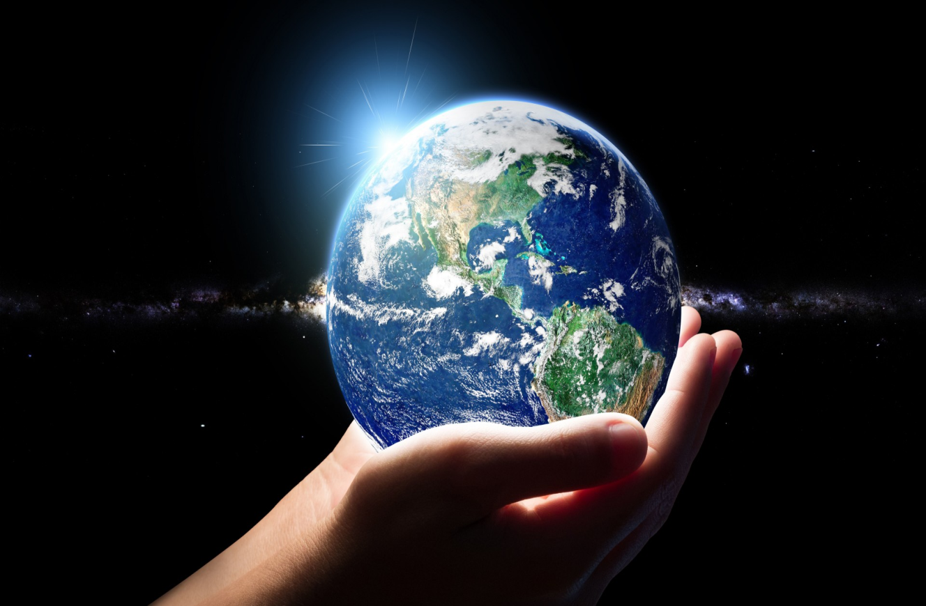
IT IS BIG..
IT IS ROUND..
IT IS BLUE AND GREEN...
WE CAN´T LIVE WITHOUT IT.

Slide 5
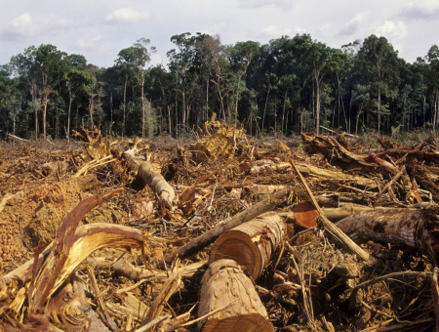
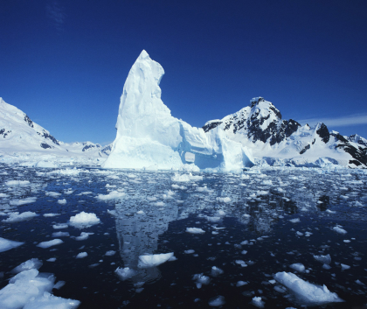
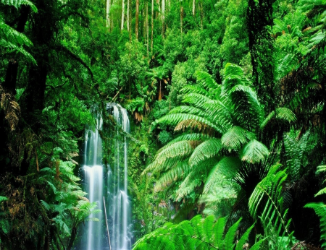
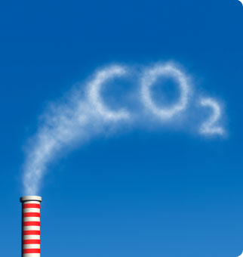
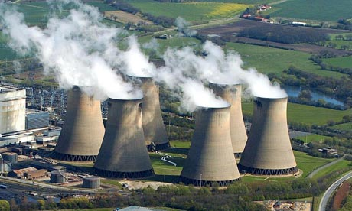
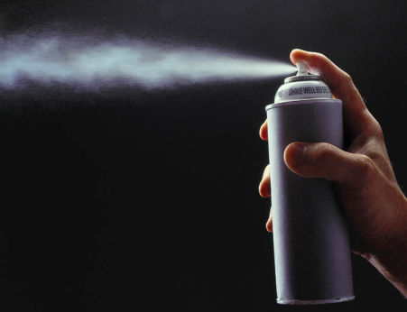
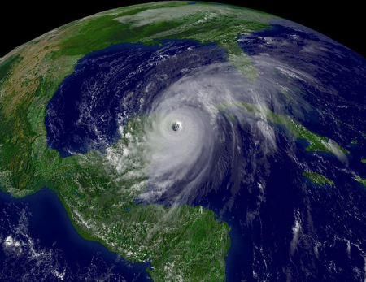
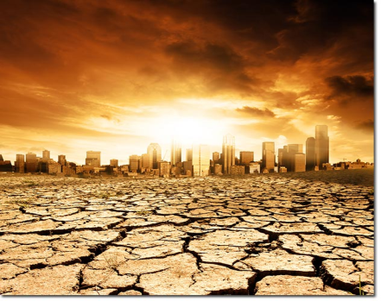
MATCH THE PICTURES WITH THE WORDS
DROUGHT
HURRICANE
POWER STATIONS
GREENHOUSE GASES
RAINFOREST
CARBON DIOXIDE
ICE CAP
DEFORESTATION

Slide 6

COMPLETE THE TEXT
Every year thousands of articles are written about global warming.
Fossil fuels are released into the atmosphere.
Scientists believe that sea levels
will rise and many islands will disappear.
under the sea. However the biggest cause is deforestation. Every year over 200,000 square kilometres of the world´s forest is destroyed. The message is very simple. If we want to save our planet, we must save our forest.

Slide 7
PUT THE VERBS INTO THE PRESENT PASSIVE VOICE
A lot of greenhouse gases ................../produce/ when fossil fuels ......................./burn/ by power stations, factories, cars and aeroplanes.Over 80 % of goods ...................../ transport/ by ships every year. Oil....................../carry/ by huge tankers.Sometimes these tankers sink and the beaches .........................../ pollute /. A lot of animals ......................../kill/ by the oil. A lot of power stations ...................../build/ on the coast, because the water ...................../use/ to cool the machines.

Slide 8
COMPLETE THE SENTENCES IN THE PAST SIMPLE PASSIVE
2
Most of trees ........................... to make paper. Extreme weather............................by deforestration. The rubbish .......................in the holes. Plastic bags.. ............................by million of people. Paper ............... by people. Pollution ..........................by cars. The beaches ..........................by a lot of rubbish and plastic bags.
1.Was produced
2.Were used
3.Was caused
4.Was recycled
5.Were covered
6.Were used
7.Was left
3
7
6
4
1
5

Slide 9
REWRITE THE SENTENCES IN THE PASSIVE VOICE
Deforestation has damaged the global environment.
.........................................................................................................
He sells the car................................................................................
The hunters found a lot of animals.
.........................................................................................................
They will protect animals at the ZOO.
........................................................................................................
Power stations and factories burn fossil fuels.
........................................................................................................

Slide 10
CHECK YOUR ANSWERS
The global environment has been damaged by a deforestation.
The car is sold by him.
A lot of animals were found by hunters.
Animals at the ZOO will be protected by them.
Fossil fuels are burnt by power stations and factories.

Slide 11
WHAT IS GOOD OR BAD FOR OUR NATURE AND ENVIRONMENT ?
Deforestation paper bags pollution plant trees recyclation bicycles fossil fuels protection save forest plastic bags power stations greenhouse gases
GOOD BAD

Slide 12
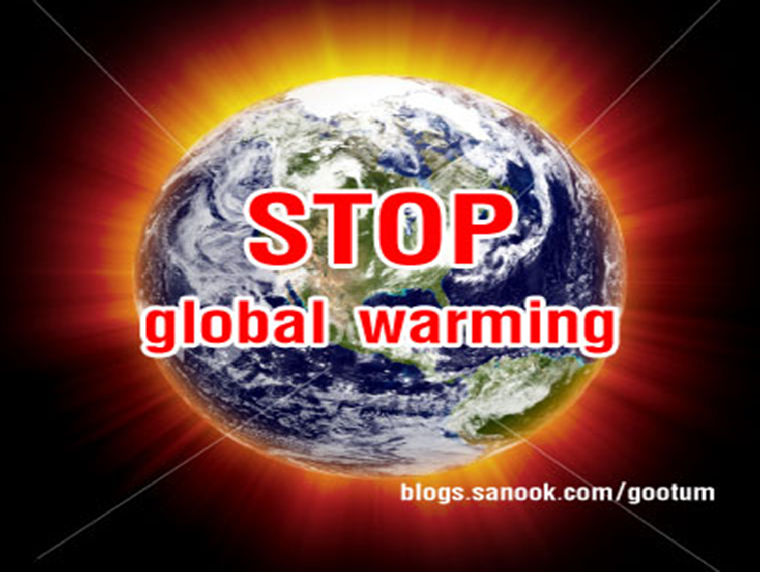

Slide 13

„ TO REALLY HELP THIS WORLD, YOU HAVE TO LEARN HOW TO LIVE IN IT „
JOSEPH CAMPBELL

Slide 14

This is our world. This is our Earth. This is the place where we belong.
This is our home. This is our time. This is the place where we come from.
We get the trash. Care it where it should go
you do your part preserve this Earth you know.
This is our world........................,
Try to reuse recycle what you can
and do your part and give a helping hand.
This is our world ........................
Just be aware of your environment
you do your part to love, preserve, protect.
This is our world ........................
This is the place where we come from
/
THIS IS OUR WORLD ...

Slide 15
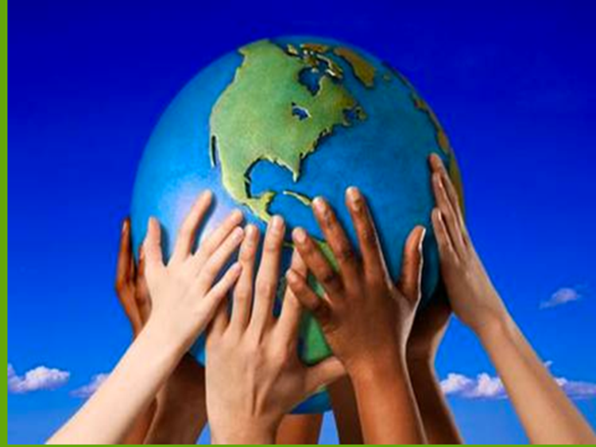
SO WHAT CAN YOU DO OR HOW CAN YOU PROTECT OUR WORLD?
WRITE.....

