Slide 1

Erasmus+"Nature and Photo"
OŠ Tin Ujević
-Krivodol Croatia

Slide 2

What is recycling?Why is it important to all of us?

Slide 3

Definition
To recycle: to treat or process used materials or waste so we can use these materials again This stops us from wasting useful materials
Recycling is important because…
It reduces the number of fresh raw materials we use It reduces the amount of energy we use It reduces air pollution It reduces water pollution It lowers the amount of greenhouse gases

Slide 4
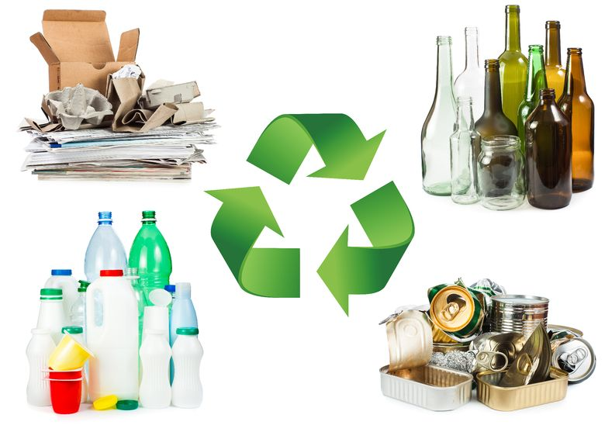
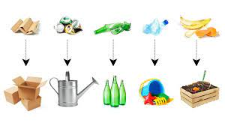
Examples of recycling
Reusing plastic bags when you go to the supermarket Recycling paper so it can be processed and used again Melting food cans made from steel and making them into new food cans Instead of throwing away uneaten food, you can compost it

Slide 5
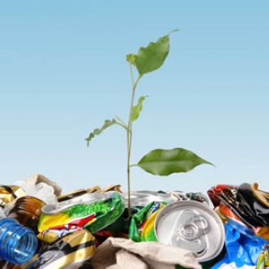
Reduce, reuse, recycle
You can help by learning about and practicing the THREE R’S of waste management

Slide 6





Reduce
Reduce/Reduction: to make something smaller or use less. The result is a smaller amount of waste.
HOW? Only buy what you need, and use everything that you buy Buy products that don’t have much plastic packaging and buy things like recycled paper Use reusable bags at supermarkets

Slide 7
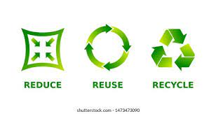
Reuse
You can reuse materials in their original form instead of throwing them away. You can also give materials to others who could use them after you.
HOW? Use washable cups or travel mugs When you use things like plastic cups, plates, etc., don’t throw them away. Wash and reuse them!

Slide 8
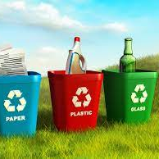
Recycle
Remember the things you use
every day that you can recycle!
Aluminum cans Cardboard Electronics Glass Metal Newspaper Paper Plastic bottles Steel cans

Slide 9

What are energy resources?

Slide 10

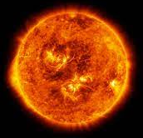
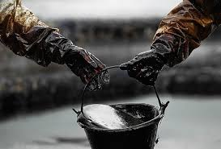
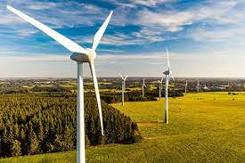

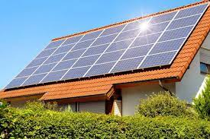
Some of the types that exist
Renewable: Non-renewable:
wind energy Coal
Solar energy Oil
biomass Natural gas
thermal energy
hydropower

Slide 11
Benefits from renewable energy resources
Renewable energy is energy created from natural sources, which means that they cannot be used up and can be renewed again
Renewable energy is increasingly considered one of the key factors in the future development of the Earth

Slide 12


Some disadvantages of renewable energy resources
Solar power is not always reliable because efficiency depends on how much sunlight the area receives
Tidal energy has very expensive installation costs
The construction of barrages can harm marine habitats
Wave energy stations can have a negative impact on marine life
Dams are very expensive to build. For reservoirs, it is necessary to flood large areas of land. Dams can stop fish migration

Slide 13

Benefits of non-renewable energy resources
Fossil fuels are cheap to mine and convert into electricity
Coal and oil give us fuel
Gas is used in the household, it is used for heating, in industry, etc.

Slide 14
Disadvantages of non-renewable energy resources
Non-renewable energy sources are energy sources that cannot be regenerated or produced again
Fossil fuels are a major contributor to global warming, as burning fossil fuels releases carbon dioxide into the atmosphere.
Coal also contains impurities such as sulfur
Waste from nuclear power plants remains radioactive and harmful to living things

Slide 15
Thank you for your attention!!

