Slide 1


Nature and photo, Erasmus+

Slide 2
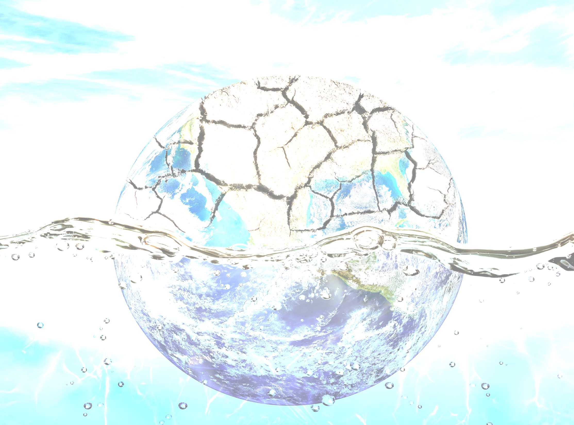
Environmental problems

Slide 3

The proces of the Earth getting hotter is caused by .................. gases.
FUMES
GREENGROERS
TOXIC
GREENHOUSE

Slide 4
The protective part of our atmosphere is called:
Ozone lawyer
Gases layer
Ozone layer
Atmospheric layer

Slide 5
Drought is:
When there is no rain for a long time
When there is no sun for a long time
When there is no rain and sun for a long time
When there is snow for a long time

Slide 6
Cutting down the forest is called:
deforestation
reforestation
preforestation
disforestation

Slide 7
The factories that produce eletricity are called:
Electric stations
Power stations
Atomic stations
Water stations

Slide 8
Climate change will cause the rise of...............:
See water
Sea streams
Sea levels
The rivers

Slide 9
Oil, gas and coal are:
Pollution
Revevable energies
garbage
Fossil fuels

Slide 10
The use of fossil fuels leads to:
overpopulation
Climate change
deforestation
drought

Slide 11
One possible consequence of climate change for humans is:
overpopulation
famine
anorexia
drought

Slide 12
Solar or wind powers are form of:
Renewable energy
Expensive energy
Eletric energy
Gas energy

Slide 13
It took a while for the fire fighters to put out the :
tornado
flood
Forest fire
drought

Slide 14
...............is created when fog and smoke is in the air:
smog
fog
rain
pollution

Slide 15
The melting of ice caps is caused by:
heat
flood
drought
Climate change

Slide 16
When the Earth is getting hotter is known as:
Sun´s heat
Greenhouse effect
Global warming
Melting ice caps

Slide 17
The land fill is area where...............is dumped:
glass
plastic
garbage
paper

