Slide 2

Erasmus +
Erasmus+ is the EU's programme to support education, training, youth and sport in Europe.
t supports priorities and activities set out in the European Education Area, Digital Education Action Plan and the European Skills Agenda.

Slide 3


Nature and Photo
General goal of this project was to raise awareness among the students about environmental problems and enrich their knowledge through innovative methods of learning and teaching.
Our students took part in two mobilities in Slovakia and Turkye and played the host roles to students from partner schools.

Slide 4
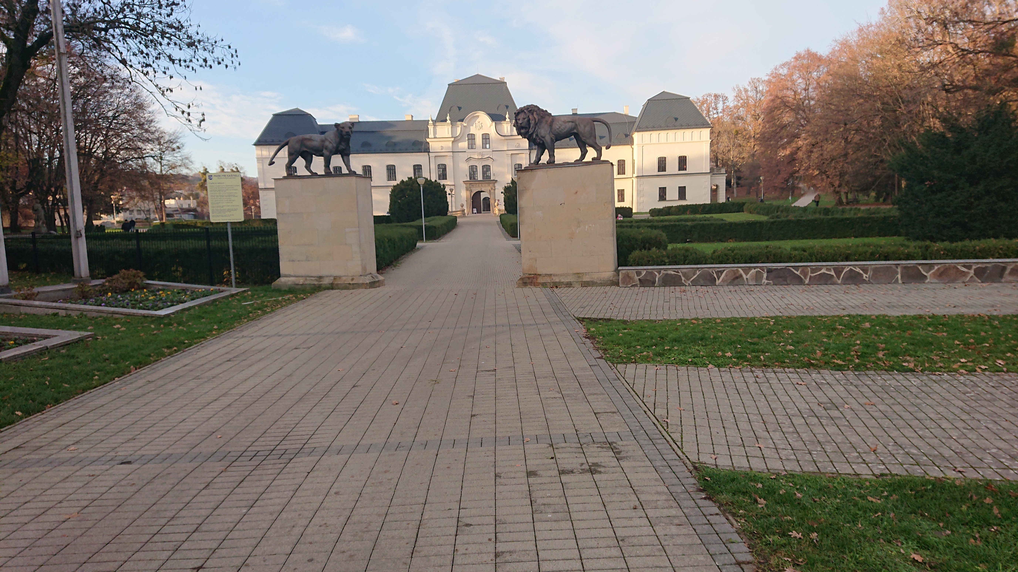
Humenne, Slovakia (20. – 26.11.2022)
Humenne is a small town in Slovakia where our host school is situated.
They greeted us with school folklore group act.
We spent our first day in school sightseeing and meeting our new friends.

Slide 5
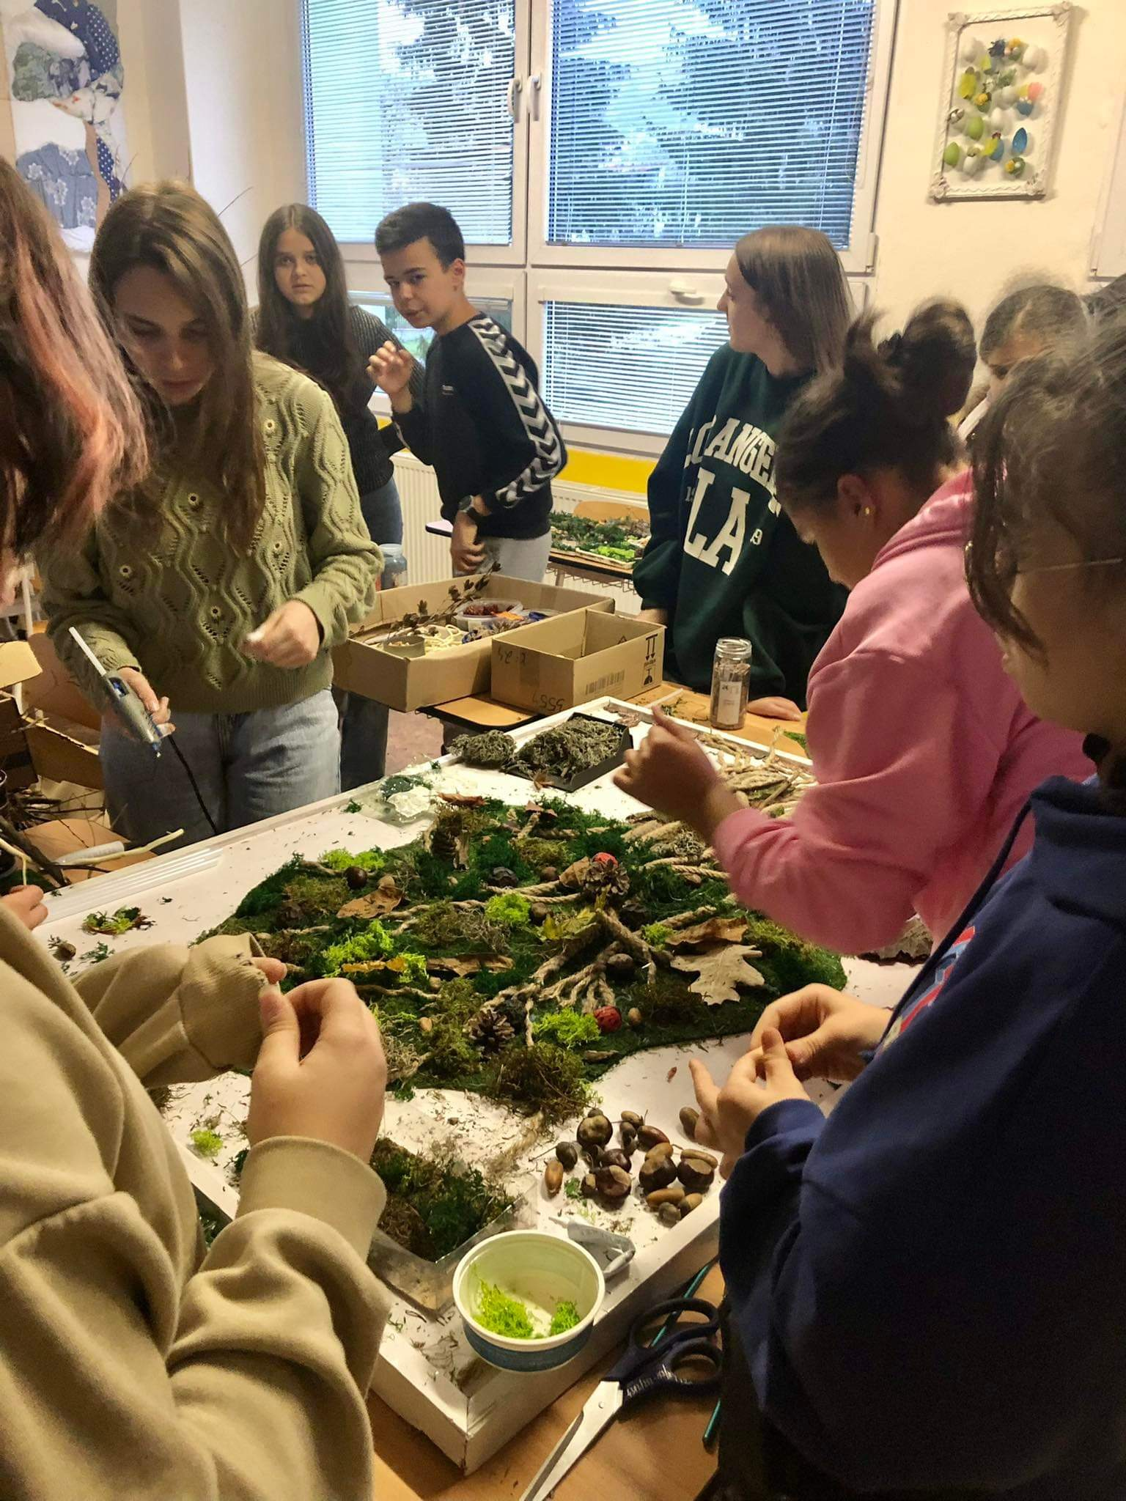
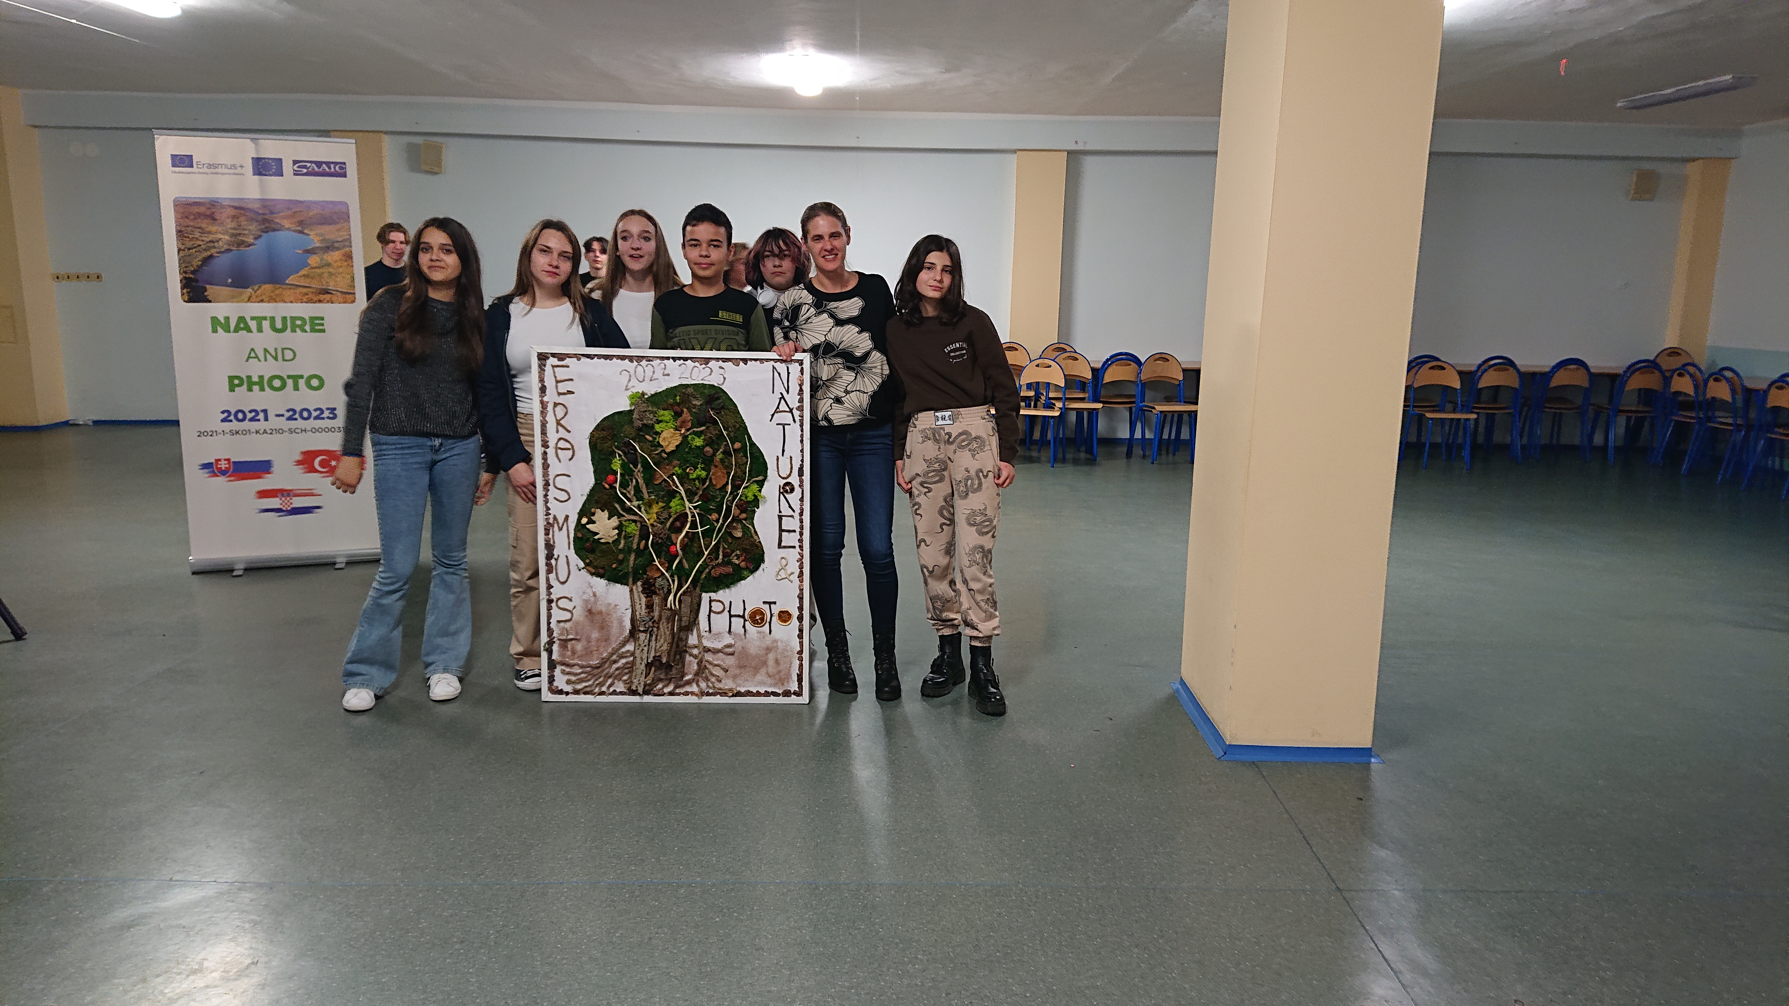
Our joint project was making moss paintings..
We also learnt to edit photos with professional tools
We took part in sports activities.
We visited recycling yard.

Slide 6
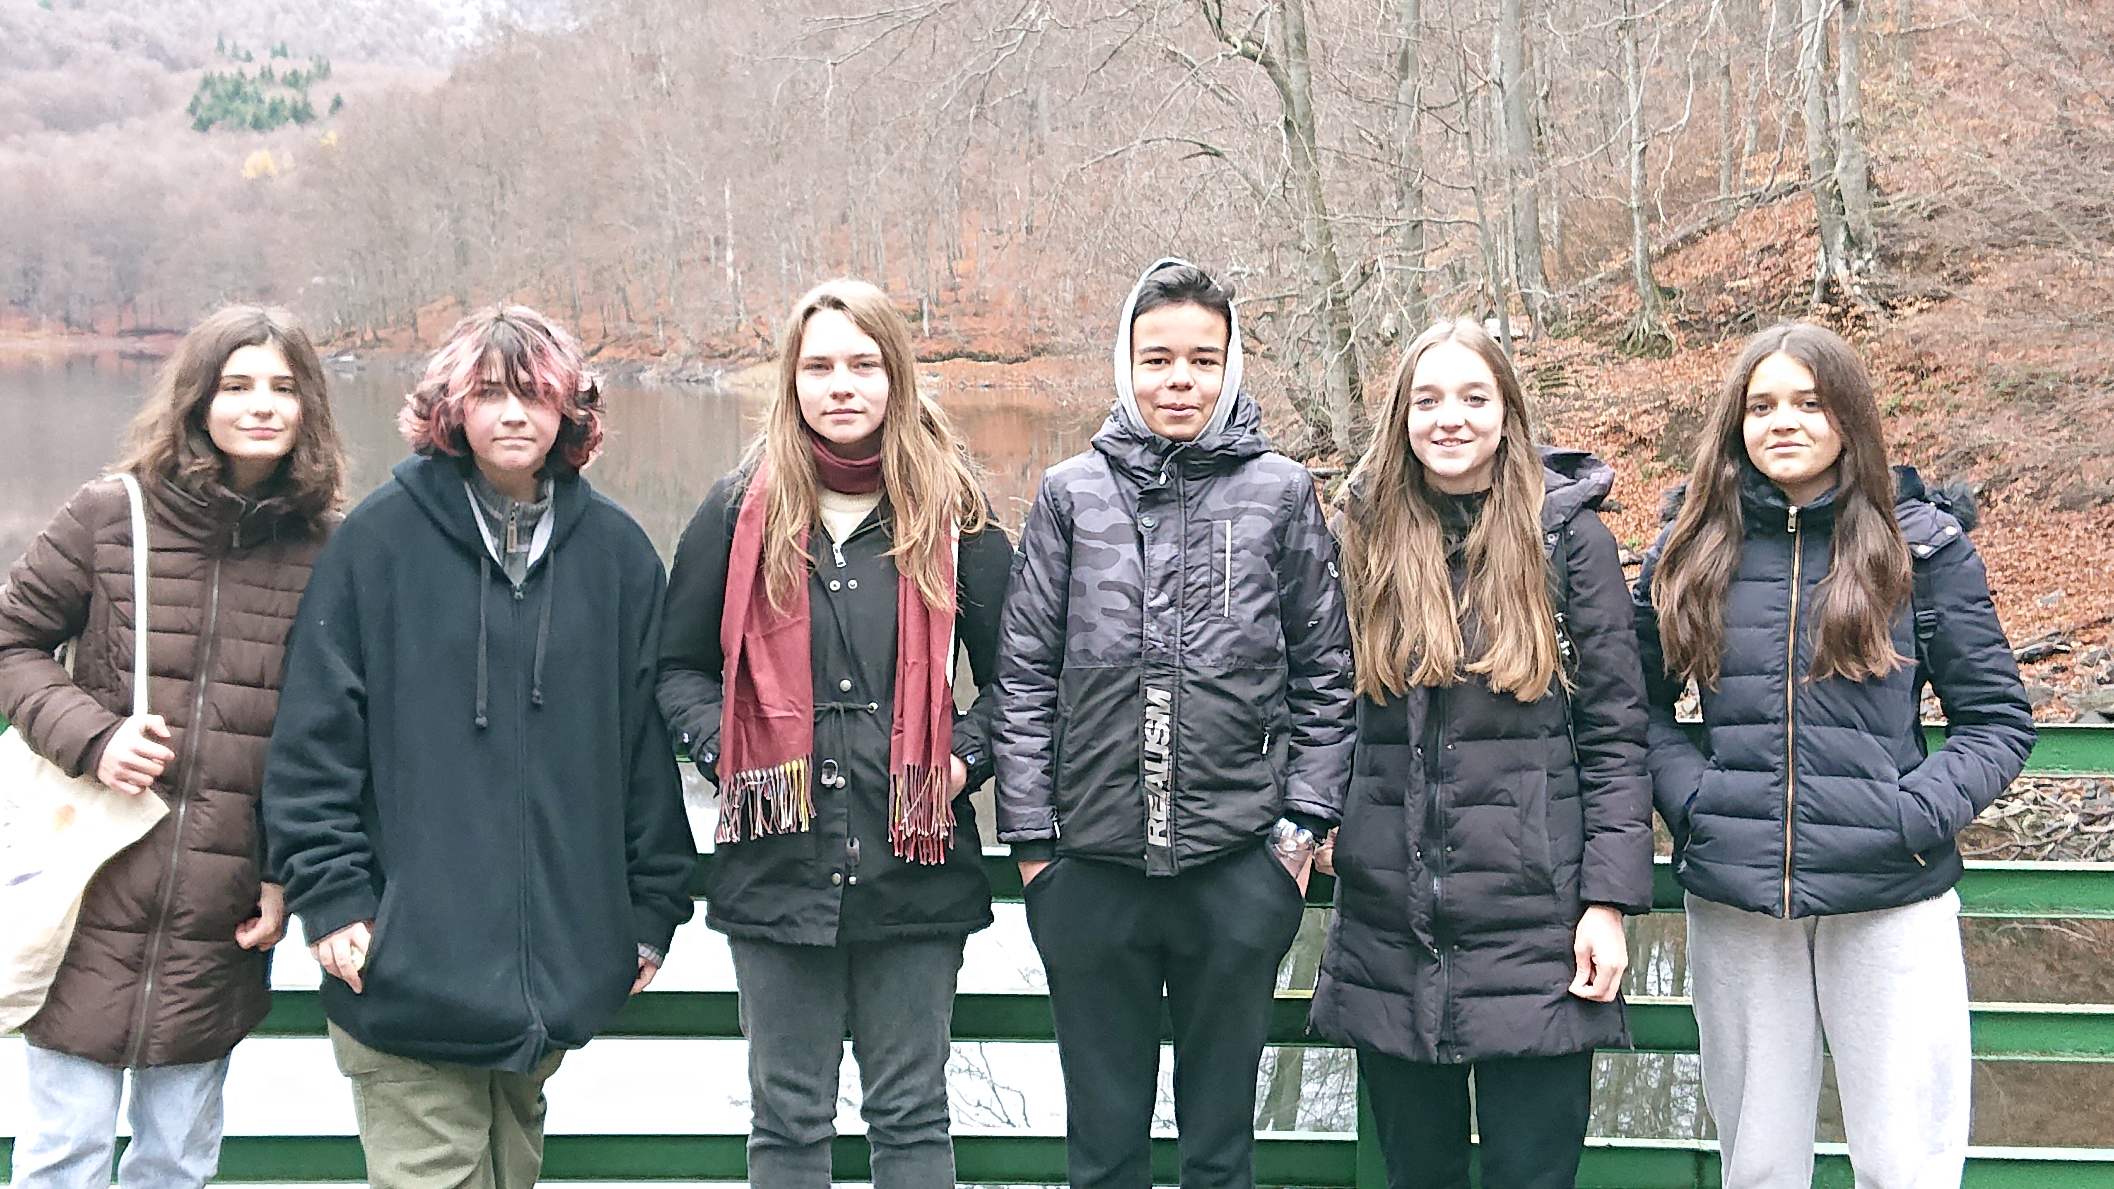
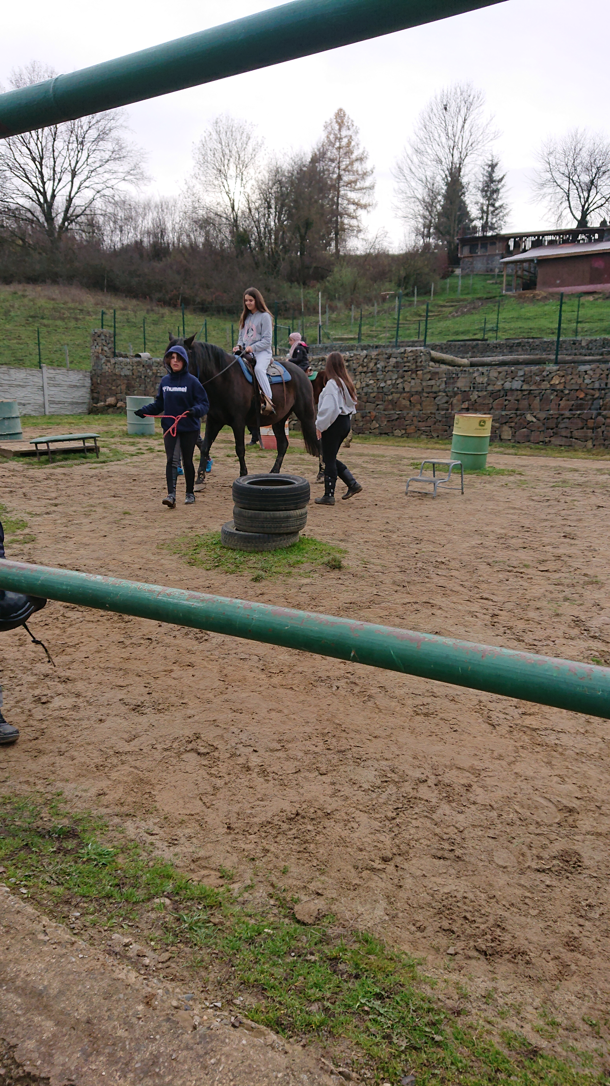
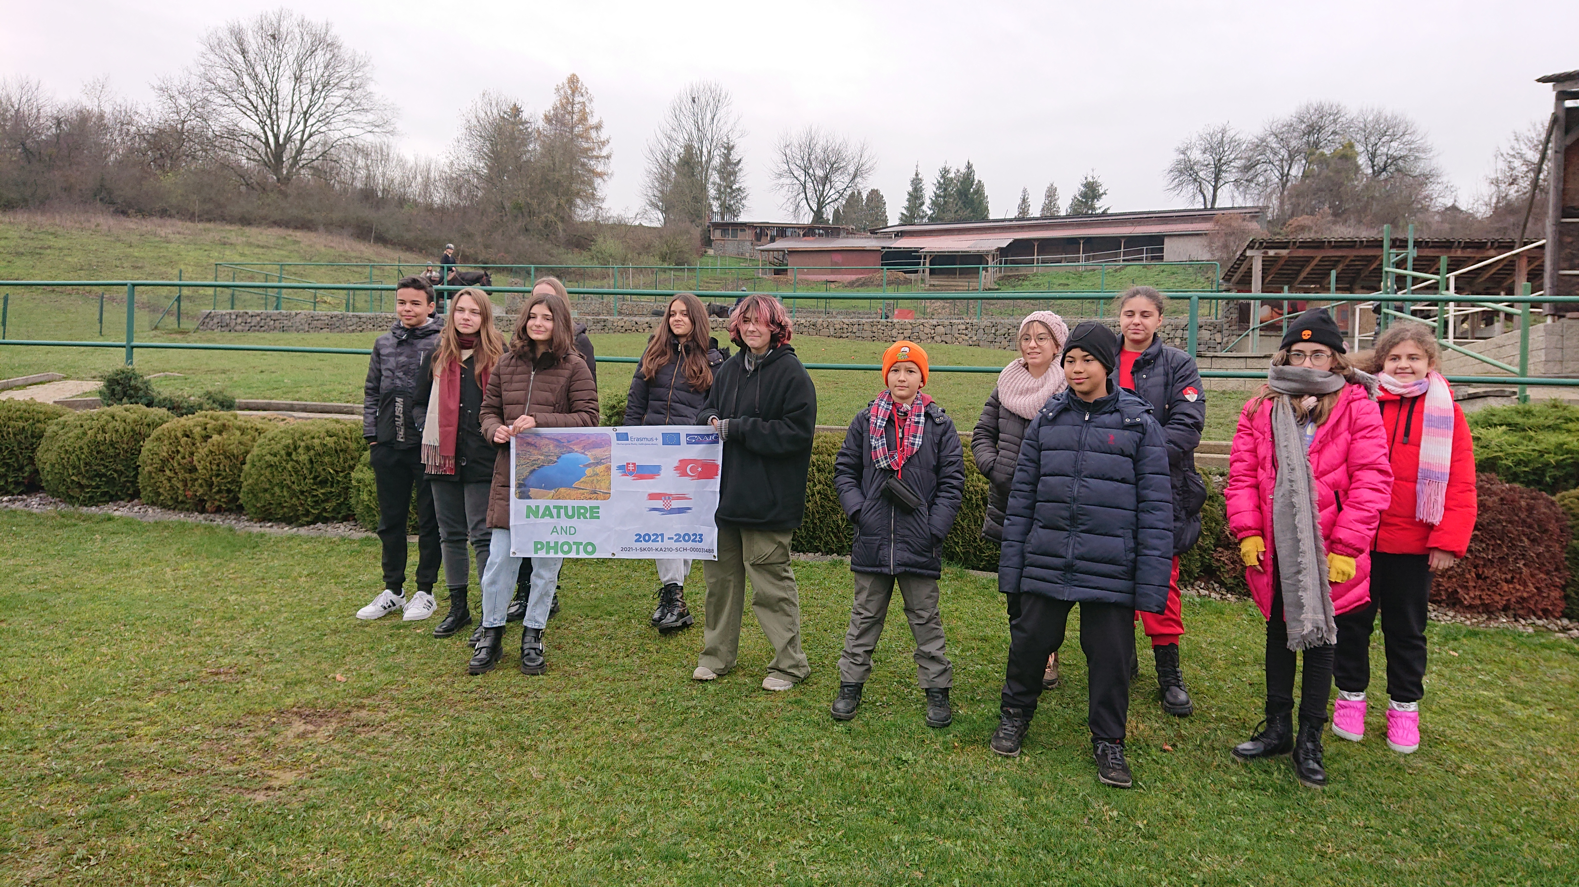
What did we see?
Lake Morske oko
Castle and church in Humenne
Ranch Vihorlat where we tried horseback riding and archery.

Slide 7
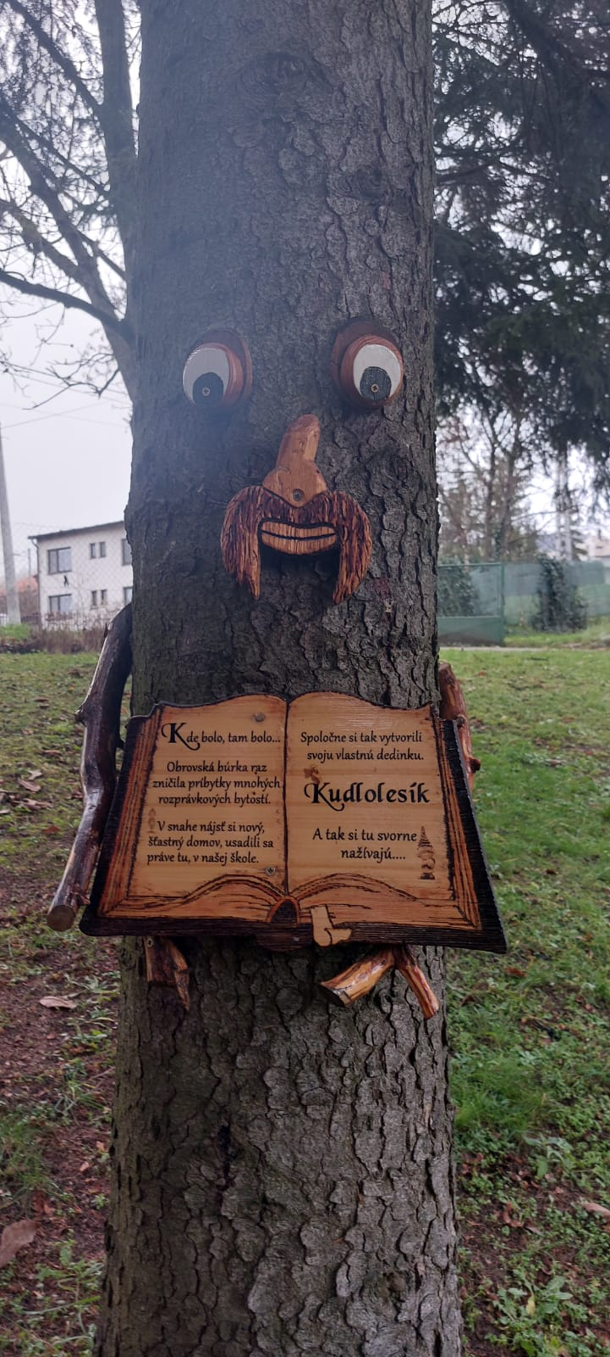
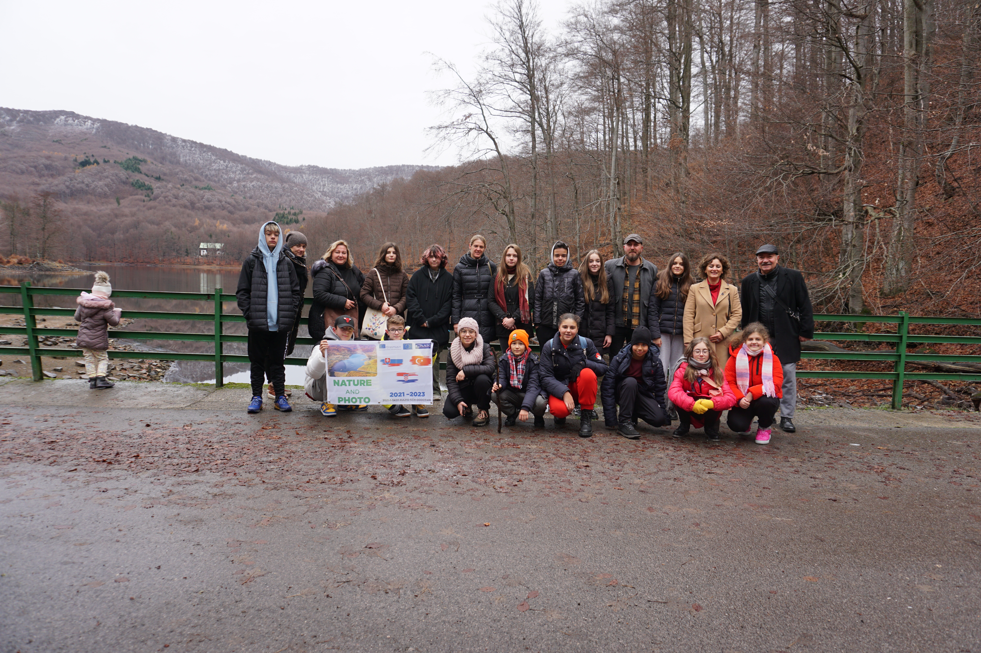
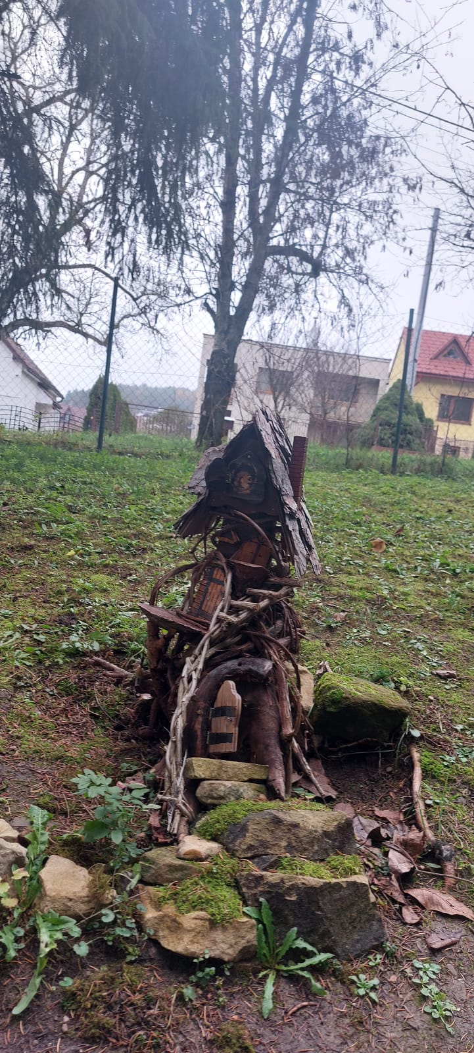

Slide 8
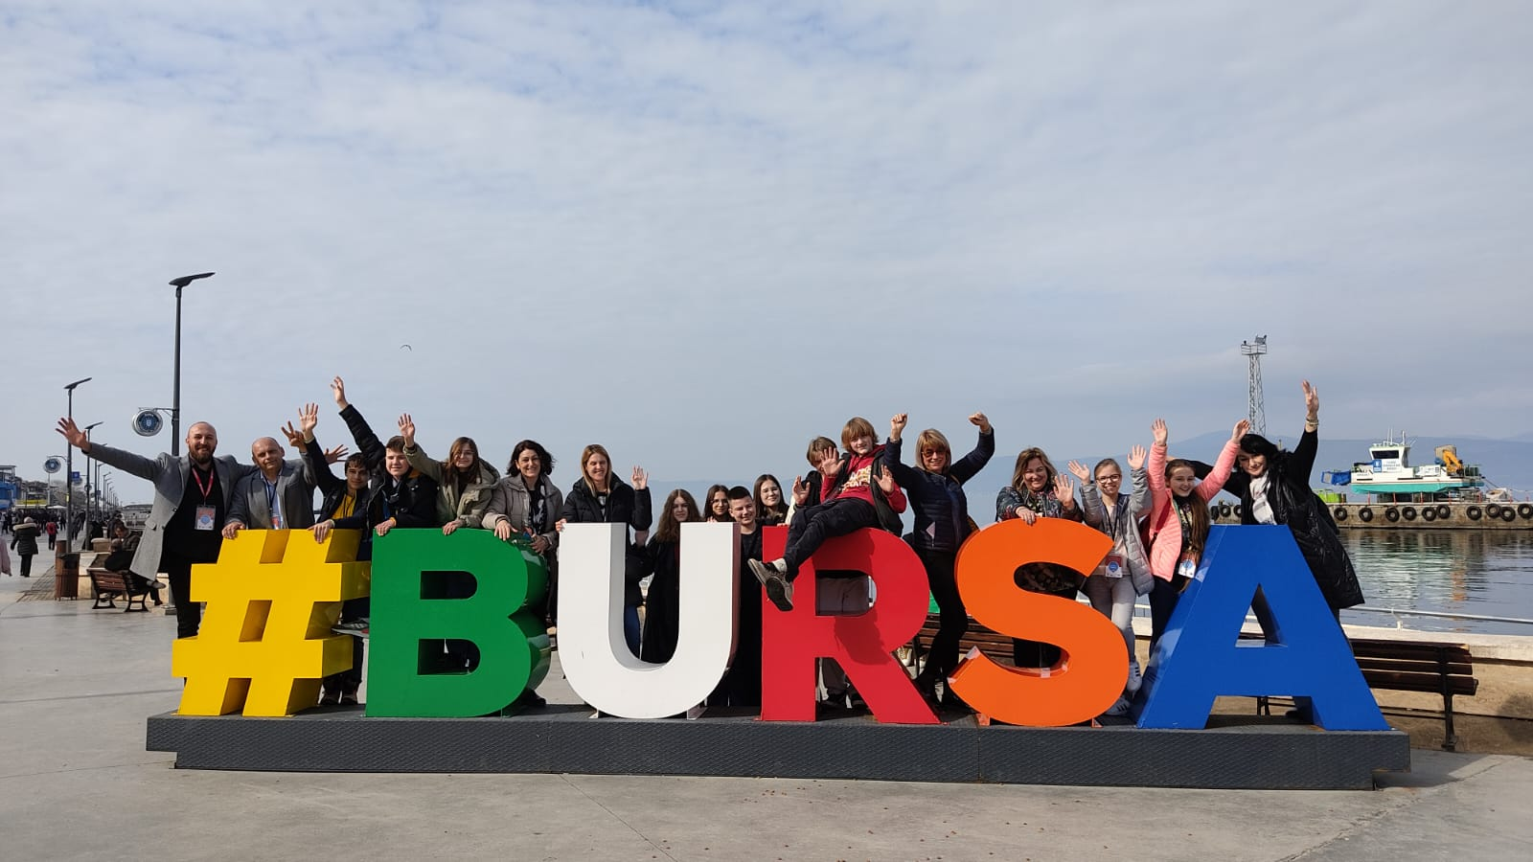
Bursa, Turkye (5. – 11.3.2023)
Bursa is considered the cradle of Turkish culture.
It has approximately 4 million inhabitants.

Slide 9
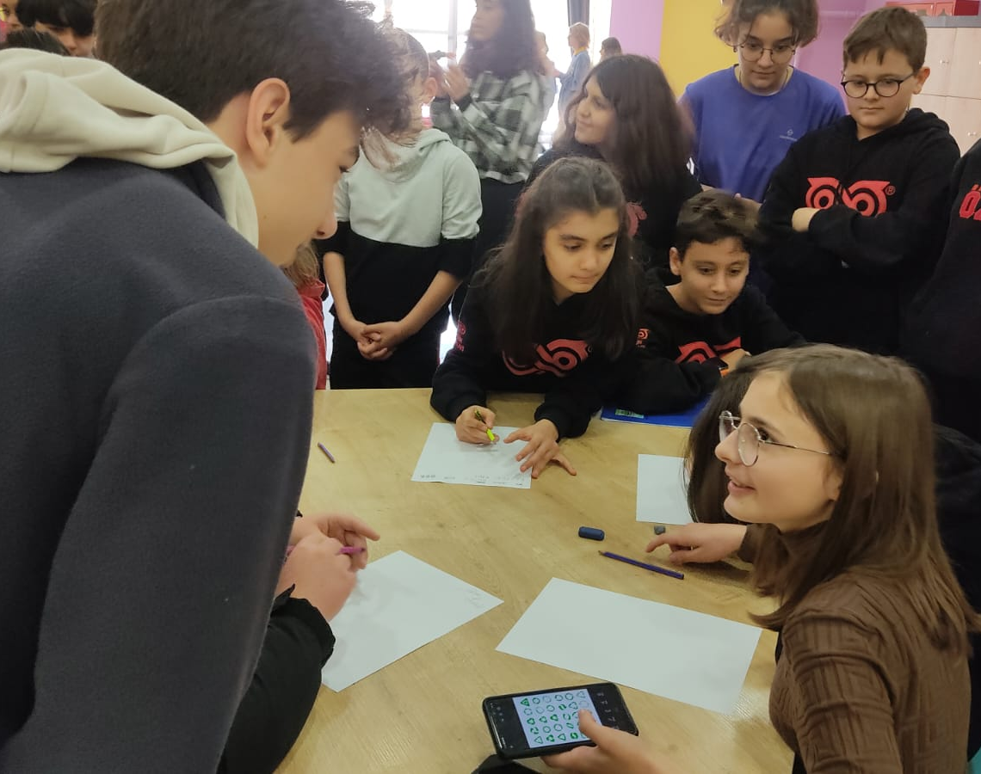
Activities at school
We made Turkey mobility logo.
Video about activities was made.

Slide 10
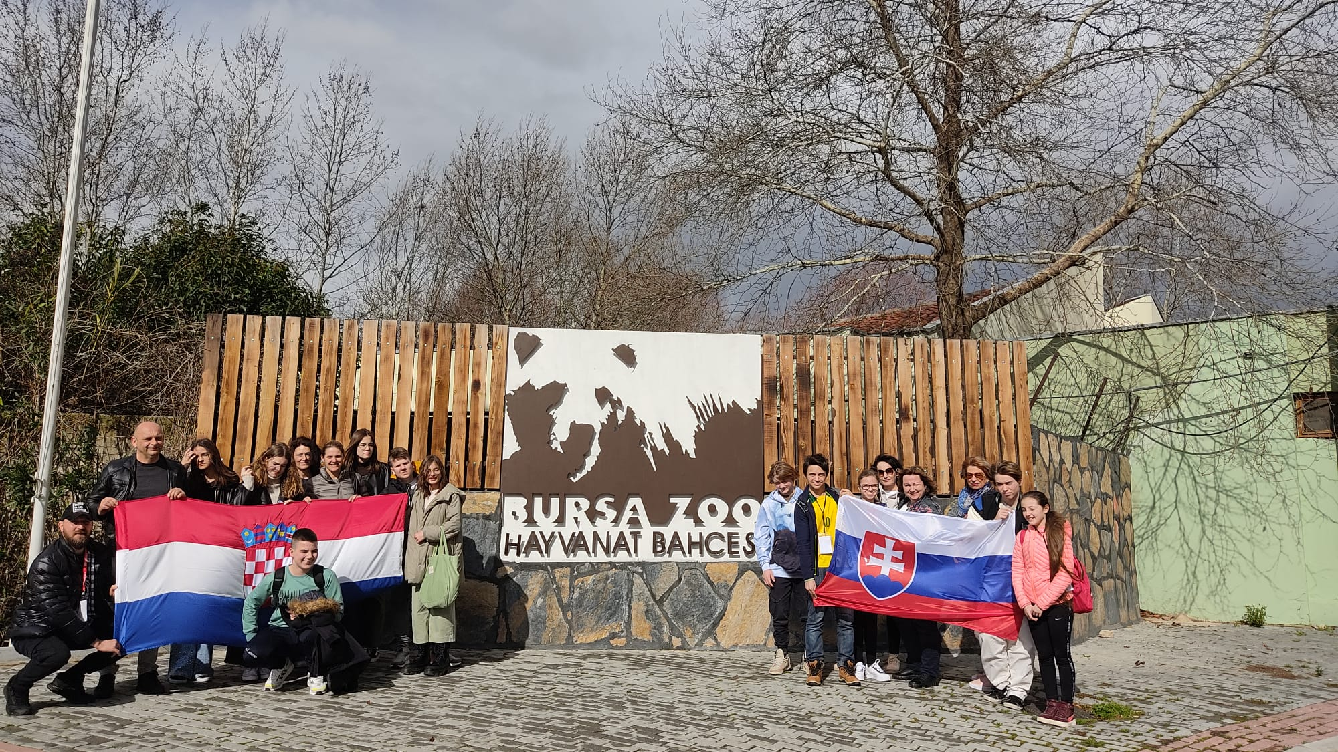
What did we see?
A visit to zoo
A visit to botanical park
Skiing on Uludag mountain
Trip to istanbul

Slide 11
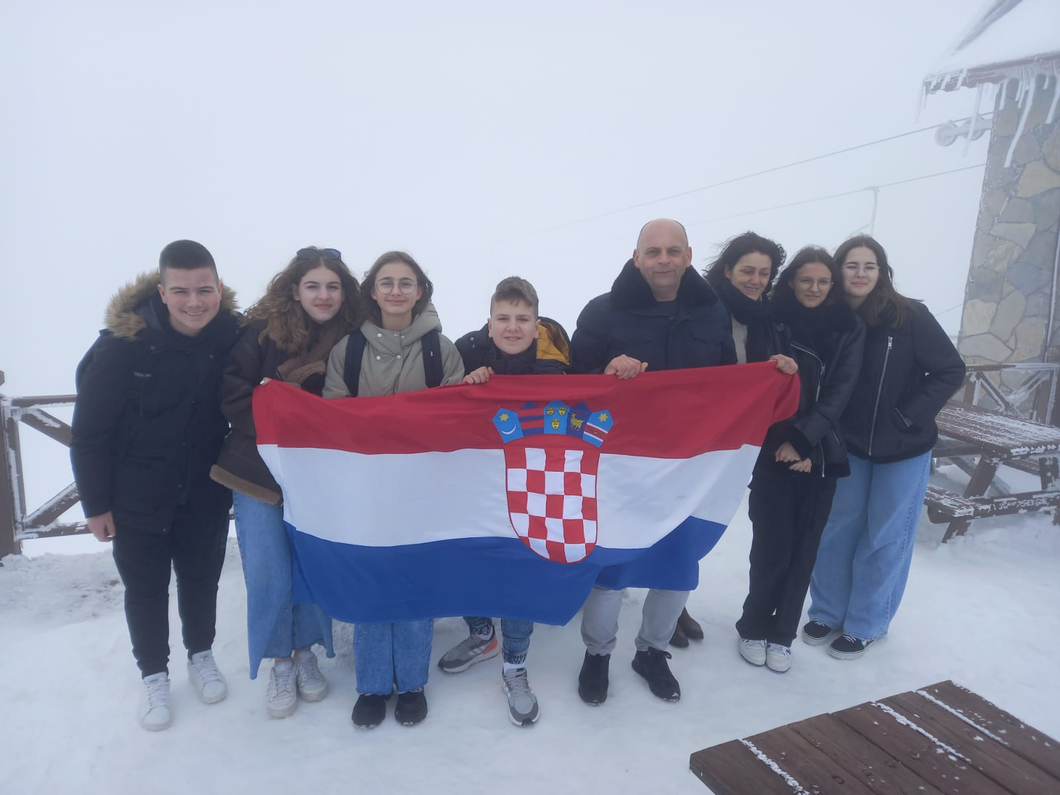
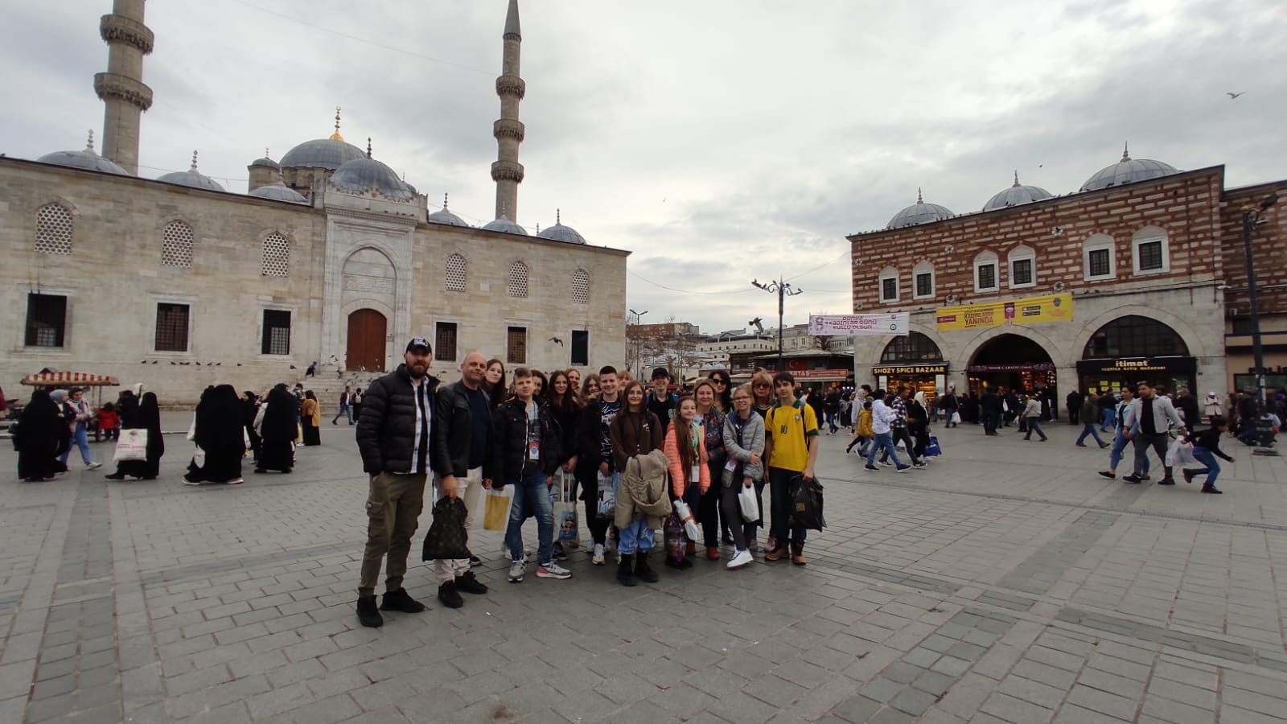

Slide 12
Krivodol, Croatia (21. – 27.5.2023.)
As mobility hosts we offered our guests a lot of activities.
We visited recycling yard in Poljica.
We made a puzzle bord game.
We listened to a lecture on the Institute for Mediterranean Cultures in Split.
Trips to Imotski, Split, Makarska and Plitvice lakes.

Slide 13
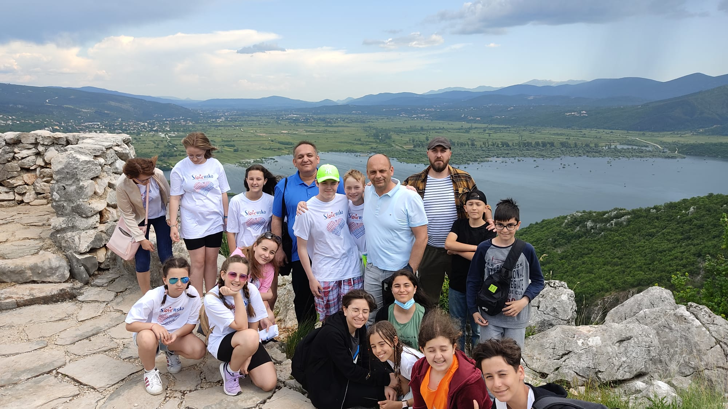
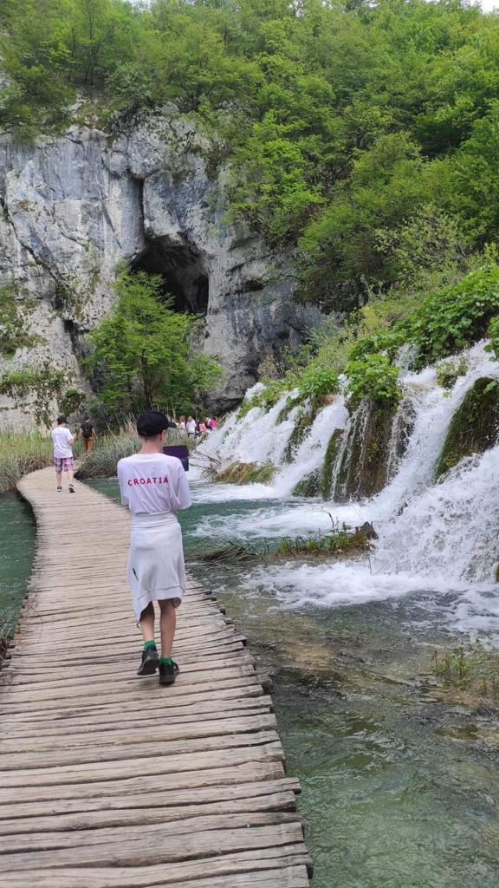

Slide 14
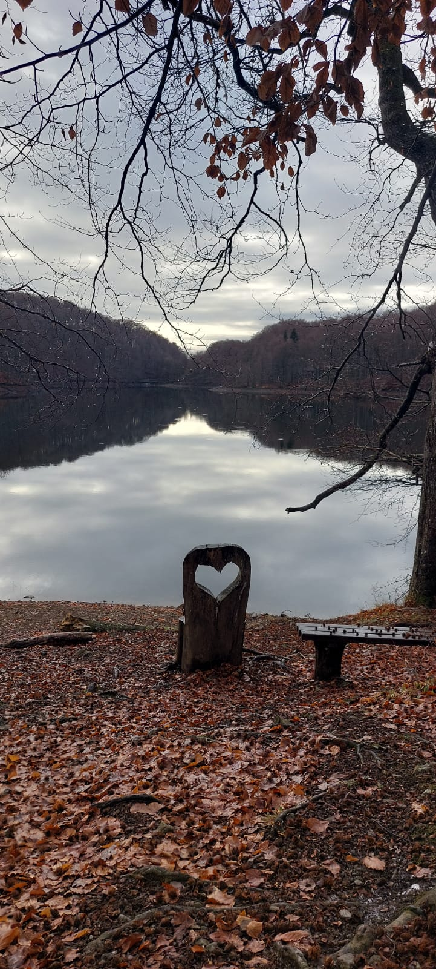
Thank you for your attention!

